Slide 1
PACABA Quiz
Assess your understanding

Slide 2
Three rounds quiz
Each participant in a team. Points only given to the team.
Open questions
Question can be answered by any participant
Nominated questions
Question can only be answered by nominated participant
Discussion questions
Question given to the team to answer after discussions

Slide 3
Round 1 – Open questions

Slide 4
Question 1
Who is the boss of all PACAs/Station Masters and of SPR in the constituency?

Slide 5
Question 2
What is required from the PACA for registration?

Slide 6
Question 3
What are the two forms for PACA registration and who sign them?

Slide 7
Question 4
What is the maximum number of voters in the saluran?

Slide 8
Question 5
When is the final station master briefing and why?

Slide 9
Question 6
What time and with what can PA1 enter the saluran?

Slide 10
Question 7
What needs to be done if the PACA text to say that the KTM does not allow to use the phone?

Slide 11
Question 8
Is this directive correct?
After inspecting Ballot Papers, text to the Station Master: serial number of Ballot Papers and Saluran Stamp

Slide 12
Question 9
What needs to be done if KTM1 accompany senior citizen behind the barung screen?

Slide 13
Question 10
What form is required if KTM reject issuance of Ballot Paper and the four conditions?

Slide 14
Question 11
What are the PACA procedures regarding Borang 13?

Slide 15
Question 12
What are the PACA procedures if polling hours are reduced?

Slide 16
Question 13
What are the PACA procedures if the Ballot Box moves?

Slide 17
Question 14
What makes a ballot invalid?

Slide 18
Question 15
How you do refer to your saluran when reporting?

Slide 19
Round 2 – Nominated questions

Slide 20
Question 1
What is prohibited when you sign the Borang A Oath of Screcy?

Slide 21
Question 2
What needs to be done if there is no phone coverage in the Polling Station?

Slide 22
Question 3
What is in the PACA kit and in your kit?

Slide 23
Question 4
What needs to be checked when you pick up your PACABA pack?

Slide 24
Question 5
What is the benefit of the pondok panas?

Slide 25
Question 6
What needs to be checked regarding Ballot Papers before Polling starts?

Slide 26
Question 7
What needs to be noted in the task of Kerani 1?

Slide 27
Question 8
What needs to be noted in the task of Kerani 3?

Slide 28
Question 9
What needs to be noted when the Voter is behind the barung screen?

Slide 29
Question 10
Why is Borang 13 important?

Slide 30
Question 11
What are the (4) basic principles in preparing the Duty Roster?

Slide 31
Question 12
What needs to be noted in vote counting?

Slide 32
Question 13
When do you ask for a Recount?

Slide 33
Question 14
Why is the Borang 14 important?

Slide 34
Question 15
What are in the things that SPR brings to the Tallying Centre?

Slide 35
Round 3 – Discussion questions

Slide 36
Question 1
What’s the agenda when meeting with your PACA team?

Slide 37
Question 2
What needs to be agreed with all KTMs before Polling starts?

Slide 38
Question 3
What does a Station Master need to do after Polling closes?

Slide 39
Question 4
What needs to be checked when opening Postal Votes?

Slide 40
Question 5
What are the steps to defend the Borang 14?

Slide 41
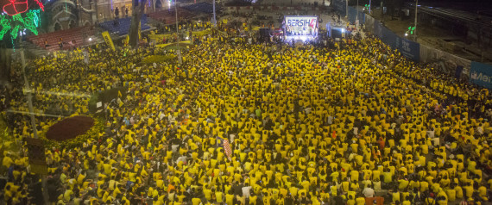
Happy Polling Day

