Slide 1
Training PACA Trainers
Organising Training for PACAs and pointers for the Trainers

Slide 2
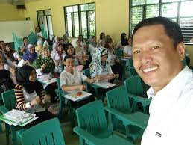

What we will cover today
Putting together a train the Trainers module
Selecting your Trainers
Organising your Trainers
For Trainers
  Before, during and after the Training
Ensuring a great Training programme

Slide 3
Train the Trainers module

Slide 4
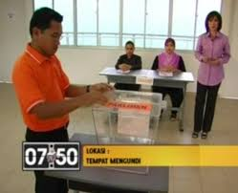
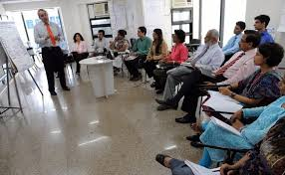
Why do we have a Training programme?
Structured and consistent way of instructing all PACAs of the PACA processes
Starting point for voter education
Establish contact and engagement for volunteers
Identify and develop PACA processes specific for the constituency or area
Provide platform for political education

Slide 5
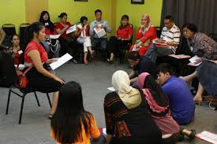
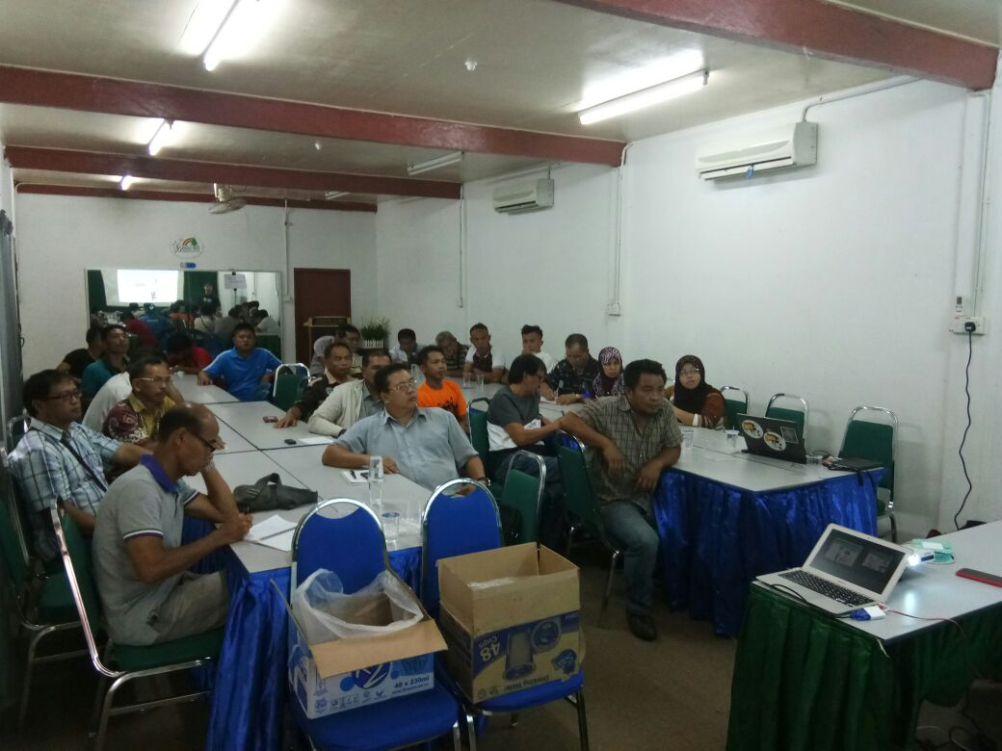
Benefits of a Training programme?
Increase confidence levels of PACAs and station masters
Enable some assessment of PACAs
Strengthen the communication channels to all PACAs

Slide 6
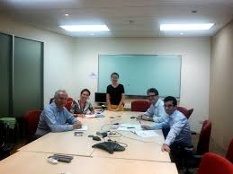
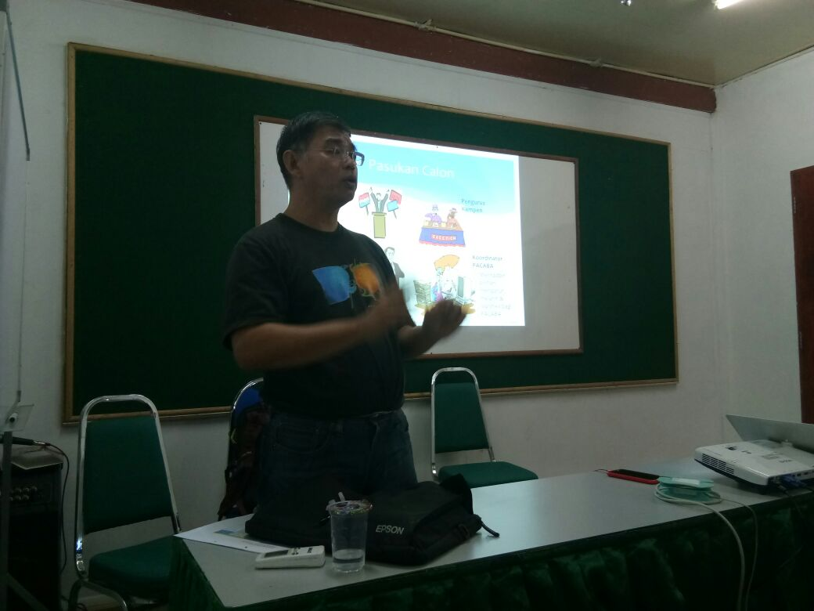
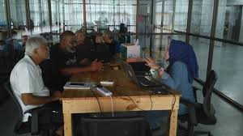
Why do we train Trainers?
It has always been assumed only detailed knowledge of PACA processes is required
Increase confidence in the Training programme
Increase confidence of the PACA leaders
  Endorsement by party leaders

Slide 7
Selecting Trainers

Slide 8
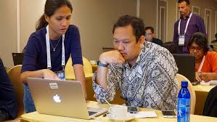
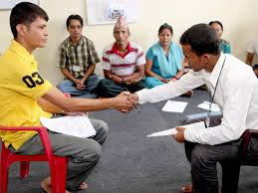
Qualities of good Trainers
Clear knowledge of PACA process
  Experience with various scenarios that arises
  Clear on objectives of PACA processes
Able to explain complex issues in simple terms
  Comfortable with speaking in public
Respected among PACAs & potential PACAs
Able to travel and available at training times
Willing to be in PACA Whatsapp group to advise, etc

Slide 9















Where to find your Trainers
Committed party workers
  Exposed to the community
Experienced Station Masters
  Any Pakatan party will do, preferably with speaking experience
Experienced NGO speaker
  As long as aligned with party objectives
Any professionals with speaking requirements
  Teachers, Lecturers
Any person willing to pick up the skills

Slide 10
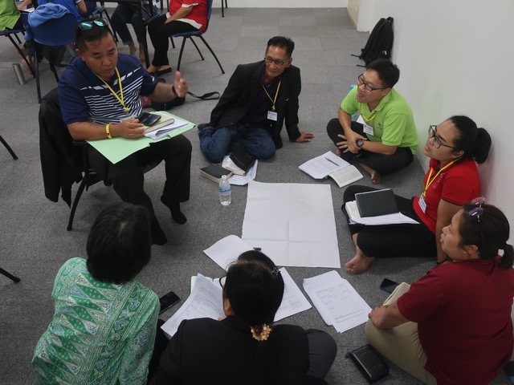
Trainers and Station Masters Forum
Led by Chief Trainer and Station Master Chief
Trainers and Station Masters need not have the same skill-sets as a PACA
  Good Trainers and Station Masters should be selected for having relevant skill-sets rather than experience as PACAs
Run monthly Trainers and Station Masters Forum to visualise PACA scenario
  Help them understand PACA process if they had no experience
  Discuss potential PACA issues and formulate responses

Slide 11
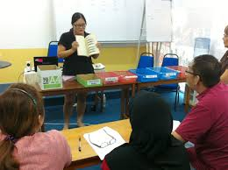


Retaining your Trainers
Ensure adequate choice of Training dates
  Appropriate to Trainer’s availability
    Remember the family
Show appreciation publicly
  Preferably by the candidate and any other senior person
  Unless they prefer to avoid publicity
    Show appreciation privately
Communicate, communicate, communicate

Slide 12
Organising Training

Slide 13






Key to organising
Why
What
How
Who, When
Where

Slide 14

Why
Objectives of training
Ultimate Objective is to train PACAs to the level they can identify electoral fraud and stop/record it

Slide 15
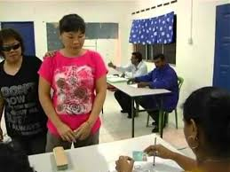

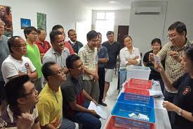
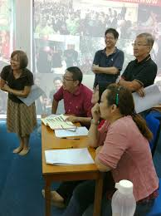
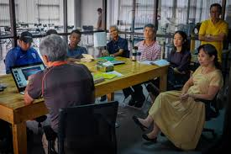

What
Be clear about the
Contents of the Training
  Basic, Full or Advanced
  Role play simulation
Audience for the Training

Slide 16
How
Plan
Target to train
Organise
Update material
Execute
Run Training
Review Training outcome
Venue availability and capacity
Publicise via Whatsapp and GoogleForm
Set venue to time slots
Assign trainers to time slots
Number of trainers
Time slots sufficient to meet targets
Adjust material and approach
Banners & posters
Book venue
Set up venue – banners, chairs
Set up sound system & test
Thank you email/Whatsapp & announce next training

Slide 17
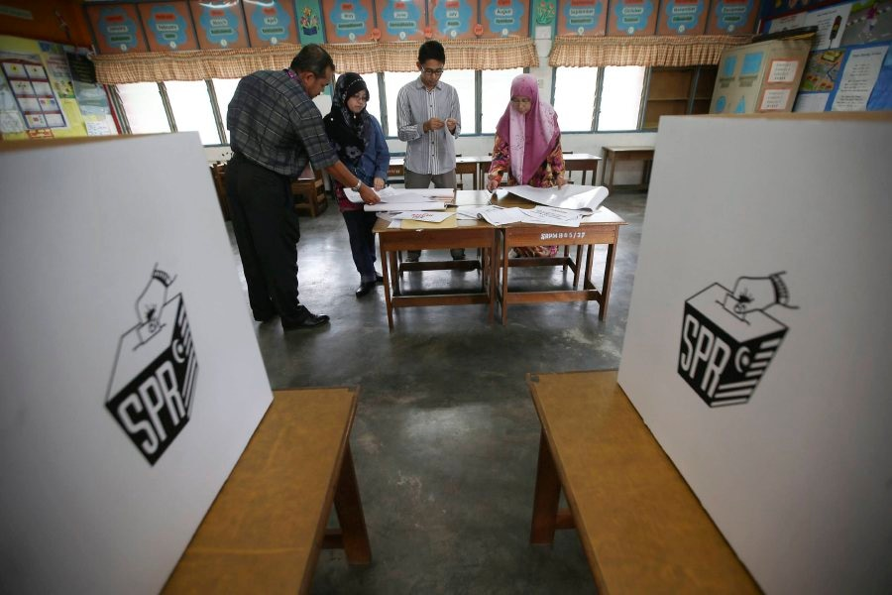
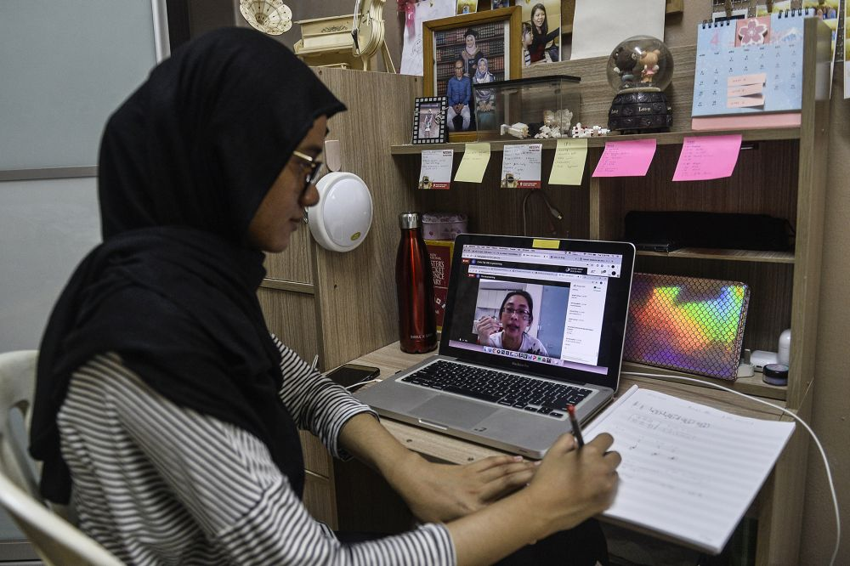
In person or On line training
In person
Why it is great
Training mor effective
You have immediate contact can assess attendee’s level of commitment & abilities
Willingness to turn up in-person could indicate higher commitment
Challenges
Harder to organise – timing for attendees & logistics
On line
Why it is great
More likely to attract young people, who prefer to do things online
Easier to video record & review
Challenges
Problem to collect photocopies of IC & signing Form A
  To call after online training
Online name may not be same as MyKad name
  Attendance harder to track

Slide 18

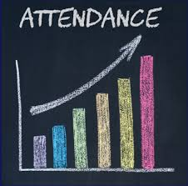
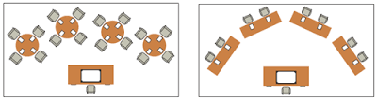
Approach – centralized or distributed
Station Master role
Recruit PACAs and track attendance at Training
Ensure each PACA have been trained until familiar to carry out tasks & identify any fraud
Arrange refresher with meeting in final week
PACA Coordinator role
Arrange place and time of Training
Maintain attendance records
  Take care where complete Training is broken up into multiple sessions
  Insists on attendance records even if Training is organised by Station Masters in remote areas
Ensure Station Masters are monitoring their PACAs

Slide 19
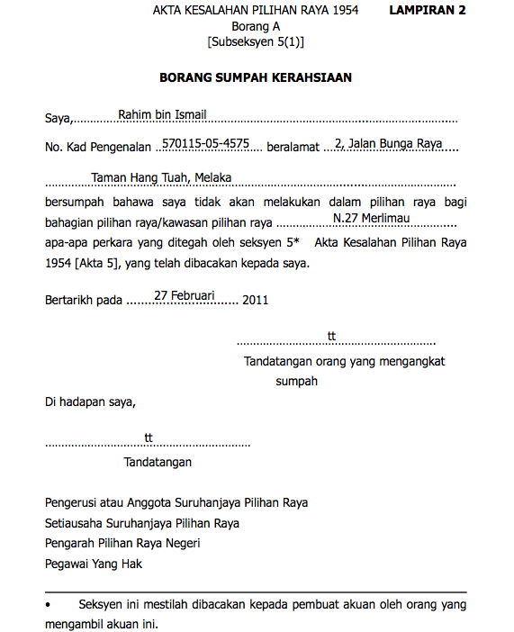
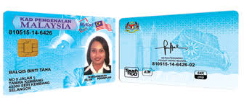
Training logistics
Have someone from Coordinators team at every Training to
  register PACABA and Training attendance on Google Form
  collect signed Form A and photocopy of MyKad
    Other details can be collected by WhatsApp
After Training
  Transfer details to Master List with training record
  Training feedback to identify better Trainers

Slide 20
Who does what – Trainers & Coordinators
Appoint
Training
Coordinators
Chief Trainer & Trainers
Set up & Publicity
Trainers
Trainers
Conduct Training
Provide time for registration
Register & Collect Documents
Registration
Issues Forum
Discuss with Station Masters
Set up and document

Slide 21

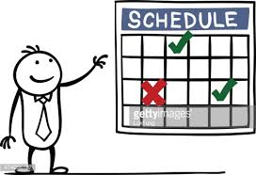
When
Before dissolution of assembly
  Start monthly and moving slowly to fortnightly/weekly
  Same day every month (eg., first Saturday of the month)
  If monthly not sustainable,
    Consider once every two months
    Station Master meeting/Training on months without PACA Training
After dissolution of assembly
  Several times a week, moving to daily as soon as possible
  Encourage each PACA to attend multiple times
    Later Training closer to Election Day should separate first time participants from refresher participants

Slide 22
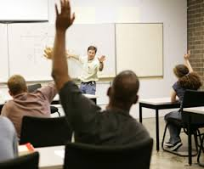
PACABA Training
Arrange regular PACABA training
  Once or twice a month
  Increase frequency as Elections get closer
Ensure every PACABA attend at least once
  Better if several times
Station Masters may require
  Advanced PACABA training
    Including management skills
  Discussions on new regulations and scenarios that may arise

Slide 23
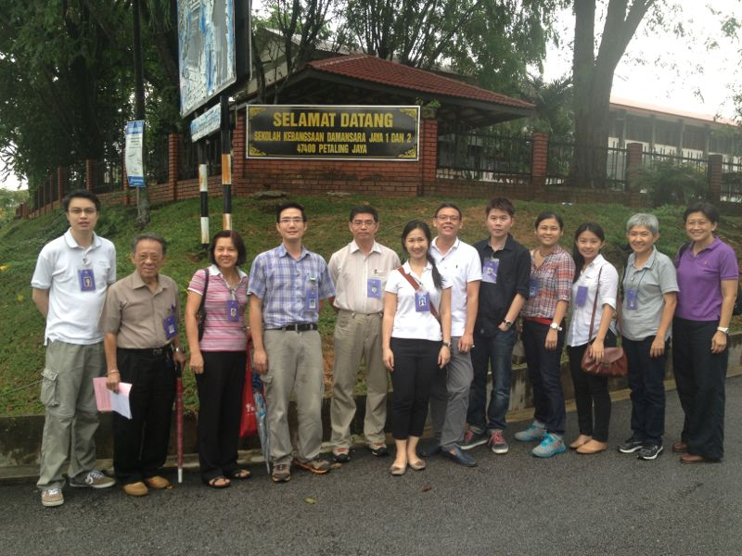
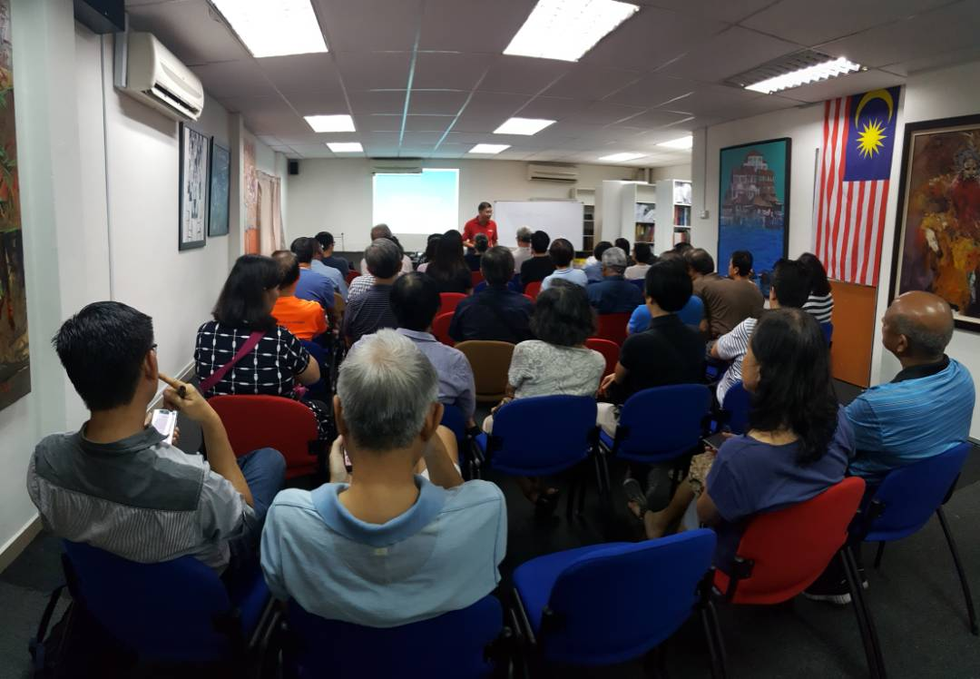
Who is attending
Station Master
Full PACA Training – multiple times, preferably by different trainers
  Use checklists
Full Station Master, including Early and Postal Polling
Discussion sessions on specific PACA process issues or PACA management problems
All Committed PACAs (including all CAs)
Advanced Training, preferably multiple times
Less available PAs
Start off with basic Training, and follow up by advanced Training, one week later

Slide 24
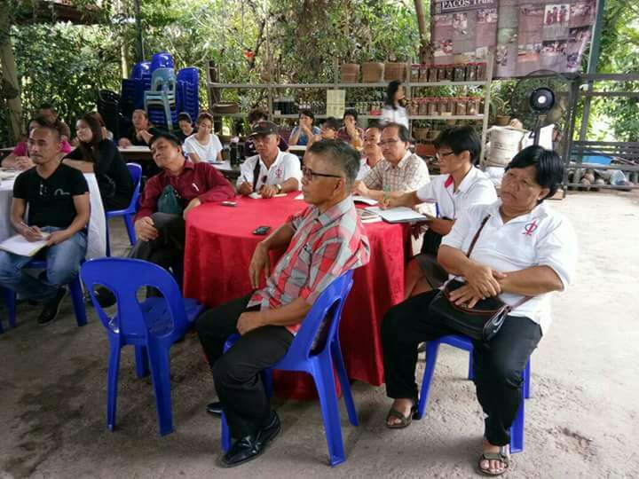
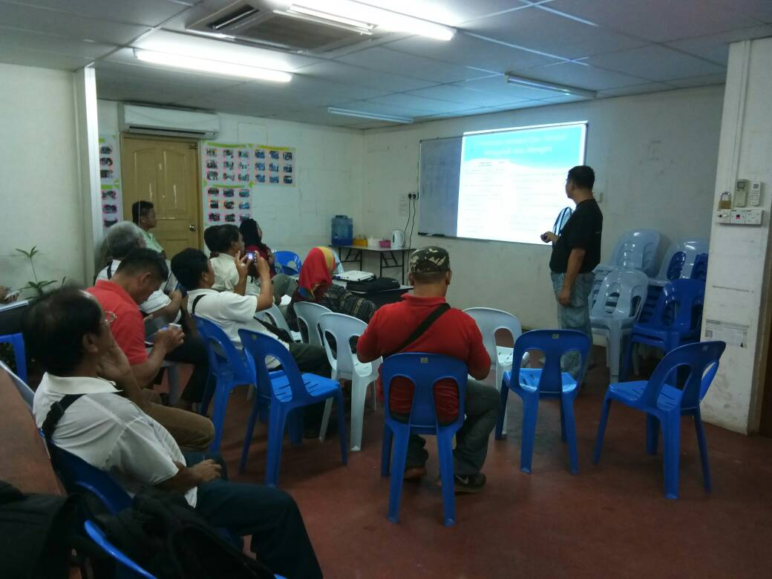
Where
Before dissolution of assembly
  Party office/premises
After dissolution of assembly
  In Bilik Gerakan
    More public, more accessible, larger
Multiple rooms/halls required closer to Elections
  Simultaneous multi-language Training session
  Breakout rooms for Station Master’s meetings
Consider need to have Training in remote areas
  Village halls or longhouses controlled by supportive chiefs

Slide 25
Trainers – before Training

Slide 26
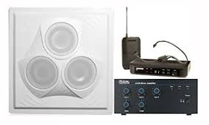
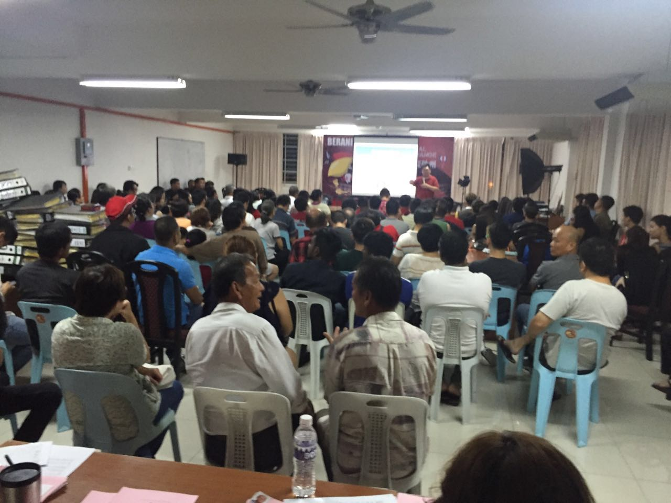

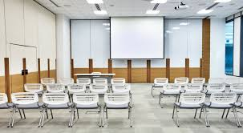
Preparing for Training
Understanding your participants
Understanding the Training objectives and contents
Understanding the logistics

Slide 27
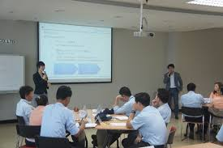
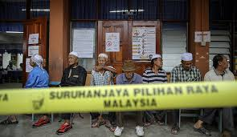
Understanding your participants
Are these experienced PACAs?
  Prior experience may help
    but if poorly trained, could inculcate false sense of security and over-confidence
Are they committed persons?
  Commitment helps focus during training
    take care those overly reacting to situations
  If low commitment, are you wasting time training them just to make up numbers?
Are they able to commit the time?
  Adjust logistics to suit them but consider their overall level of commitment
What is the level of understanding?
  If low, consider breaking up Training into several shorter sessions
  Consider use of role playing

Slide 28
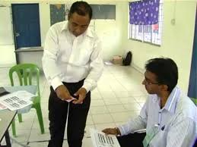
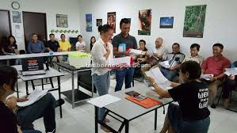
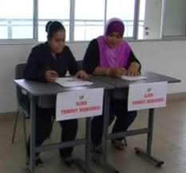
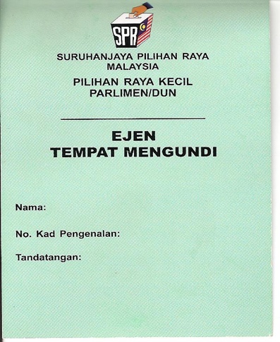
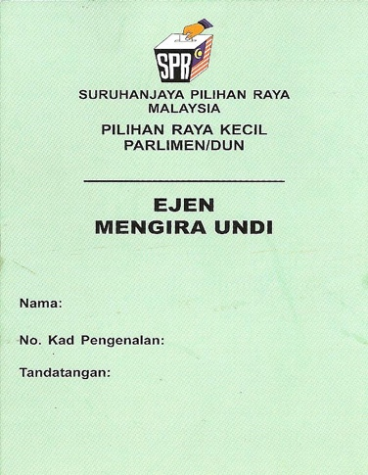
Understanding the Training Objectives and Contents
Ultimate Objective is to train PACAs to the level they can identify electoral fraud and stop/record it
  If Ultimate Objective cannot be achieved in one session, consider:
    First session is to introduce PACA concepts and the whole syllabus
    Subsequent sessions focus on individual areas, starting with most critical areas
Drop sections if not related to the Training objective

Slide 29
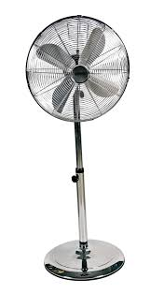
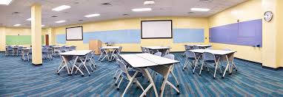
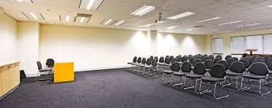

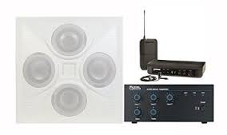
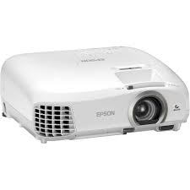
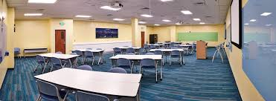


Understanding Training Logistics
Venue
Make sure large enough
  Prepare additional chairs – move participants further in the room so that latecomers do not disrupt
  Tables only if small group or role play
Make sure comfortable
  At least fans
Audio visual
Projector is available and bright enough
Place to put up screen or at least empty white wall
Sound system if room/attendance is large
MAKE SURE YOU TEST EVERYTHING BEFORE YOU START
Materials
If takeaway material is required, have they been printed in sufficient numbers

Slide 30
Trainers – during Training

Slide 31
Registering PACABAs
Use GoogleForm from your PACA Coordinator and ask trainees to fill it in
Study the profile of trainees to understand or gauge their
  prior PACA experience
  capacity to understand
  level of commitment
  potential area of service
Send the Form using email or Whatsapp
  Only the link is sent, not the physical Form

Slide 32
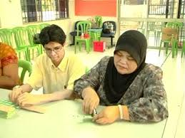

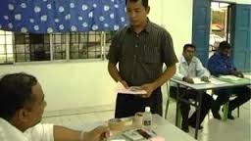
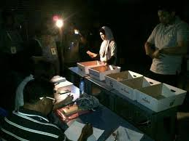
Your aim is
Help participants to link Training to their roles and what happens on election day
by
making accurate observations
involving in discussions
listening effectively

Slide 33
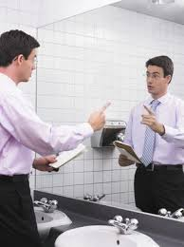



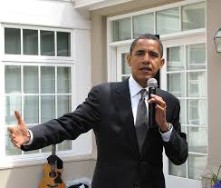
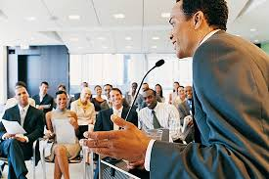

Do
Introduce yourself by name
Lay out what you intend to cover that day
Practice, practice, practice
Rehearse all scenarios
Thank the participants & ask them to spread recruitment
Maintain eye contact
  If nervous, eye contact with back of the room until you find someone supportive
Maintain a positive attitude
Speak in a clear voice
Gesture appropriately
Maintain interest
Dispel confusion

Slide 34






Do not
Get side-tracked from Training Objectives or the flow
  Avoid protracted questions that others cannot follow
    Speak to the person after the session
  Avoid questions for which there is presently no answer
    Open a Parking Lot
  Avoid political talk
    Stop the talk and if repeated, explain why
Pretend you know everything
  Put into Parking Lot and get back to questioner
Ridicule or insult participants
  Maintain a open environment where participants can question without fearing consequences
Parking Lot

Slide 35
Trainers – after Training

Slide 36


Training reviews
Ask trainees to fill in GoogleForm to review your presentation
  Grading using numerical scores
  Boxes to put in free form comments
  Areas
  Content & material
  Your presentation & their level of understanding
  Venue & facilities
Have another trainer or your PACA coordinator to attend (online if cannot attend in person) to give you feedback
If video recorded, review video a few days after training, when you have a fresher pair of eyes

Slide 37





Follow up
Any questions in Parking Lot must be followed up
  Even if just to say no decision has been taken
Identify anyone who has
  potential for larger role
    Pass on to PACA Coordinator/Station Master for follow up
  has displayed difficulties following the concepts
    Recommend role as PA2 only or drop altogether

Slide 38




Review your material
Were you able to finish all the areas you intended to cover?
  If no or if excess time, consider
    Spend more/less time in specific areas
    Expand/Reduce the areas for discussion
Were any areas not clear to participants?
  Is there another way to explain?
  Is your own understanding clear?
  Is there even an answer?

Slide 39



Review your logistics
Was number of participants unexpected?
  If facilities was not able to cope with the larger number, consider expansion if this is expected to be sustainable
Was the room large enough and comfortable enough?
Was the material & furniture layout for role playing sufficient?

Slide 40
Training programmes

Slide 41



A few pointers to run a programme
Plan and review
Set targets and track
Decide what, how, who, where, when
Communicate and share information
Decentralise and delegate but monitor
It is not just about PACAs
It is about the whole elections and building a politically conscious force for our common future

Slide 42

Jim Khong
012-320 3867
PACA4GE15@gmail.com
Slides are at https://www.jimkhong.com/jim-the-polling-agent
Any Questions?

