Slide 1
PACAs for Borneo
Briefing for PACAs assisting in Sabah Sarawak for GE14
October 2017

Slide 2
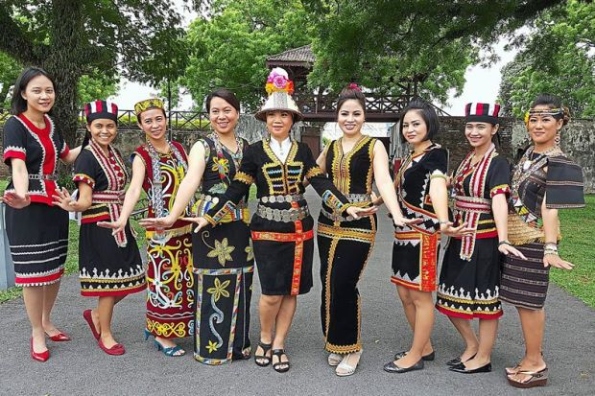
What we will cover today
Objective of this exercise
Basic introduction to Sabah and Sarawak
Being a PACA in Sabah and Sarawak
Tips to dealing with Sabahans and Sarawakians
Next steps to serving to Sabah and Sarawak

Slide 3
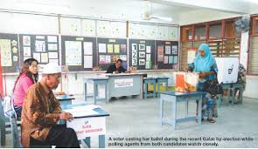
Objective of this exercise
Primary
To ensure sufficiency of PACAs in the more marginal constituencies
Secondary
To ensure consistent PACA process, methodology, kit and support
Relieve party leadership of any worries regarding PACA organisation

Slide 4
Introduction to Sabah
Geographical divisions
The various ethnicities
Political culture

Slide 5
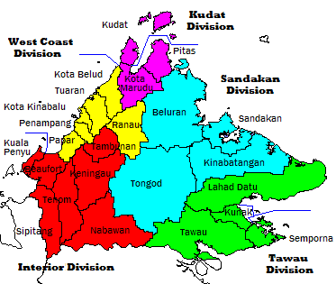
Geographical divisions
No clear geographical divisions in Sabah
Other than
  East Coast
    Sandakan division
    Tawau division
  West Coast
    K Kinabalu division
    Kudat division
  Interior

Slide 6

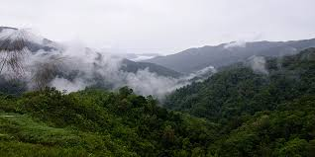
3 Regions of Sabah
West Coast
Kudat to KKinabalu
Most developed
  Largely urban or semi-rural
Northern part is Bajau area
Chinese in KK
KadazanDusuns more in south (Papar, Penampang), inland (Ranau & Inanam) & Kota Belud
East Coast
Sandakan, Lahad Datu & Tawau
Largely rural outside of coastal cities
  Inland is largely palm oil
Mostly Suluks and Bugis
Interior
Beyond Croker range
  Largely rural
KDM heartland
  Dusuns in Keningau & Tambunan
  Muruts in Tenom & Nabawan
Small scale farming

Slide 7
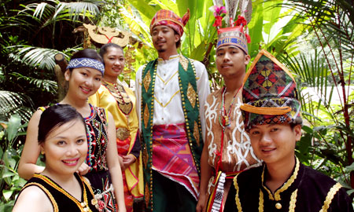
Ethnicities in Sabah
% | 2010
Kadazan-dusun | 17.8
Murut | 3.2
Bajau | 14.0
Melayu | 5.7
Other Bumiputra | 20.6
Non Bumiputra | 10.6
Non citizens | 27.8
Basically grouped into
  KDM 25% (previously 40%)
  Muslim 65% (previously 40%)
  Chinese 10% (previously 20%)

Slide 8
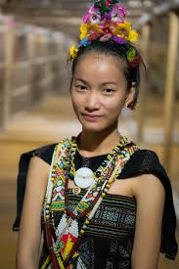
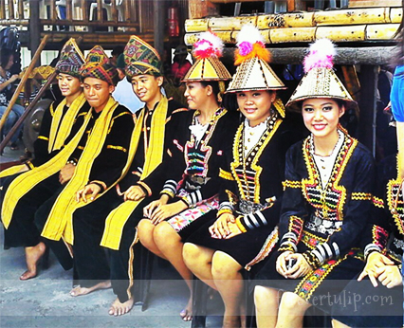
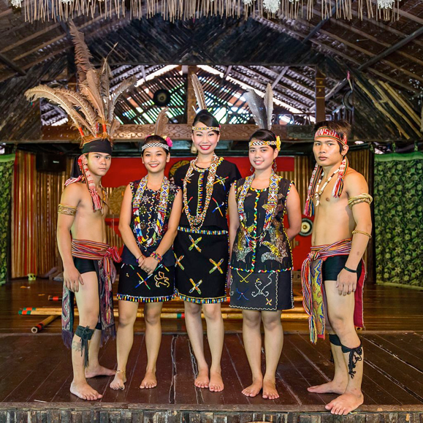
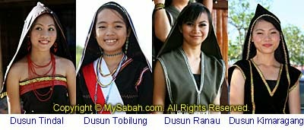
KadazanDusun-Murut
Umbrella group of 40 ethnic communities registered under KDCA
  Kadazans and various Dusun groups share similar languages
  73% Christians (mostly Catholics) 25% Islam
Kadazans
Largely farmers centered around Penampang
Seen as more affluent
Dusuns
Many Dusun sub-groups by localities
largely Interior & Ranau
Farmers
Muruts
Dayak grouping, largely in Interior
Seen as warrior types
Includes Lunbawang/Lundayeh found also in Sarawak
Other Dusuns
Rungus
  Around Kudat
Orang Sungai
  Around Sandakan
  Muslims

Slide 9
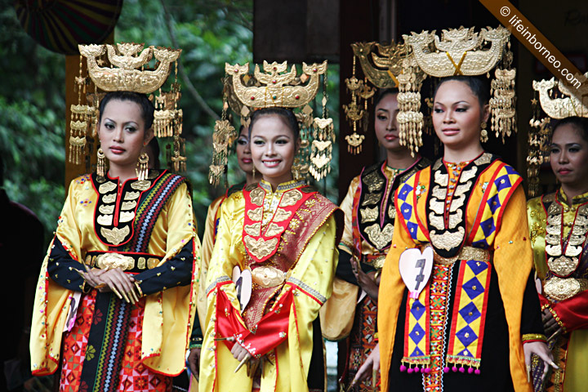
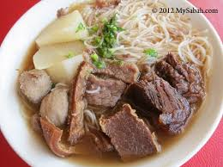
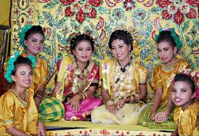
Other peoples of Sabah
Muslims
Malays
  Originally only Brunei Malay
  Semenanjung Malays now predominate in government
West Coast Bajau (Land Bajau)
  Original Bajaus of Sabah
  Farmers, horse-riding culture
East Coast Bajau (Sea Bajau)
  Recent Suluk immigrants
  Fishermen, houses on stilts
Bugis
  Recent Indonesian immigrants
  Petty traders
Non-natives
Chinese
  Down from 23% of population
  High level of inter-marriage with natives
    grouping Sino recognises both heritage
  Mandarin is lingua franca
    Hakka are about 55% of Chinese
    Sandakan is predominantly Cantonese

Slide 10
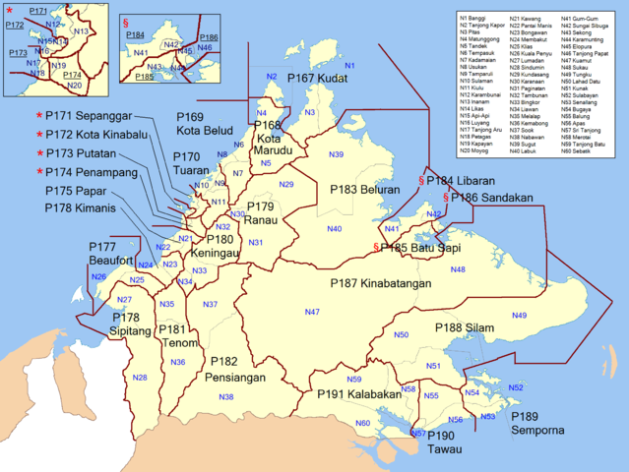
Sabah constituencies
Marginal DAP
  Penampang
  Keningau
  Pensiangan
  Tenom
Or their respective DUN seats
Incumbent DAP
  KK (P)
  Sandakan (P)
  Sri Tanjung (N)

Slide 11














Political parties in Sabah
Barisan Nasional (P22/25; N48/60)
Umno (P 14/14; N 31/32) Muslim
PBS (P 4/5; N 7/13) KDM
UPKO (P 3/4; N 4/6) KDM
PBRS (P 1/1; N1/1) KDM
LDP (P 0/1; N 3/4) Chinese
Gerakan (P -; N 2/2) Chinese
MCA (P -; N 0/2) Chinese
Opposition
PKR (P 1/19; N7/43) KDM
DAP (P 2/4; N 4/8) Chinese
STAR (P 0/28; N1/47) KDM
PAS (P 0/2: N0/9) Muslim
SAPP (P 0/8; N 0/41) Chinese
Bersama (P -; N 0/3)
Kita (P 0/1; N 0/1)

Slide 12


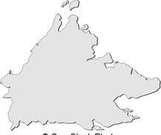

Political culture in Sabah
Barisan dominance
  Single Muslim party – UMNO
    Merger of 2 Sabah parties
    1 non-Muslim MP
  Multiple KDM and Chinese parties – 3 each in BN
Opposition
  Difficulties in uniting single platform
    Lost 10 seats in GE13 due to 3-cornered fights
  Culture of party defections
  Secessionism
Opposition front runners
Pakatan squeezed by defections – now only 2 ADUNs from 11 won in GE13
Warisan – led by Shafie Apdal
United Sabah Alliance – grouping of 3 Sabah parties
  STAR – Jeffrey Kittigan
  SAPP – Yong Teck Lee
  Harapan Rakyat – Lajim Ukin
Unaffiliated
  Parti Cinta Sabah – Wilfred
  Parti Anak Negeri - Edwin Bosi

Slide 13
Introduction to Sarawak
Geographical divisions
The various ethnicities
Political culture

Slide 14
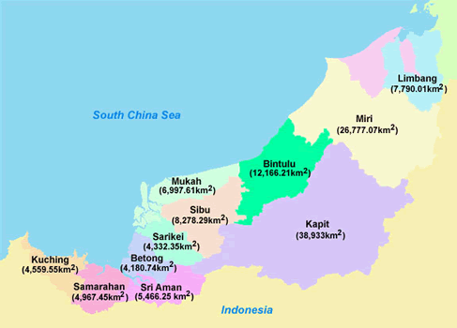
Geographical divisions
Sarawak is really three regions
Southern (Kuching)
Central (Sibu)
Northern (Miri)
Equivalent sizes
Pahang 36,137
Johor 19,210
Selangor 8,104
Melaka 1,664

Slide 15
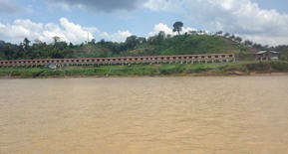
3 Regions of Sarawak
Southern
Area around Kuching
Most organised & developed
Largely urban or semi-urban
Dayaks are Bidayuh
Large number of Malay & Melanau
Central
Rejang Valley
Sibu town, known as cowboy town
Many remote areas require river access
Many longhouses
Dayaks are Ibans, many who speak only Iban
Chinese are Foochow
Northern
Miri-Bintulu area
Miri is Shell-Petronas town
Remote areas required 4-wheel drive
Dayaks are Orang Ulus

Slide 16
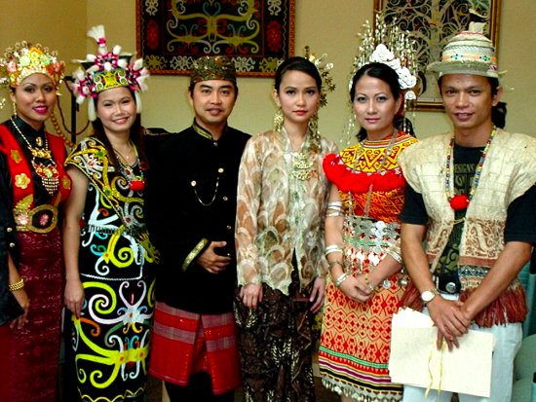
Ethnicities in Sarawak
% | 2010
Iban | 29
Cina | 24
Melayu | 23
Bidayuh | 8
Melanau | 6
Orang Ulu | 5
Others | 5
Basically grouped into
  Dayak 45%
  Malay 30%
  Chinese 25%

Slide 17
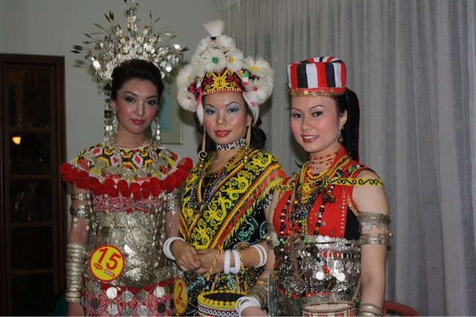
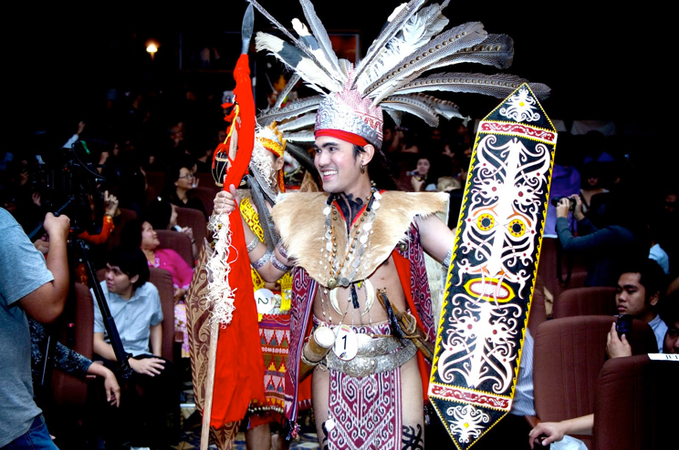
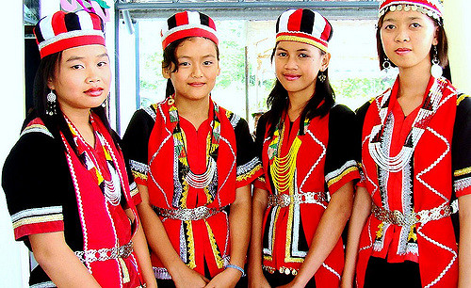
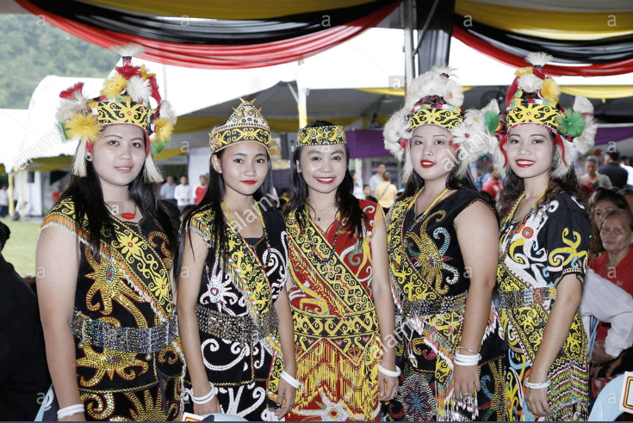
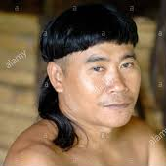
Dayaks
Umbrella group of natives originating from Kalimantan
Formerly living in longhouses, now only Ibans
Largely farmers and hunters
Protective of own language but uses English & Malay as lingua franca
Almost all Christians (mostly Catholics) and pagans, <2% Muslims
Iban
Sea Dayaks
Rejang valley, Bintulu to Sri Aman
Strongly Iban speaking
Bidayuh
Land Dayaks
Around Kuching
English & Malay speaking
Orang Ulus
Kayan, Kenyah, Kelabit, Lunbawang
Miri & Limbang
Mostly farmers
Other natives
Penans
  Nomadic hunter-gatherers
Bisaya
  Limbang area

Slide 18
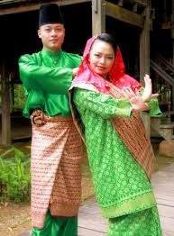
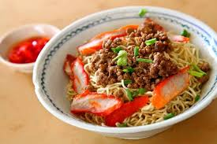
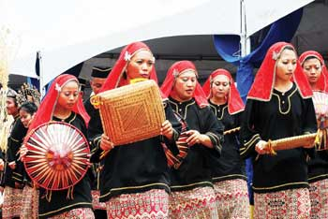
Other peoples of Sarawak
Non-natives
Chinese
  Concentrated in cities
  Moderate level of inter-marriage with natives
    No Sino grouping like in Sabah
  Mandarin is lingua franca
    Kuching is mixed with Hokkien predominant
    Foochow in Sibu
    Cantonese in Sarikei
    Hakka in rural areas, farmers
Muslims
Malays
  Descendants of Brunei Malays and Bugis
  Now largely government servants
  Mostly around Kuching
    And Kg Melayu in many small towns
Melanau
  Originates from Mukah
  Now, largely integrated with Malay

Slide 19
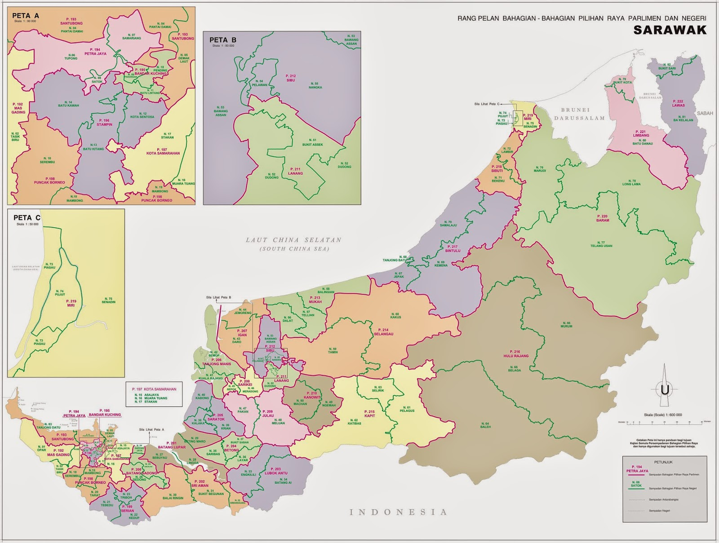
Sarawak constituencies
Marginal DAP
Kapit
Mas Gading
Incumbent DAP
Kuching
Stampin
Sibu
Sarikei
Lanang

Slide 20








Political parties in Sarawak
Barisan Nasional (25/31)
PBBB (14/14) Muslim, Dayak
PRS (6/6) Dayak
PDRS (4/4) Dayak
SUPP (1/7) Chinese
Opposition
DAP (5/11) Chinese
PKR (1/15) Dayak, Chinese
PAS (0/5) Muslim
STAR (0/7) Dayak, Chinese
SWP (0/6) Chinese, Dayak

Slide 21
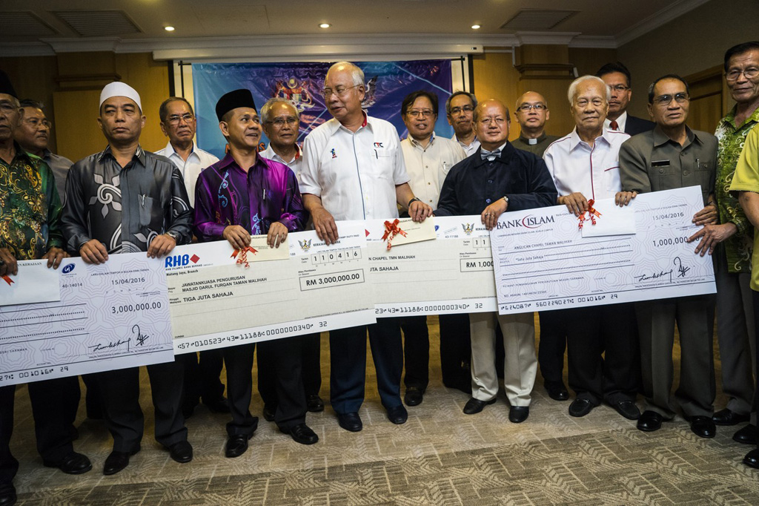

Political culture in Sarawak
Barisan dominance
  PBB sole Malay-Melanau party
  2 Dayak parties – PRS, PDRS
  2 Chinese parties – SUPP + UPP
High elections budget
  Voter expectations of handouts & development budgets
Strong on local autonomy
Opposition challenges
Strong in Chinese areas
Dayak areas lacking in resources and machinery
  Volunteers need to be paid
  Trained personnel and processes not in place
Rural people not used to opposition politicians
  Especially those with a permanent office in town

Slide 22
Being a PACA in Borneo
Marginal constituencies
PACA process for Sabah and Sarawak

Slide 23

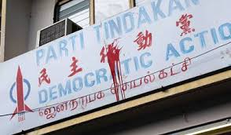
The marginal constituencies
With Chinese being largely pro-DAP and Malay/Muslims being largely pro-BN, the battleground is over native constituencies
Most targeted native constituencies have following features
  Identified KDM or Dayak candidate
    Some may have only started working recently
    May not have established election machinery
  Rural or semi-rural; Usually one main town
    Difficulties in transportation; River boats or 4-wheel drive into interior
  Traditionally BN incumbents
    Electorate may be politically apathetic or disinclined to support opposition

Slide 24
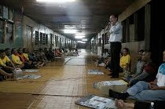
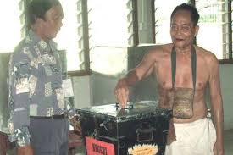
Rural salurans in Sabah & Sarawak
Most semi-urban constituencies are organisationally recognisably similar to Semenanjung
Rural constituencies are largely single-saluran
  Constituencies tend to have a town with a multi-saluran station and single-saluran stations elsewhere
  Stations are organised into districts
    Considering local recruitment by districts
  Single saluran stations normally have several villages or longhouses
    Longhouses tend to be largely pro-BN or otherwise
    Longhouses normally politically led/infuenced by tuai rumah

Slide 25

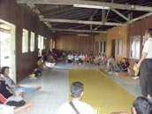
Two types of Station Masters
Urban areas
Several Polling Streams in one Polling Centre, one location
  Normally a school
Much easier to manage
  Pondok panas only in some places in Sabah
Rural areas
Several Polling Centres, each single Polling Stream
Normally will cover entire Polling District
Task more complicated
  Managing several locations at same time
  Each saluran is on its own
    Likely senior PACA paired with a junior one
  Communication may be problematic if poor coverage
  May require 4WD

Slide 26



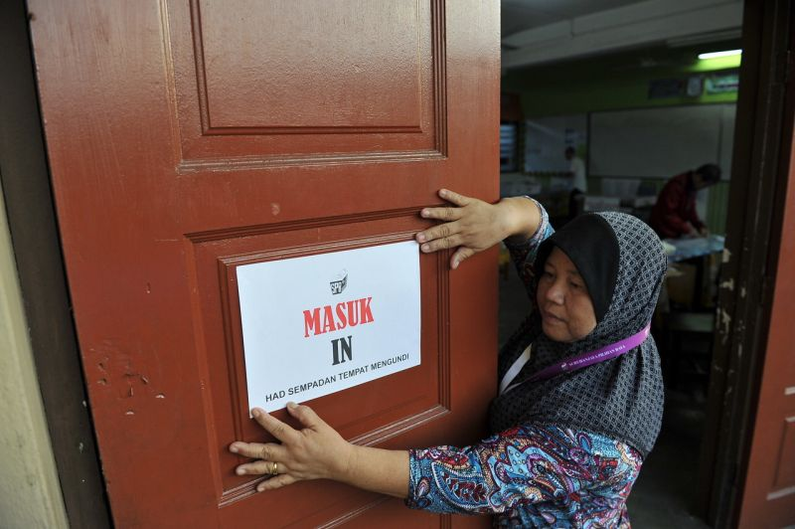
PACA process – reduced polling hours
If several villages/longhouses in the same saluran are close by, voters are expected to travel to one centre for voting
BN normally transport voters from the other villages/longhouses to the one centre for voting
As a result, voting is over once the last village/longhouse group leaves the centre. Voting hours then closes and the ballot box is transported to tallying centre: by helicopter if remote
PACA Process
EA to confirm with RO, voting centres with reduced voting hours
Possible to delay counting until 5pm?
  If yes, to guard the ballot box until then
  If no, to try delay announcements until after 5pm

Slide 27

PACA process – KTM for more than one centre
KTM may have responsibility for more than one polling centre
SPR Regulations provide for only one ballot box
  Each voting centre will have its allocated ballot book and thus the From 13. The ballot box is sealed up as usual and will be opened at the new place & packets will be merged. New Form 13 issued & signed after merging (Reg 24(3)). This means ballot box moves, is opened before end of polling and Form 13 can get superseded.
  SPR to give notice where counting takes place in location different from where polling takes place. (Reg 23A (2)(3))
PACA process
EA to confirm with RO which polling centre will share KTM & polling hours at each centre
PACA to organise to accompany ballot box but in own vehicle/boat, cannot be in same vehicle/boat as ballot box. If helicopter?

Slide 28
Some advice

Slide 29
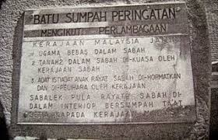
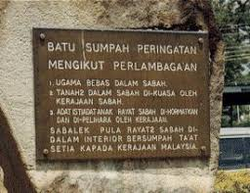
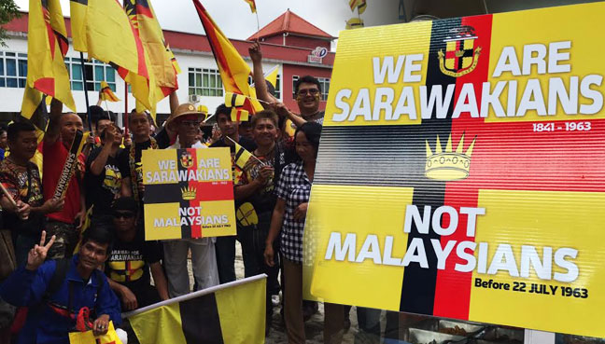


Secessionists or autonomy
Sabahans and Sarawakians jealously guard their autonomy
  Many Sabahans esp KDM resents loss of autonomy which Sarawak retains
  Batu sumpah issue
As far as they are concerned, Sabah and Sarawak are two out of four regions that formed Malaysia
  So, equal status to Malaya – they did not “join” Malaysia
  They are not two out of 13 states
SSKM (‘Sabah Sarawak Keluar Malaysia’) widely supported in Sabah
Sarawakians tend to support S4S (‘Sarawak for Sarawakians’)

Slide 30
Dealing with the people
Sabahans & Sarawakians normally
are not aggressive or confrontational
  They have their ways to say “no” or anything negative!!
are more laid-back and less organised than West Malaysians
  Don’t be surprised to be missing something!!
don’t refer to selves as East Malaysians
  You are the Orang Semenanjung or 西马人
  If they refer to you as Orang Malaya, beware!!
Treat Sabahans & Sarawakians with respect
  Sarawak is the only state with English as official language & no official religion
Sabahans & Sarawakians must be the front, Semenanjung people can only be in support from back
Christians may have commonality with Dayaks and KDMs
  KDM Christians have high fear of Islamisation
Ibans in interior may prefer use of Iban instead of Malay
  Insist on use of Malay for all official communications

Slide 31
Next steps

Slide 32
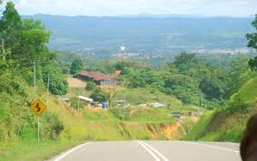
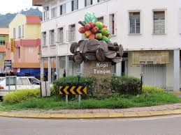
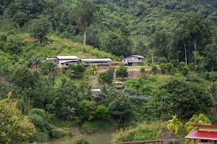

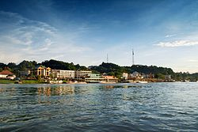
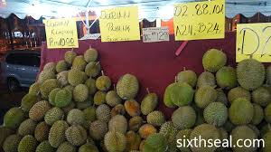
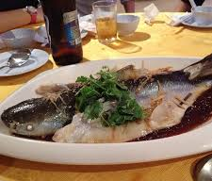
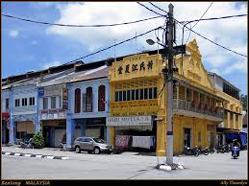
Constituencies supported from PJ
Sabah
Keningau – Dusun, small town
Pensiangan – Murut, very rural
Tenom – Murut, very small town with large rural interior
Sarawak
Mas Gading – Bidayuh, very small town (Bau) rural
Kapit – Iban, very small town, 3 hours boat from Sibu, very rural requiring much river transport
Semenanjung (driving distance from PJ)
Currently the list of accessible places being worked out

Slide 33

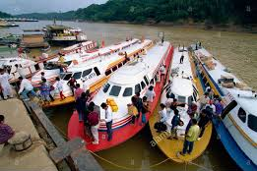
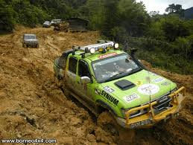
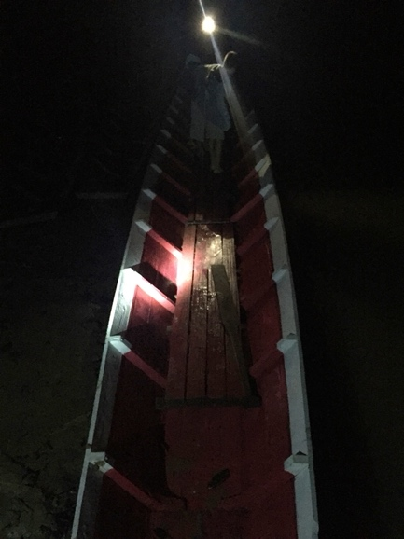
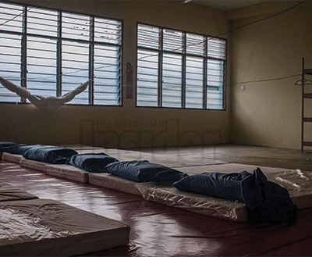
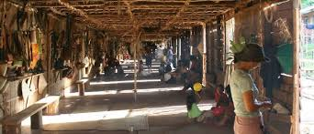
We will work out logistics
We will contact the local party to work out
Which stations will you be in
  Which stations are Chinese-majority, rural, need transportation, etc
  Which stations may not be appropriate for ladies
Transportation pick-up and accommodation
  Is pick up from airport or from constituency town centre/jetty
  Some places have little/no hotel room. Be prepared to stay in service centre – ask if mattress available or to bring own sleeping bags
  Ask for local guide
Don’t assume anything or take anything for granted
  Most of the locals have never organised election campaigns before
Check out voice/SMS and 3G data coverage
  Celcom tends to have the best coverage in Sarawak

Slide 34

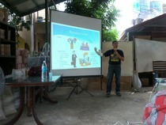

Next steps by us
Current Visits
  Check out PACA sufficiency
  Work out logistics
  Arrange training for local PACAs and leaders
PACAs in Semenanjung
  Publicity to explain
  Recruit and train PACAs
  Identify and train Station Masters
  Liaise with local party PACA Coordinators
Preliminary visits
  Identify those who can assist in campaigning or go over earlier
  Liaise with local party

Slide 35
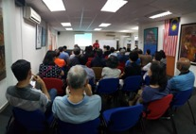

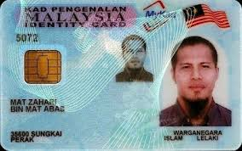
What you can do
Register yourself with the DAP PJ office
  Register using GoogleForm
  Erica Hew 03-7496 9119, dapdamansara@gmail.com
  Jim Khong 012-3203867, pacaforge14@gmail.com
  Chang Feng, recruiting for Mas Gading
You will be placed on a contact list, and we will send you updates on developments
If you have not been trained as PACA or require a refresher, please inform us
Help us publicise
  If you require further briefings to any private group, please let us know

Slide 36
Any Questions
All the best
pacaforge14@gmail.com

