Slide 1
You at the Voting Booth
How to make sure you support the Democratic voting process in Malaysia

Slide 2
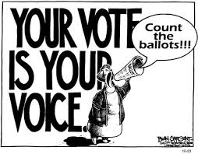
What we will cover today
How the new Electoral Boundaries affect you?
What do YOU need to do to ensure your vote is properly counted?
Where do I go if I want to help in the Elections?

Slide 3
The new Electoral Boundaries

Slide 4
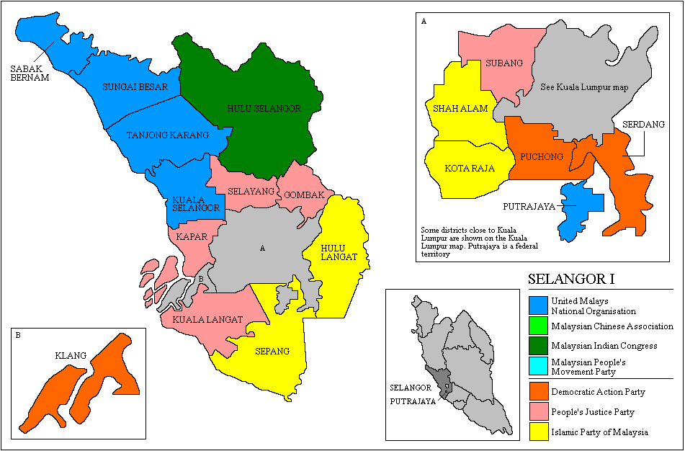

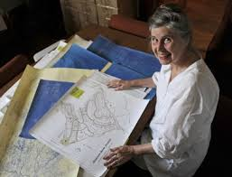
What is delimitation
Technical term for redelineation of constituency boundaries
Conducted by SPR
  Revisions displayed to public
  Objection period of 1 month
Law requires it to be performed once every eight years
  New boundaries need to be approved by Dewan Rakyat by simple majority
  Increase in seats require 2/3 majority as it involves change to Constitution

Slide 5



Breaking down the Constituency
Constituency (P & N)
School; Village
Polling Centre (Pusat Mengundi)
Classroom; Hall; Longhouse
Polling Stream (Saluran Mengundi)
Mukim, Town & surroundings
Polling District (Daerah Mengundi)
Only set during Election time

Slide 6
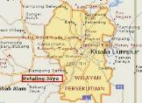

What you see at the SPR website now
Constituency (Parliament)
Mukim, Town & surroundings
Polling District (Daerah Mengundi)
Road, Housing Estate, Kampung
Lokaliti
Constituency (State DUN)

Slide 7
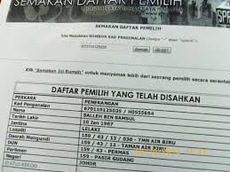
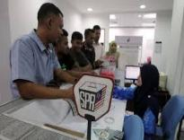
Electoral roll
Lists all voters by Lokaliti/Saluran
  Updated when Elections are called to assign voters to Polling Stations and Polling Streams
  Until then Electoral Roll only shows Locality
Updated every 3 months
  Will be publicised for two weeks to be effective
  If no objection, the Electoral Roll can be used for Elections
  Current approved Electoral Roll is March 2017

Slide 8
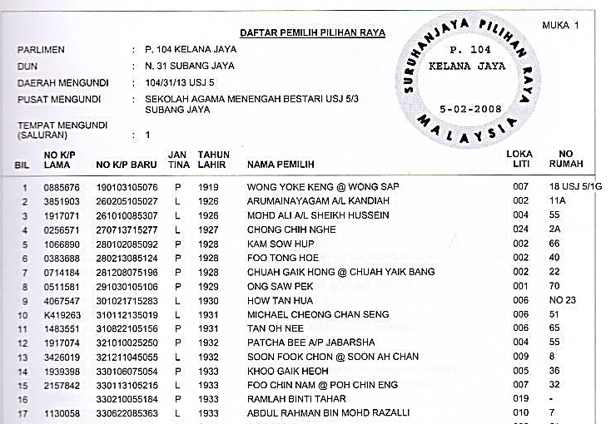
Voter Roll / Daftar Pemilih
Nombor Bilangan
Notes:
Sample of a voter roll.

Slide 9
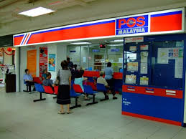
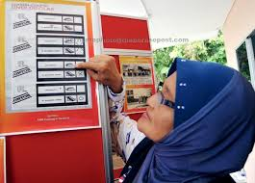
Change of address
Change can only follow IC address
Can be done at Post Office
  Full service Post Office
  Not the temporary booths
But consider where your vote will make a difference
  May leave Voting address at old address even if IC is new address

Slide 10

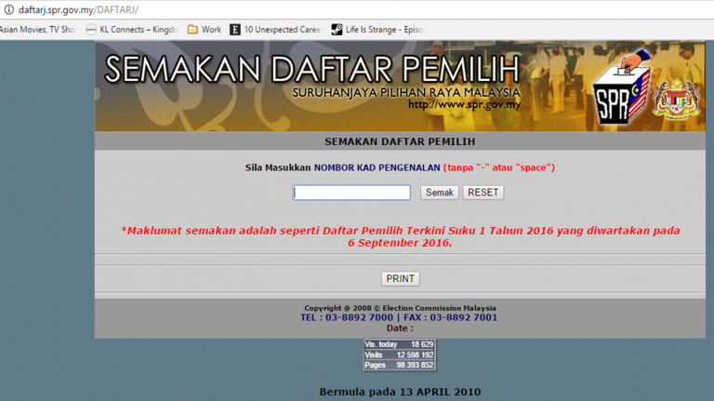
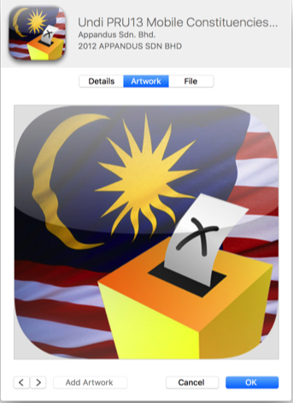
Checking if you are on the Electoral Roll
Checking the Electoral Roll
Website: http://daftarj.spr.gov.my/DAFTARJ/
SMS: Type SPR SEMAK [IC no] & send to 15888

Slide 11
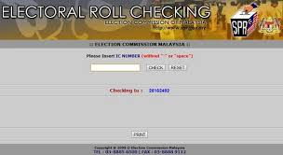
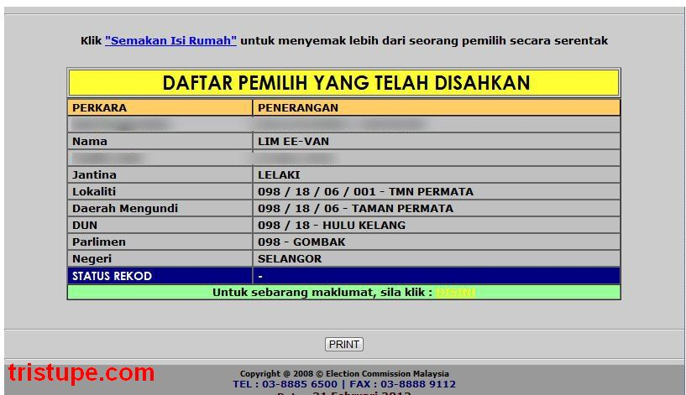
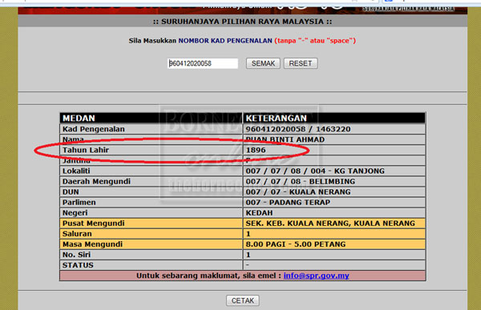
Voters to check
When to check?
Now
That you are still on the electoral roll
After redelineation
That you are still in the same constituency
1-2 weeks after dissolution of Parliament
Where your Polling Centre is
You should still check even if you have ‘checked earlier’

Slide 12
The Voting Process

Slide 13

Who’s Who on Election Day
Election Agent
PACABA Coordinator
Station Master
Polling Agent
Counting Agent
Barung Agent
Returning Officer
Polling Officer 1 (KTM 1)
Polling Officer (Ketua Tempat Mengundi)

Slide 14
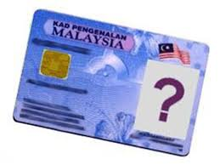
Who can vote
Registered in the Electoral Roll
  Malaysian citizen
  21 years and above
Has not yet voted on Election Day
  Name not cancelled off on Electoral Roll
  No indelible ink on any finger

Slide 15

Voter Dress Code
No Pictures of Political Logos or Colours
No shorts nor mini-skirts
No sandals nor slippers
Dress conservatively and decently

Slide 16
Typical Polling Centre (School)
6
5
4
6
5
4
2 SPR clerks + BA, one for each contesting candidate
3
2
1
3
2
1
Saluran/Stream in classrooms
Voters
Barung SPR
Voters
Max 700 Voters Per Stream except stream 1: 350

Slide 17


Voting Flow in 2-door Polling Stream
Barung – Situated outside the Stream
1
2
3
EC Clerks
Police Officer
Enter
Ballot Boxes
EC Barung
4
Polling stream room
2 doors
2
Polling Agents
1
Polling Booths
Exit
Presiding Officer (KTM)

Slide 18
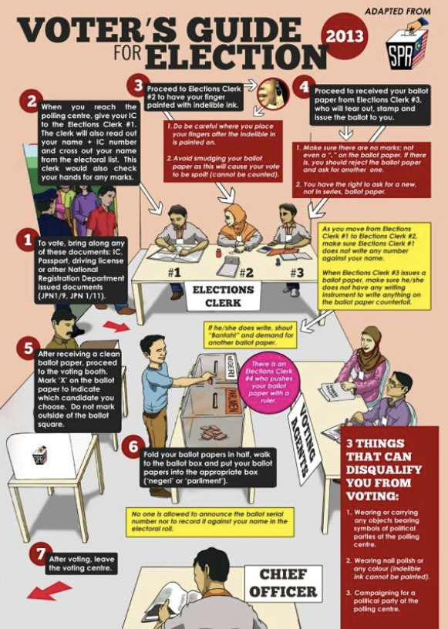
Flow in the Polling Stream
Voter enters Polling Stream & goes to EC Clerk 1
EC Clerk 1
  Checks Voter’s hands, verify the Voter’s MyKad & make face identification
  Reads out Voter’s Serial number & MyKad number & name
EC Clerk 2
  Mark Voter’s left index finger with indelible ink
EC Clerk 3 Stamp Ballot Paper
  Stamps and tears Ballot Paper from ballot book
  Folds and hands Ballot Paper over to Voter
Voter
  Goes to Polling Booth to mark Ballot Paper
  Drops Ballot Paper into Ballot Box
  Voter leaves the Polling Stream

Slide 19
Clerk 1: Electoral Roll
Voter Number
1
2
3
4
PP
Notes:
Sample of a voter roll.

Slide 20
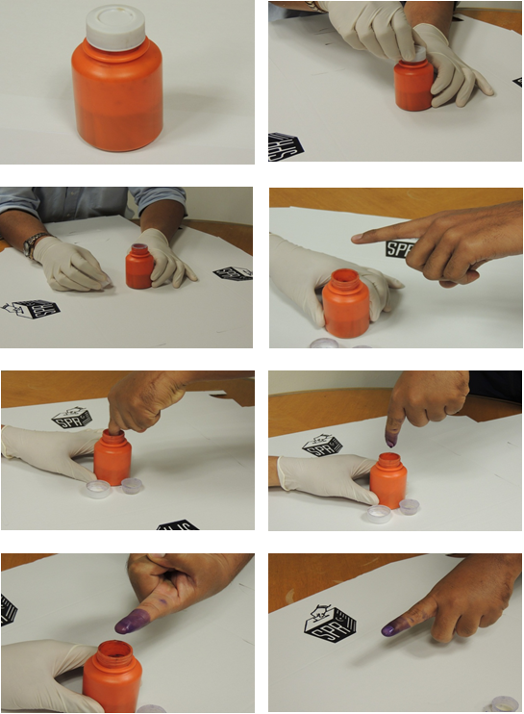

Clerk 2: Mark Finger with Indelible Ink
2
4
1
5
3
KIRI
KANAN

Slide 21
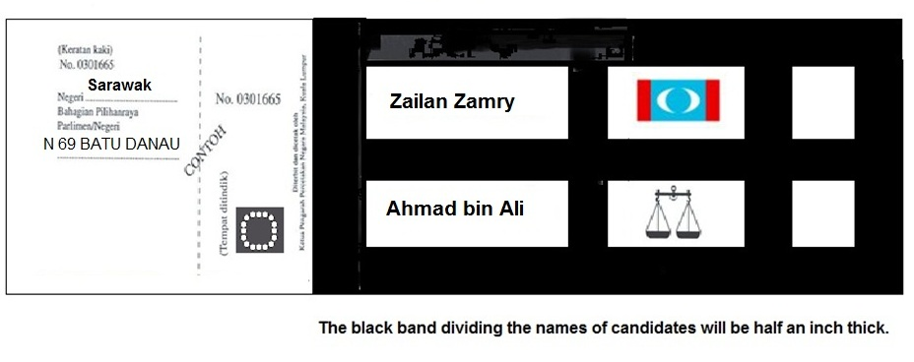
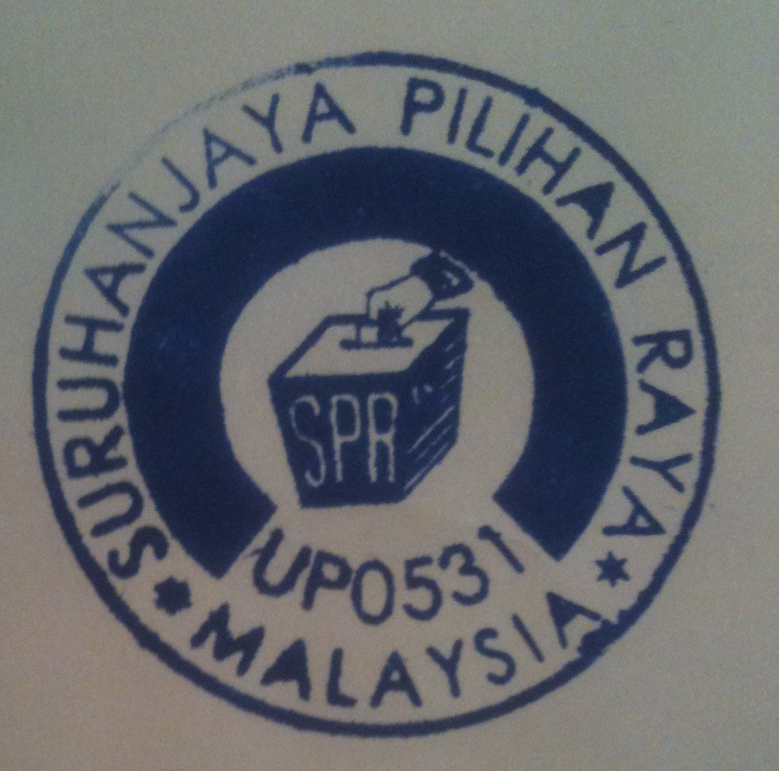
Clerk 3: Ballot Paper
SPR Clerk 3 Will Tear Here!
A voter will be issued TWO ballot papers as follows:
1 ballot paper for Parliament (MP);
1 ballot paper for Dewan Undangan Negeri OR State Assembly
A voter for Kuala Lumpur will receive ONLY ONE ballot paper for Parliament as there are NO State Seat in FTs

Slide 22
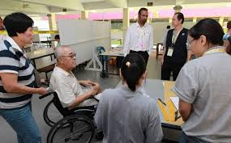
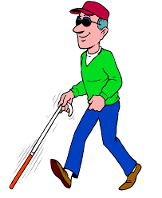
OKU/Blind Voters
OKU means only those physically not able to vote by themselves
May be helped by Trusted Person nominated by Voter
Trusted nominated person shall be citizen and above 21 years old. Sign Form 10 (PO will prepare the Form).
If no person is nominated by the OKU, PO is authorised to mark the ballot paper

Slide 23
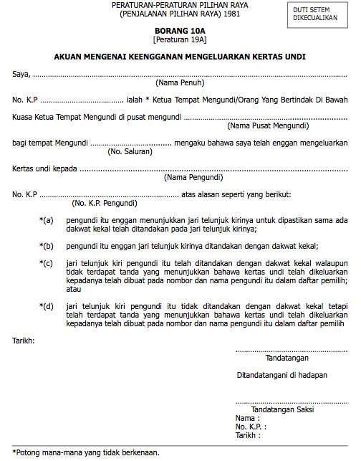
Form 10A
To be issued by PO where ballot Paper is refused
  Voter refused to show finger
  Voter’s finger already marked
  Voter’s name on Electoral Roll already marked
  Also, if Voter not on Electoral Roll, no adequate identification or name/MyKad differs from Electoral Roll
PO to fill in Form 10A in presence of witness

Slide 24

Doubtful Identity
If identity of Voter is doubtful, PO can fill in Form 11
Form 11
  Voter signs to declare that he/she is a Malaysian and a bona fide voter entitled to a Ballot Paper

Slide 25
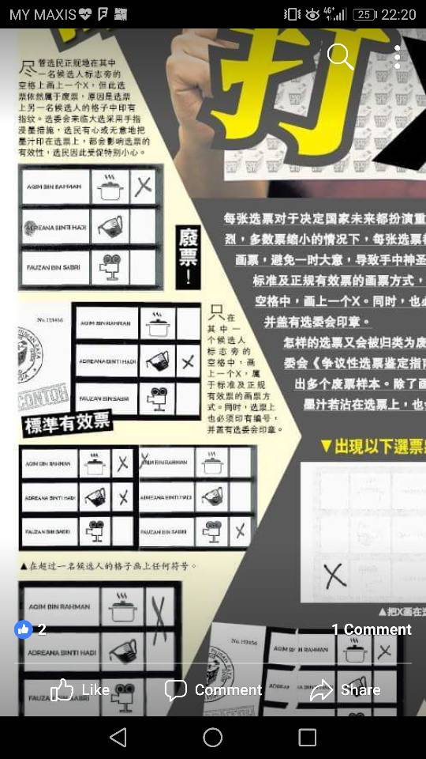
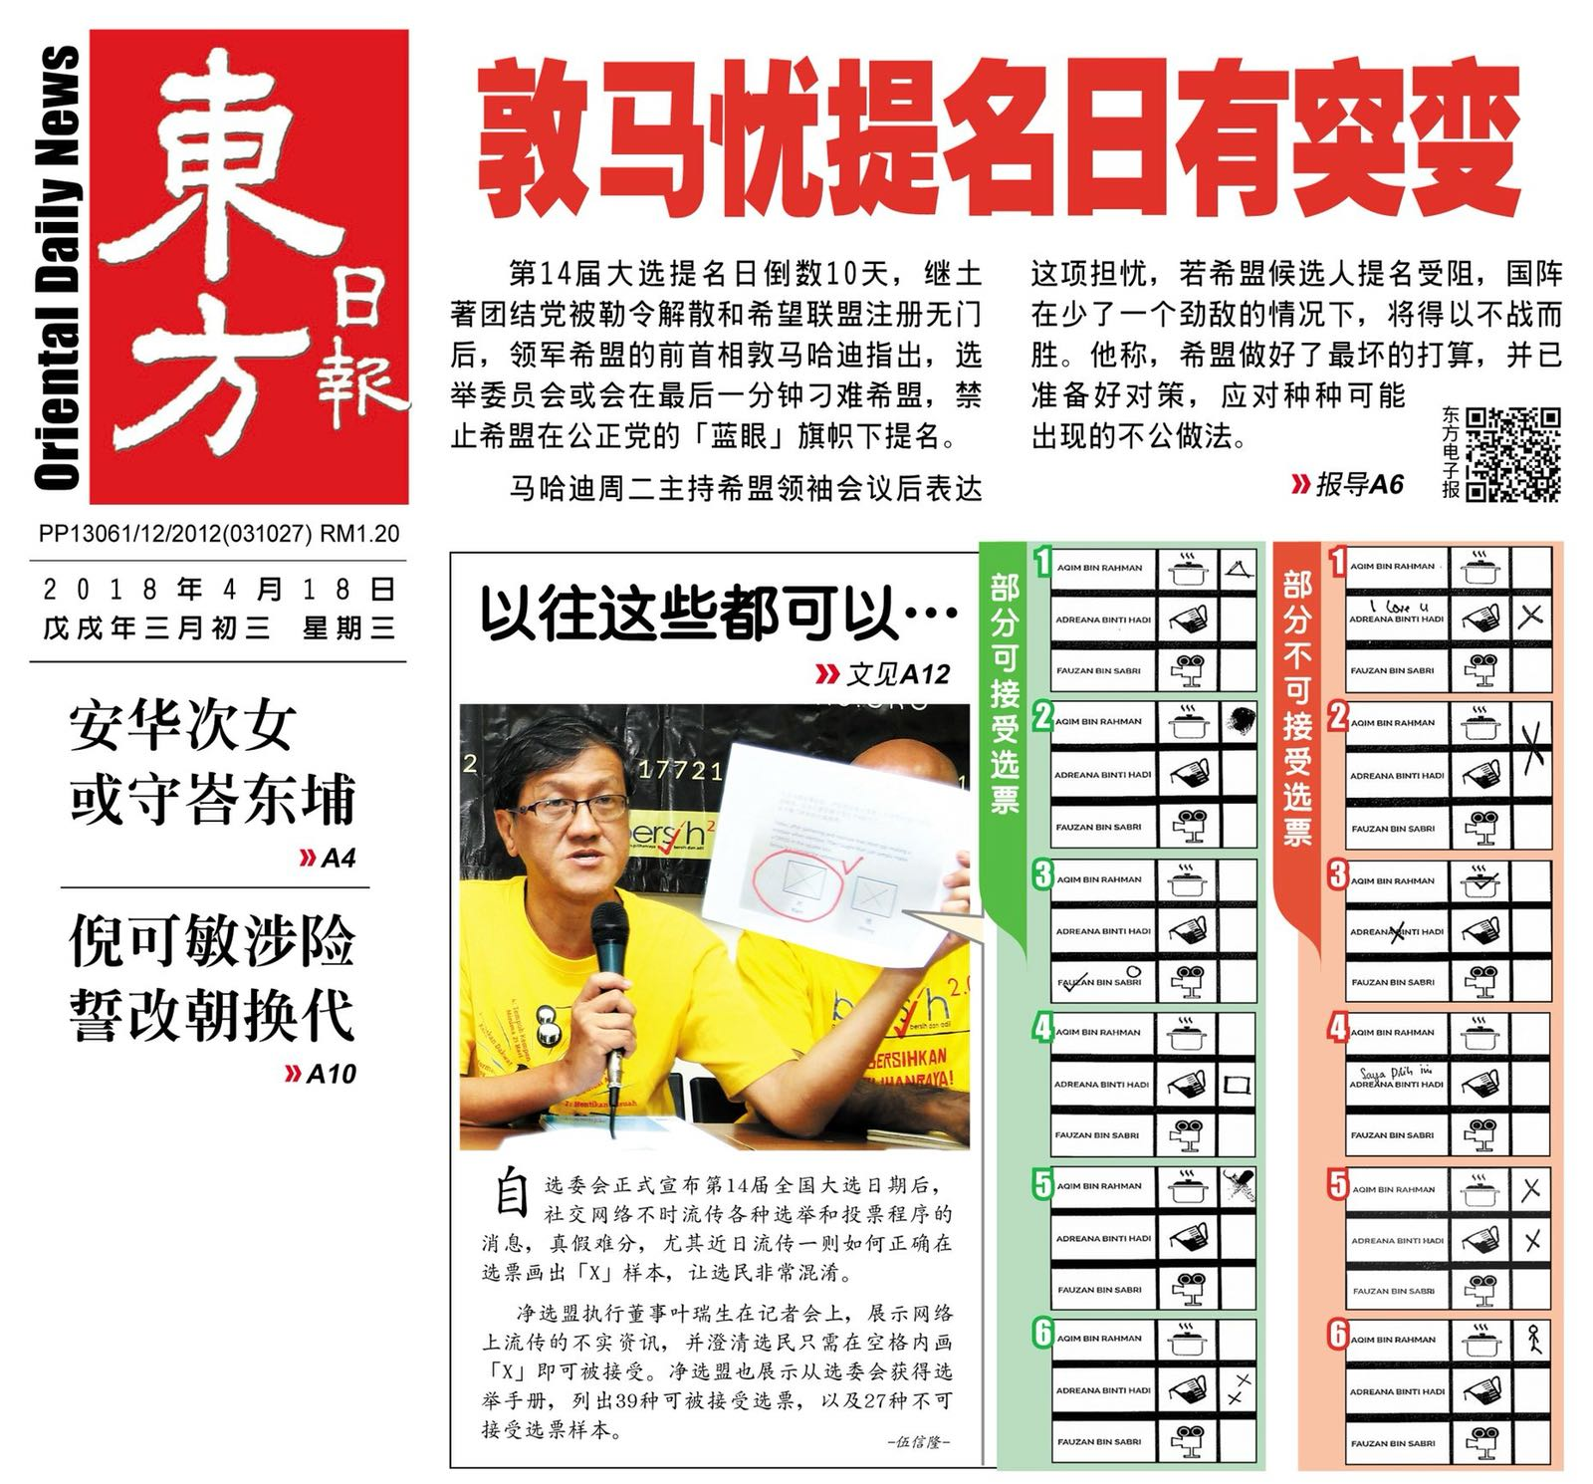
Marking your Ballot Papers
Leave BLANK
Mark X HERE
Just Mark your Ballot Paper with a clear X
Don’t worry about the right way
  Too many media distractions
Your Ballot will be accepted as long as the intention is clear

Slide 26

Any irregularities
Inform Pondok Panas outside voting station
  The right party of course
If you have relative who will not be voting that day
  Inform with name & IC number
Typical irregularity
Writing/marking on ballot paper
Ballot number/etc written down in electoral roll/etc
KTM over-zealous in assisting voter behind screen
Anything you find suspicious or uncomfortable or unfair

Slide 27
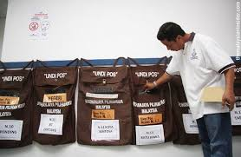
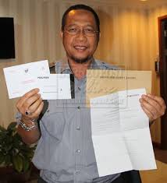
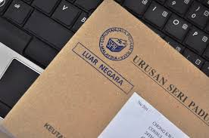
Postal Voting
Eligibility
Must be registered as voter
  Name is on electoral roll in a constituency
Available to
  Full time students overseas
    Except in Singapore, Brunei, South Thailand & Kalimantan
    Been back to Malaysia for 30 days in the last 5 years
  And spouses
Procedures
Check date of registration and procedures at SPR website
Request for postal vote
  Form A at SPR website
  With copy MyKad/passport
Collect ballot paper from Embassy
  Ballot paper, Form 2, Envelope B inside Envelope A
Deposit at embassy or post

Slide 28
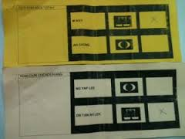


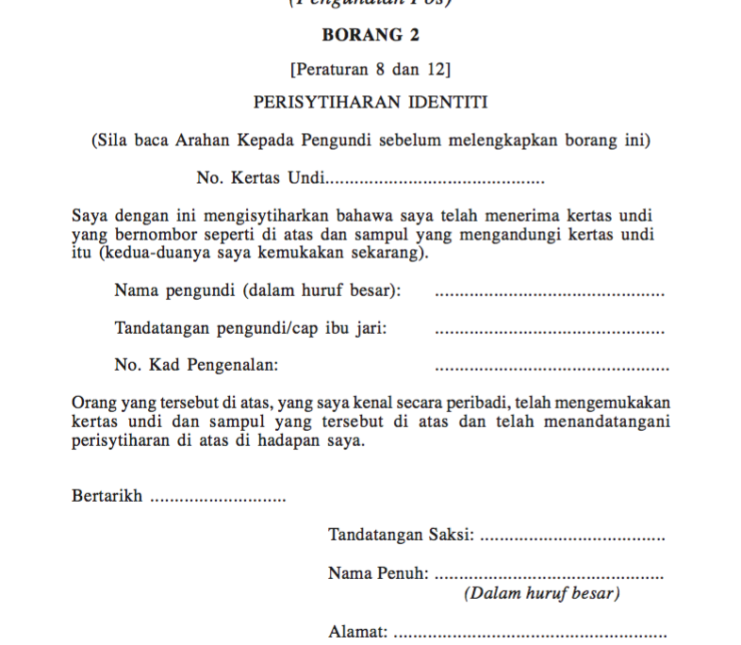

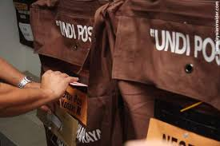
Voter Procedures
Voter receives four items
    Ballot Paper(s)
    Envelope A
    Form 2
    Envelope B
Mark
Deposit at embassy
Sign by Voter and Witness

Slide 29
Postal Voting – Form 2
Ensure
Signed by Voter and Witness
Same serial number on Ballot Paper

Slide 30
How to help

Slide 31
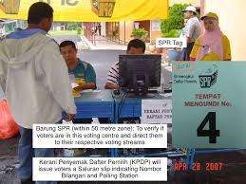
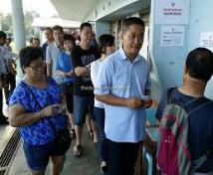
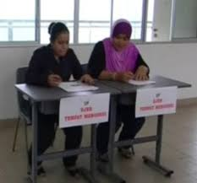
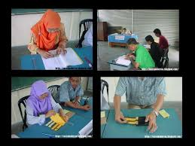
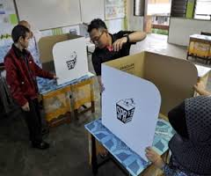
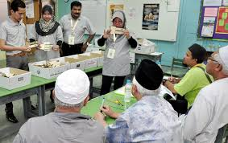
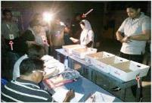
Roles available
SPR
  Ketua Tempat Mengundi
Political parties
  Polling Agent & Counting Agent
  Campaigning
Non-partisan parties
  Pemantau with Bersih

Slide 32
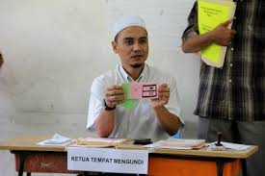
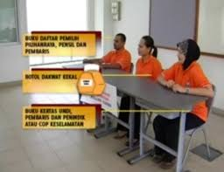
Volunteering as a Ketua Tempat Mengundi
Open to volunteers from private sector as well
  Most are drafted from public sector
Training is provided
Mandated by and subject to election law

Slide 33

What’s a Polling Agent Counting Agent
An agent of a candidate
Observe the polling and counting process
Mandated by and subject to election law

Slide 34
Who can be a Polling Agent Counting Agent
Malaysian citizen
21 years and above
Not charged in Court for any offense in the last 5 years
Not a discharged prisoner within the last 5 years
Not an undischarged bankrupt
Need not be a party member

Slide 35
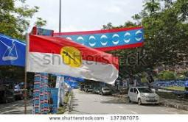
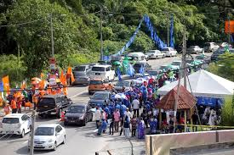
Volunteering to campaign
Assisting in election campaign
  Canvassing, Distribute posters, Putting up banners etc, Administration
Just walk in to the Bilik Gerakan and offer to help
  Need not be a party member
Helping out a personal friend
  Election agent

Slide 36
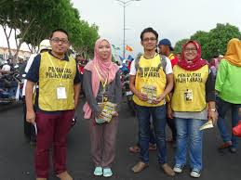

Volunteer with third parties
Bersih
  Pemantau – monitoring election process from outside
  Funding – merchandise or donations
    Check website for latest location

Slide 37
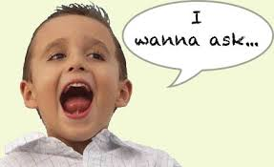
Jim Khong pacaforGE14@gmail.com
Any Questions

