Slide 1
Polling Agents Training
Role and Procedures of Polling Agents in General Election

Slide 2

What we will cover today
What’s a Polling Agent
Before Polling Day
Before Polling Starts
Polling Procedures
After Polling Closes
Potential issues marked in red
Pictures may be taken from EC training to facilitate reference for EC Officers

Slide 3
What’s a Polling Agent

Slide 4

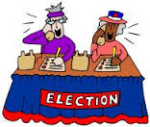


The Candidate’s team
Campaign Manager
Candidate
Election Agent
Mandated to represent Candidate to EC
Help run Election for Candidate
PACABA Coordinator
Administer recruitment, assignment, training & logistics for PACABA

Slide 5



Breaking down the Constituency
Constituency – Parliament & State
School; Village; Housing Estate
Polling Centre (Pusat Mengundi)
Classroom; Hall; Longhouse
Polling Stream (Saluran Mengundi)
Mukim, Town & surroundings
Polling District (Daerah Mengundi)

Slide 6

Who’s Who on Election Day
Constituency
Returning Officer (‘RO’)
+ Asst ROs
Presiding Officer 1 (Coordination role) Polling Centre Officer
Presiding Officer (Ketua Tempat Mengundi = ‘KTM’)
Election Agent
PACABA Coordinator
Station Master (Ketua PACABA)
Polling Agent (‘PA’)
Counting Agent (‘CA’)
Centre
Stream=Saluran

Slide 7

What a Polling Agent is
An agent of Candidate
  Act of agent is act of candidate
  Interest of candidate is interest of agent
  You are not independent
Two separate roles – PA and CA
Observe Polling and Counting process
  Not part of the process
  No veto
Subject to Election law

Slide 8
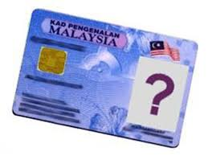
Who can be a Polling Agent
Waiting for the change
Malaysian citizen
21 years and above
Not charged in Court for any criminal offense in the last 5 years
  Traffic offenses excluded
Not a discharged prisoner within the last 5 years under Elections Offenses Act
Not registered under Prevention of Crime Act
Not an undischarged bankrupt

Slide 9
Before Polling Day

Slide 10
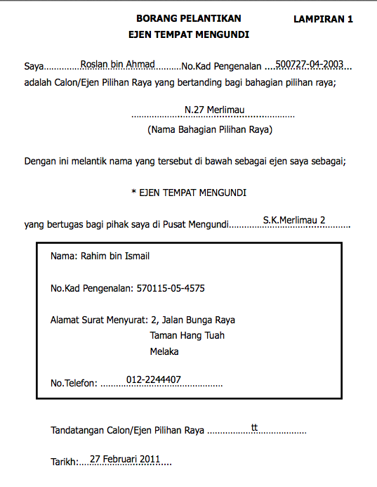
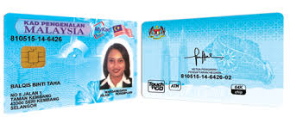
Appointment to be Polling Agent
Registration requirements:
  copy of MyKad (both sides)
  Passport size photo (recent) for tag
    One for each role PA, CA and BA
    Write name & IC no at back
White Appointment Form filled in by PACABA Coordinator and signed by the Candidate or Election Agent
  One for each role PA, CA and BA
  Specific to the Polling Centre

Slide 11
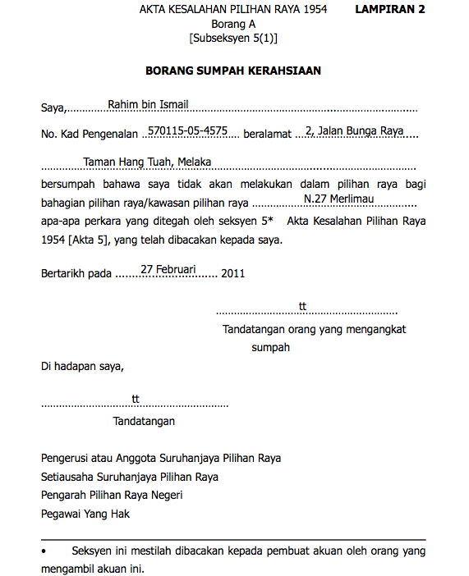
Form A Oath of Secrecy
Red Form
Required to comply with Election Offenses Act s5
  Cannot try to find out candidate for whom Voter has or intend to vote
  Cannot communicate any details regarding name or voting number of any Voter before Polling close
  Cannot communicate with Voter between receipt of Ballot Paper & inserting into Ballot Box (except PO)
  Cannot communicate Polling Stream stamp before Polling close
  Full s5 on reverse of the Form
Only those who have taken oath may enter Polling Stream or see serial number on Ballot Paper

Slide 12

After Registration
You will be called to attend PACABA Training
You will be assigned to a Polling Centre
  You can request for the Polling Centre convenient to you
Your Station Master will call you
  Will brief you and assign you your shift
  May meet the team before Polling day
  Set up a Whatsapp group or communication channel

Slide 13
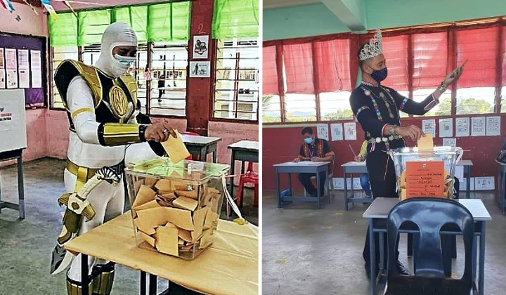
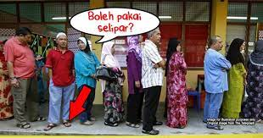
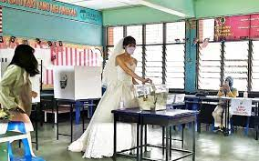
PACABA Dress Code
Smart casual – remember you are on official duty
  Dress comfortably – can get hot in the room
Legal requirement: No political statements or logos
Subject to discretion of PO
  No colours that can be interpreted as political statement
    If in doubt, wear or bring something neutral as spare
  No round-neck or sleeveless T-shirts.
  No shorts, mini-skirts, sandals nor slippers

Slide 14

Eve of Election Day
Follow dress code
Prepare the following
  MyKad
  Handphone charged and sufficient credits; smartphones should have sufficient data plan/quota; Powerbank
  Small torchlight (handphone light may not be enough)
  Additional passport size photo
  Spare pens, paper, ruler & marker pen
  The PACA kits
Make sure adequate sleep
  PA1 will need to be at Polling Centre at 7am
  You could be on duty the whole day until night
PO equipment list also include emergency torch

Slide 15
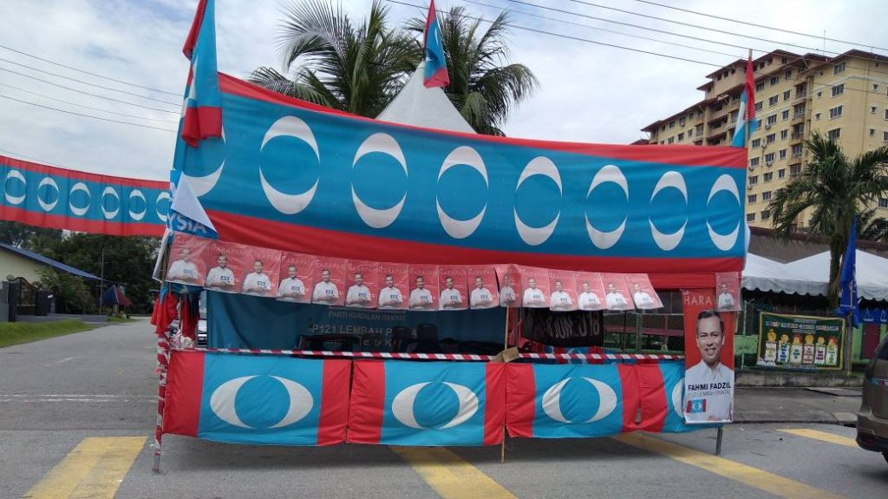
Reporting for duty on Polling Day
PA1 meet Station Master at 7am or designated time at Pondok Panas and collect
  PACA Kits
    Subsequent PACAs - Your PACA kit is with the previous PA
  Red Form A Oath of Secrecy, signed by RO and PACA
    If you have not yet signed the red Secrecy Oath, you will need to sign it before going in
    Sometimes, Form A is unsigned, even if you has previously signed one
  White Appointment Form appointing you as PA, CA or BA, signed by Candidate/EA
    One for each role
    If you are a standby PACABA is transferred from another Polling Centre, ensure you have filled up an empty Appointment Form for your Station signed by Candidate/EA.
  EC tags (colour coded for PA, CA or BA) with your photo – one for each role

Slide 16

PACA Kit
Each PACABA Kit will be labeled with Polling Stream
Electoral roll (specific to each Polling Stream)
Sample Forms 13, 14, 753
Sample of accepted and rejected Ballot Papers
Pencil, Eraser, Sharpener, Pen & Ruler
Permanent marker pen
Empty paper & Paper clip
Three Objection Letters
Optional/May be with Station Master only
Glue or Tape
Training slides
PA checklist & CA checklist
Relevant pages of Act & Regulations

Slide 17

Typical Polling Centre (School)
6
5
4
6
5
4
2 SPR clerks + BA, one for each contesting candidate
3
2
1
3
2
1
Streams in classrooms
Max 700 Voters per Stream
Electoral Roll organized by MyKad number
Stream 1 includes handicapped: 350
All the rest distributed equally
Voters
EC Kiosk
Voters
For Concurrent Elections:
No of PA allowed 2: 1 for P & 1 for N
No of CA allowed 2 if concurrent count
Covid Change

Slide 18
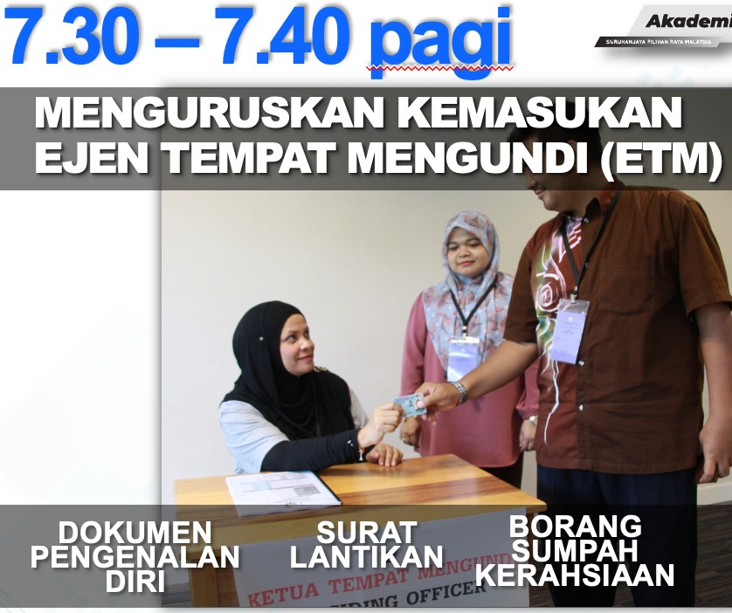
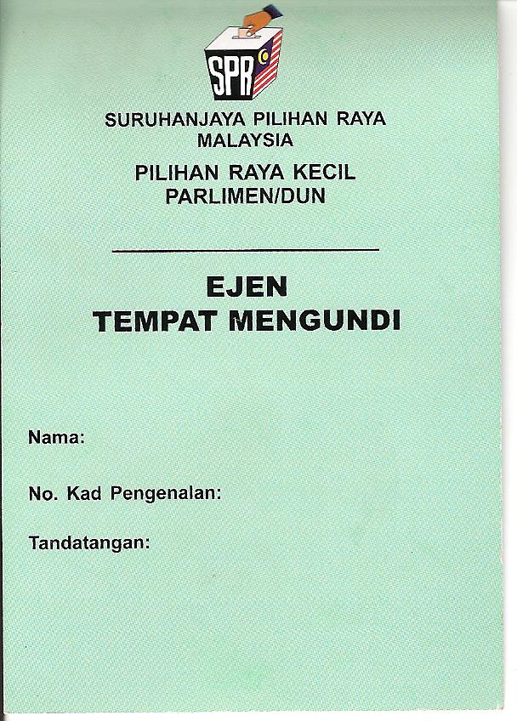
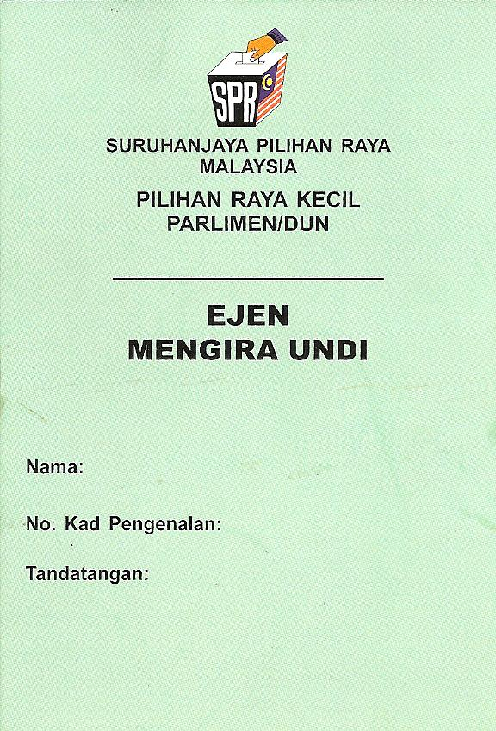
Entering Polling Stream
PA1 can enter Polling Stream at appointed time
  7.30am or any other time agreed with PO
Make sure that you enter with
  MyKad as identity
  Red Form A, Oath of Secrecy, allowing them into the Stream
  White Appointment Form authorizing them as PA
  EC tag, allowing them into the Polling Centre
  PACA kit
PO will brief PAs and Clerks

Slide 19

The Presiding Officer
Presiding Officer (Ketua Tempat Mengundi)
Normally non-partisan
Most are civil servants, called to work on day off
  Some are volunteers from outside government
May not be that familiar with laws or Regulations
  One training every five years
Make him your friend
PO1 more experienced

Slide 20


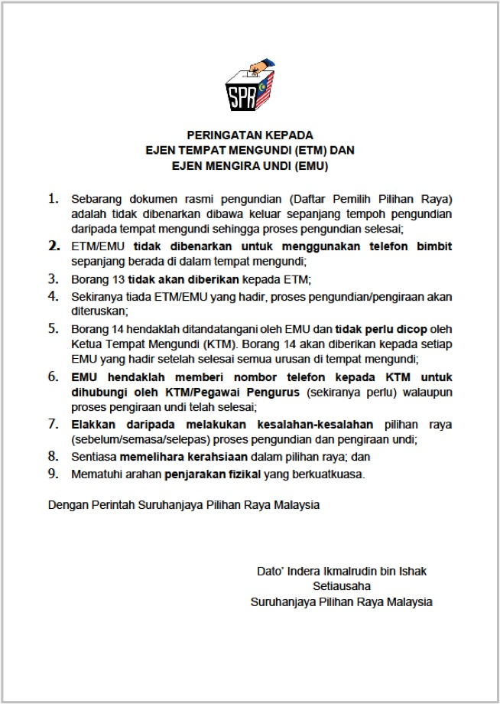
Use of handphones
EC procedures prohibit handphones from Polling Stream
  Always understood to mean prohibited from talking
  Surrender of phones only apply to Voters
  More zealous POs may ask for handphones in basket
Action
  Inform PO phones will not be used to talk & only text
  If no, ask PO if phones can be used outside the room
    PA to bring paper out to record voter number while texting
  If no, runner to be sent to the room every 30-60 minutes to talk to PA if anything to report
PAs to try to keep your handphones and not give it up. Turn off and keep in pocket or bag
Do not get thrown out of the room on this issue

Slide 21
Before Polling Starts

Slide 22
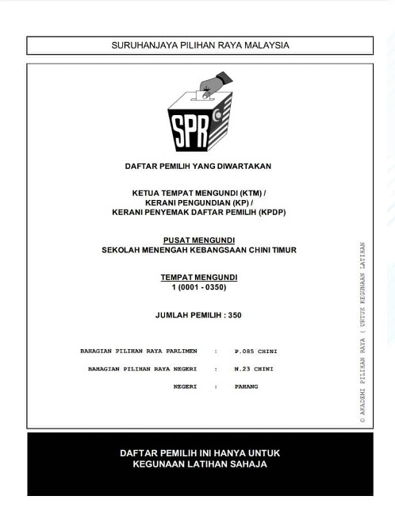

Before 8am: Check facilities
Facilities
Facilities enable Voter to mark ballot paper in secret: Check windows closed
No posters, symbols, wordings or pictures of any political party or candidate (except of King, Sultan or Governor)
PO and all clerks do not have any insignia, symbols or wordings of any political party or candidate
Position yourself so that you have good visibility of the PO’s desk, all 3 clerks, all polling booths, Ballot Box and the door
Not more than one PA per candidate (note: not party)
Electoral Roll
Compare Electoral Roll with PO’s copy
  Total voters in the Stream (350 in Stream 1, balance distributed equally among remaining streams)
  Same number of pages
  Check first & last name & voter number on each page plus any others at random
  Check your Electoral Roll is not marked other than Early/Postal Voting
Note against Voter name if informed that the Voter is absent & will not be voting (usually Station Master will inform you)

Slide 23
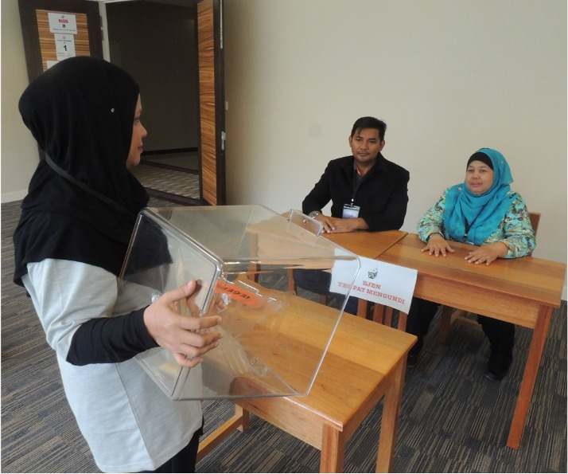
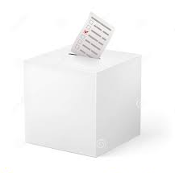
Before 8am: Check Ballot Papers
PO training to check before Polling Day
Ballot Papers
PO to count ballot books: ensure running number order, none missing, 50 to each book, clean & not defaced
  Ballot Papers must have number in top left hand corner with same number on counterfoil; & capable of being folded twice
  Non-complying Ballot Papers to be removed, stamped ‘Rejected’ & kept in separate envelope
PO to fill up Form 13 Part A. Check Ballot Papers details match Form 13 Part A. Copy the details into your empty Form 13
Ballot Box
Ballot Box must not enable Ballot Paper to be taken out except by unlocking
PO must show everyone present Ballot Box is empty
PO must lock Ballot Box & affix with mousetail & tape; Tape signed by PO & PA with permanent marker. Or stamp with party stamp. Take photo of Ballot Box if allowed
PO stamps on EC Form 753. Ask PO to stamp on your empty Form 753 & sign. If not, note the serial number of the stamp

Slide 24
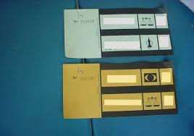
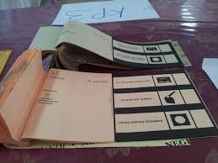
Ballot Books
Ballot books are like cheque books, 50 in each book
  Clerks required to count and check in earlier session
Ballot Papers are sequentially serialised, with serial number on top left hand corner and on counterfoil
Ballot Papers must be clean, with no markings or writing

Slide 25
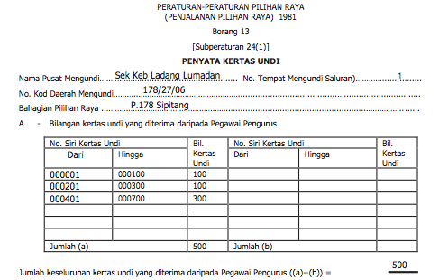
Before 8am: Form 13 Part A
PO fill in Form 13 Part A. Form 13 records total number of Ballot Papers issued for Polling by end of the day
Form 13 Part A is section of Form 13 which records total & serial number of Ballot Papers available to be issued that day
PO will not give copy to PA; ask for details to fill in your empty Form 13

Slide 26

Rubber Stamp Patterns
Note:
This serial number is unique to each Polling Stream and has no relationship with the Stream number
Rubber stamp is unique for each Stream and design changes with each election
Used to be selected at random in morning before Polling
Must not be known by anyone outside the Stream before close of Polling
If stamp is damaged, PO will sign on Form 753 and each Ballot Paper

Slide 27
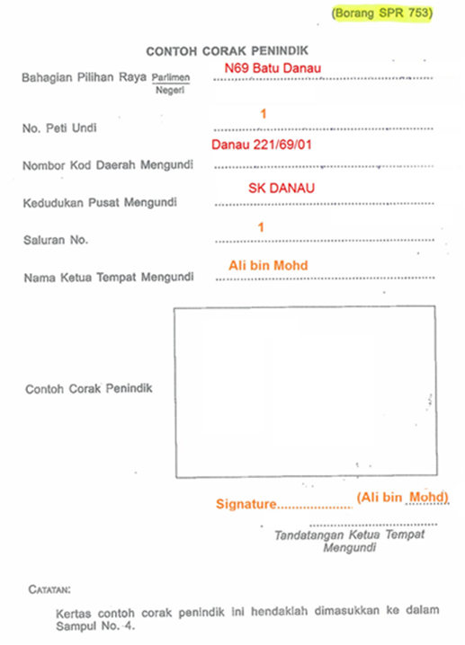
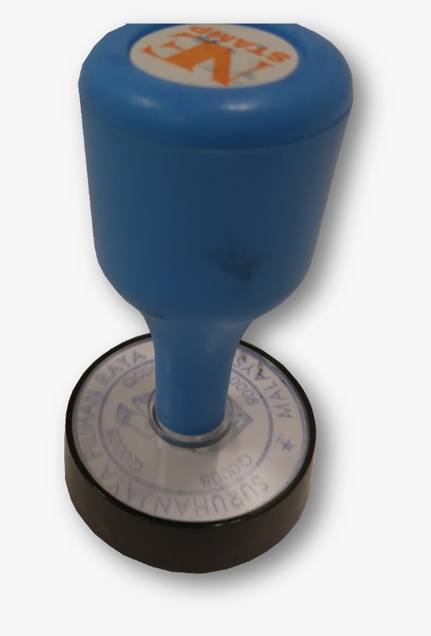
Form 753 Sample Official Mark
Ask Clerk to stamp on the empty Form 753 from your PACA Kit
If won’t stamp, just record down the serial number
  For CA to refer to during Counting to verify Ballot Papers are from this Stream
Do not communicate this serial number to anyone outside the Stream until after close of Polling
Note:
If PO refuses to allow a sample to be stamped on EC Form 753, ask to sight and record the serial number on the stamp for your Stream

Slide 28
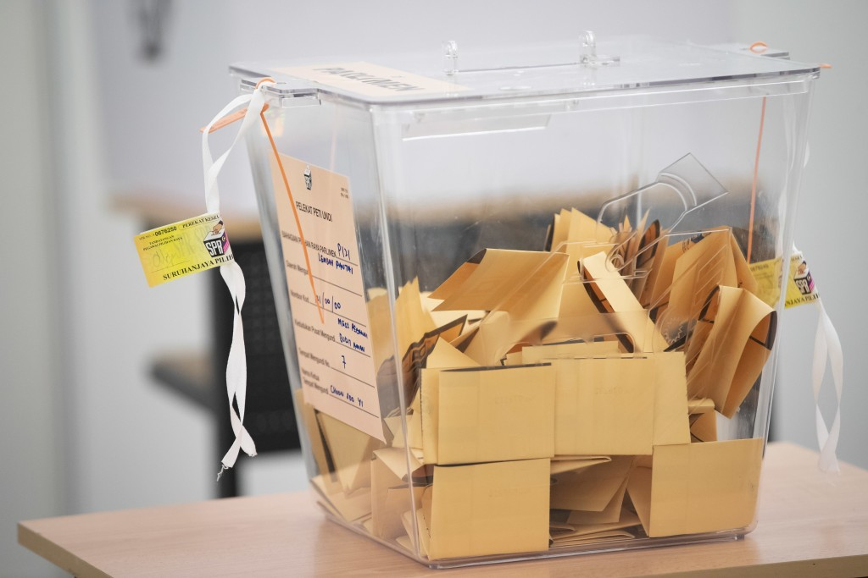
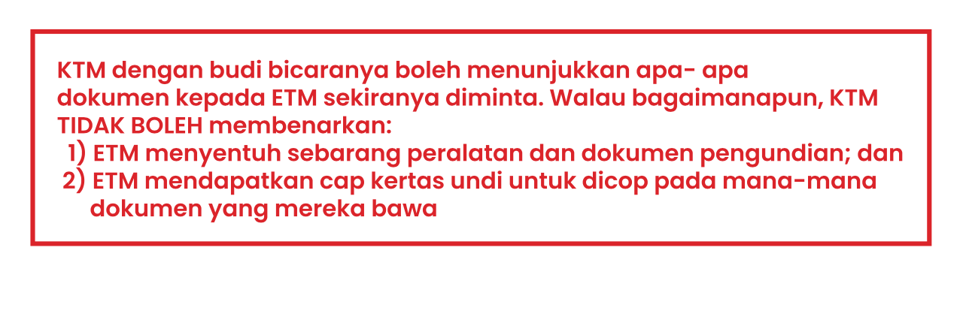
Ballot Box
PO will show Ballot Box is empty to anyone present and willing.
Box is locked at side by tie and sealed using EC seal
PO and PA sign on EC seal using ballpoint pen. You cannot touch Ballot Box
Page 37 PO Workbook

Slide 29

Before 8am: Potential Issues
PO will refuse to give your PA his Form 13
  PA to obtain info to fill in own copy
PO may refuse to stamp the Stream number for PA
  No issue, PA to take down the serial number
PO do not allow PA to sign Ballot Box seal
  Against the Regulations, Report to Station Master
PO may refuse to allow use of handphone
  Speak to the PO and explain that PA will only be texting but will not be calling
  If refused, ask that PA will message outside the room
  If still refused, send standby PACABA to Polling Stream every 30 or 60 minutes for messages
    If necessary, PA comes out of room to discuss
No data coverage or phones disallowed altogether
  Send standby PACABA to Stream every 30-60 minutes
  Send standby PACABA to place with coverage to text to Bilik Gerakan

Slide 30
What happens in Polling

Slide 31


Voting Flow in 2-door Polling Stream
Barung – Situated outside the Stream
1
2
3
EC Clerks
Police Officer
Enter
Ballot Boxes
EC Barung
4
Polling stream room
2 doors
2
Polling Agents
1
Polling Booths
Exit
Presiding Officer (PO)

Slide 32
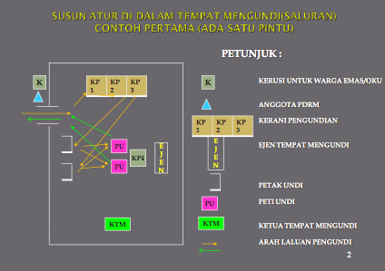
Arrangement of A Polling Stream
With 1 Door

Slide 33

Flow in the Polling Stream
Voter enters Polling Stream & goes to EC Clerk 1
EC Clerk 1
  Checks Voter’s hands, verify the Voter’s MyKad & make face identification
  Reads out Voter’s Serial number, MyKad number & name
EC Clerk 2
  Mark Voter’s left index finger with indelible ink
EC Clerk 3 Stamp Ballot Paper
  Stamps and tears Ballot Paper from ballot book
  Folds and hands Ballot Paper over to Voter
Voter
  Goes to Polling Booth to mark Ballot Paper
  Drops Ballot Paper into Ballot Box
  Voter leaves the Polling Stream

Slide 34
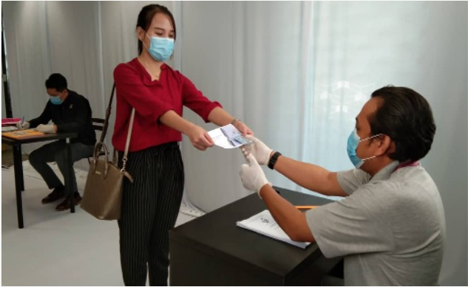
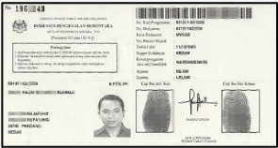
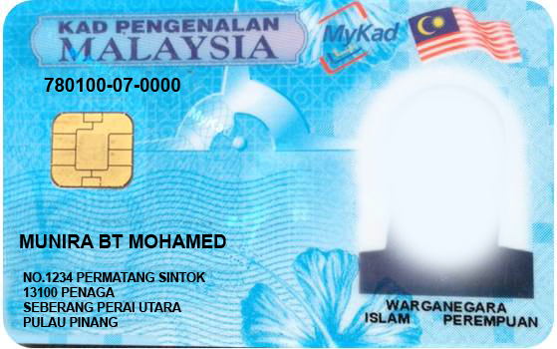
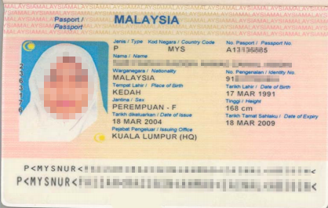
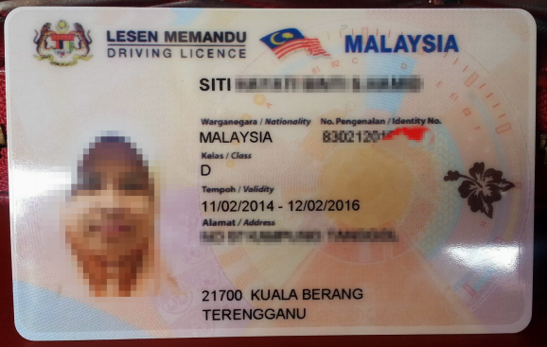
Identity Documents accepted by EC
Official document with name photo, MyKad number issued by authorised government department
MyKad or Police/Army Service Card
  Report receipt KPPK11 or Temporary IC KPPK09 certified by JPN
    KPPK11 do not carry photo
International passport
Driving license with photo
Department access card

Slide 35
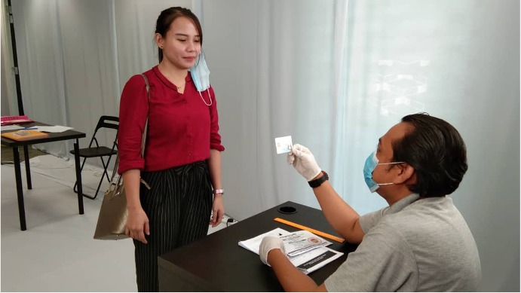
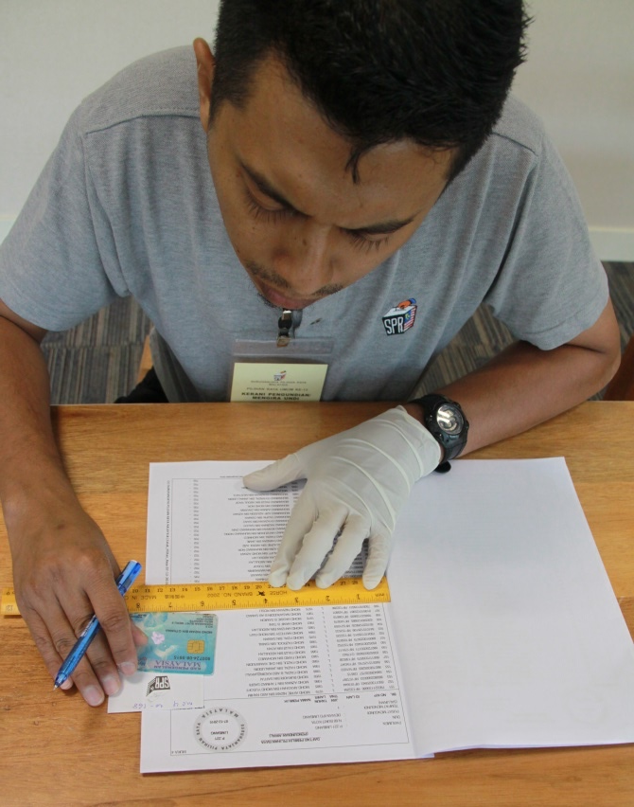
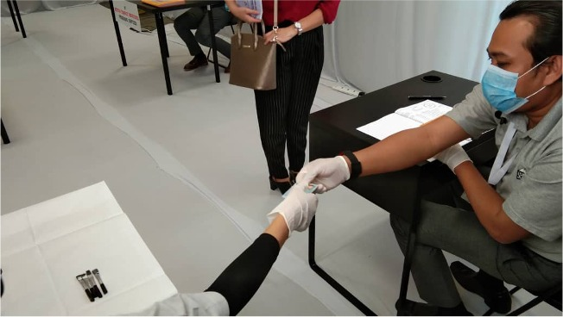
EC Clerk 1: Verifying Identity of Voter
EC Clerk 1 will
check Voter’s fingers not marked with ink
verify identity of Voter from Voter’s identity documents and MyKad name & number same as in Electoral Roll
  Must look at face of Voter
    Bring to attention of PO if not done
call out number, name of Voter & new (or old) MyKad number
  Name and MyKad number from Electoral Roll, not from MyKad
pass MyKad to Clerk 2 for second verification
mark off Voter’s name from Electoral Roll after Clerk 2 mark Voter’s finger
  May not write down Ballot Paper serial number against Electoral Roll

Slide 36
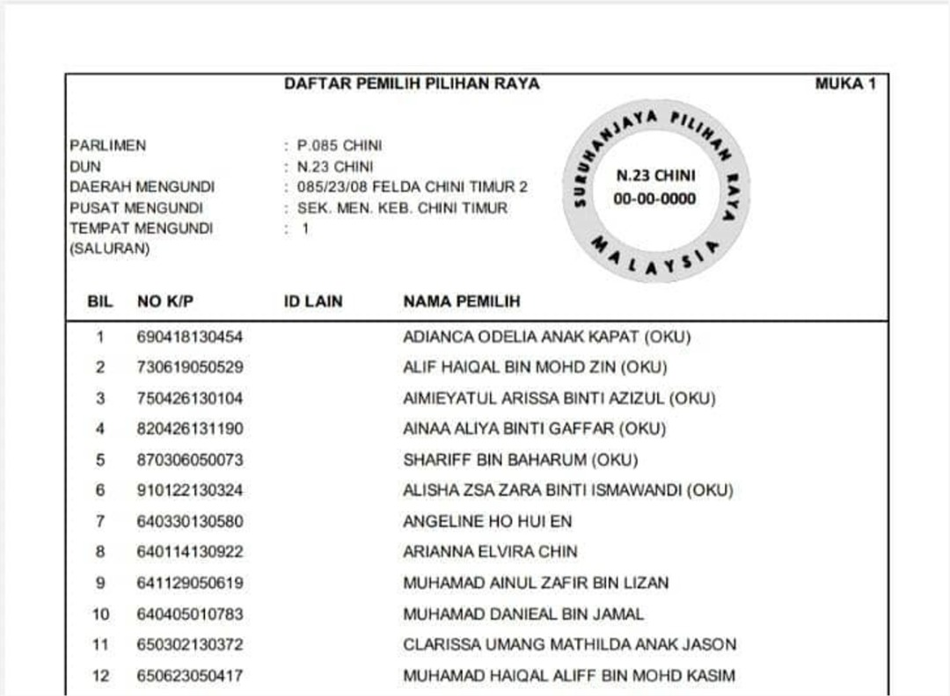
Electoral Roll
1
2
3
4
PP
Notes:
Sample of a voter roll.

Slide 37
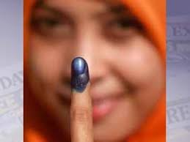
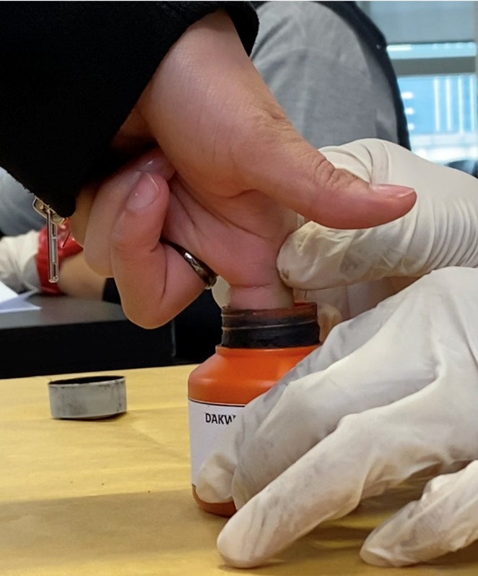
EC Clerk 2: Using Indelible Ink
EC Clerk 2 will check Voter’s left forefinger for any previous marking
If none, Voter’s left forefinger will be dipped into ink until first joint
  Use other fingers on left hand if Voter do not have left forefinger
  If none, use fingers on right hand
  Brush used only if Voter has no arms
Ballot Paper is issued by EC Clerk 3 and name marked off by EC Clerk 1 AFTER finger is marked
No marking of finger = No issue of Ballot Paper

Slide 38
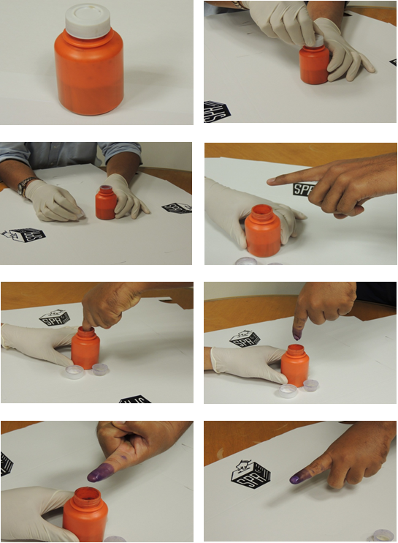

Finger Marking with Indelible Ink
2
4
1
5
3
KIRI
KANAN

Slide 39
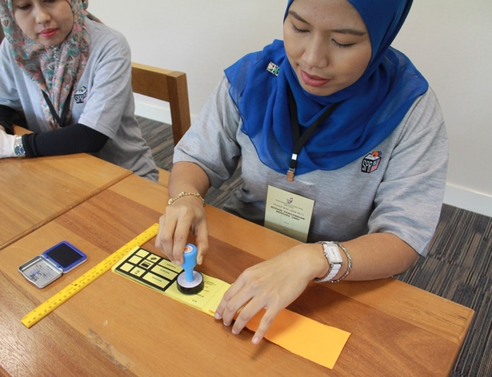
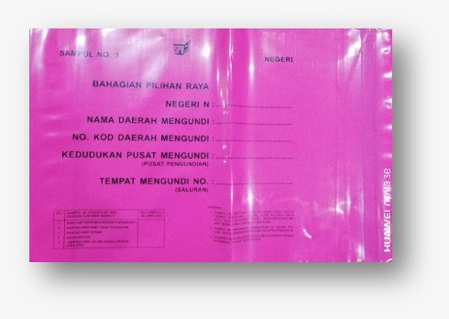
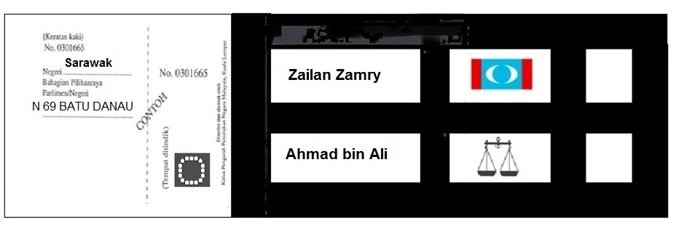

EC Clerk 3: Issue Ballot Paper
EC Clerk 3 will
  Stamp Ballot Paper and counterfoil with Stamp of Stream, consistently in the same position and orientation
Ballot Paper must be free of any notation or marking
If Ballot Paper is torn or smudged or incorrectly marked, Voter may request a replacement Ballot Paper
  PO may issue new one if satisfied not on purpose
  Damaged Ballot Paper will be cancelled, recorded and kept in envelope
EC Clerk 3 will tear here
Rubber stamp made by EC Clerk 3 before handing Ballot Paper to voter

Slide 40
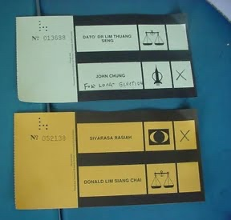
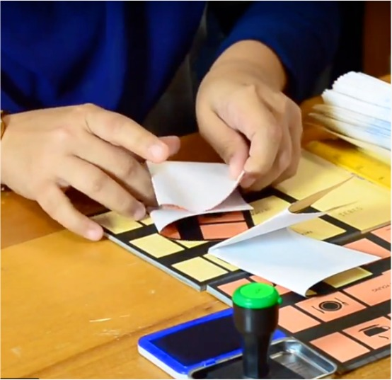
Ballot Papers
N
P
Voter will be issued TWO ballot papers in simultaneous elections:
  1 Ballot Paper for Parliament (MP)
  1 Ballot Paper for State Assembly (ADUN)
Voters in Kuala Lumpur, Labuan, Putrajaya will receive ONLY ONE Ballot Paper for Parliament as there are NO state seat in FTs
Voters in Sabah, Sarawak and states where DUNs not dissolved also get only one Ballot Paper
Notes:
Sarawak just had their State Election in April this year.

Slide 41
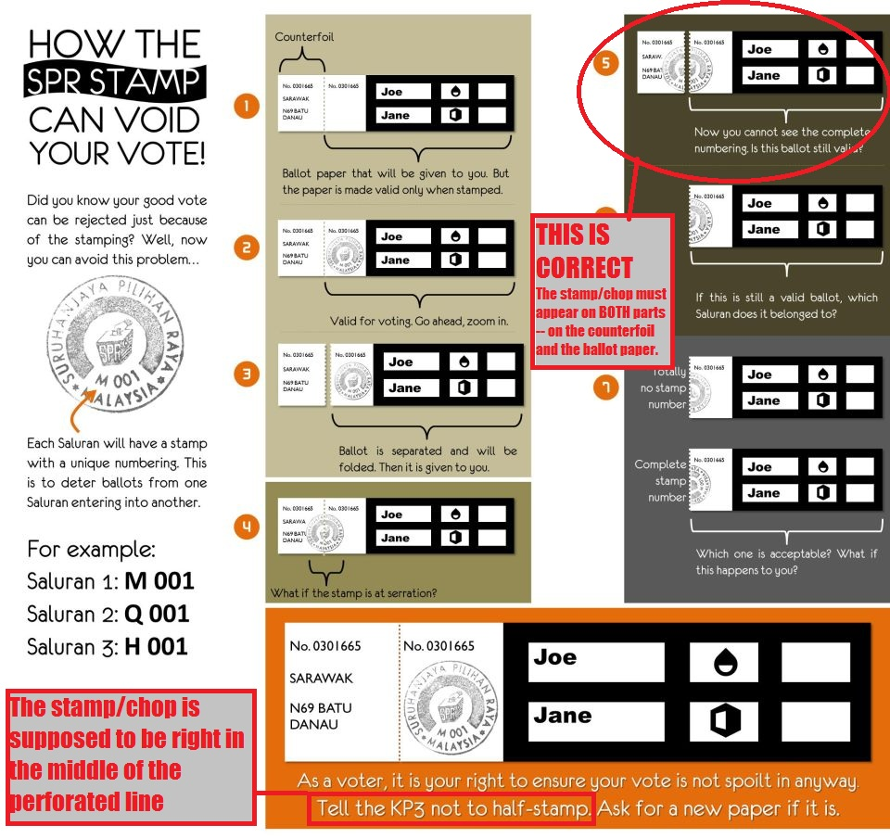
Stamping Ballot Paper
Rubber stamp should be stamped
printed neatly and wholly
in the middle under serial number
consistently positioned in the Stream

Slide 42
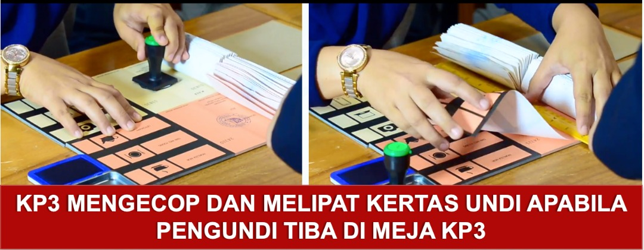
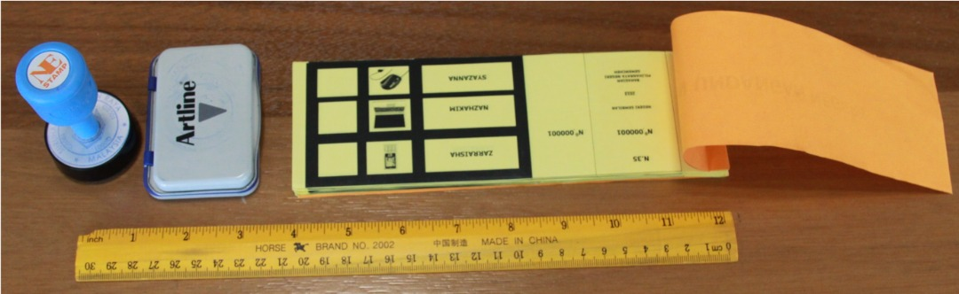
Issues regarding Ballot Papers
  Writing stationery
  Clerk 3 may not write on Ballot Paper or Counterfoil or inform Clerk 1 of serial number
    Clerk 3 must not have any pen or pencil
    Clerks should not talk to each other unless can be heard by all
  Stamping one book
Do not allow multiple stamping to avoid multiple Ballot Papers issued
  But may be hard to control as may wish to expedite polling
  Do not allow any unused but stamped Ballot Papers at close of Polling
  Stamped Ballot Papers to be cancelled immediately

Slide 43
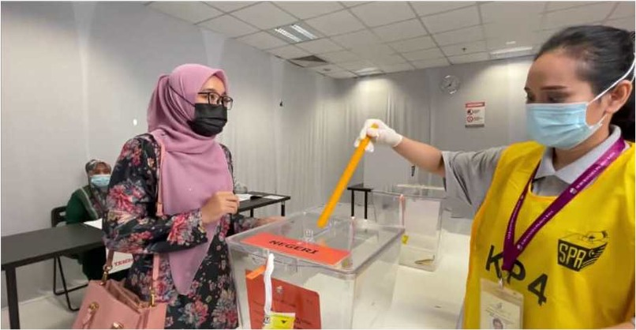
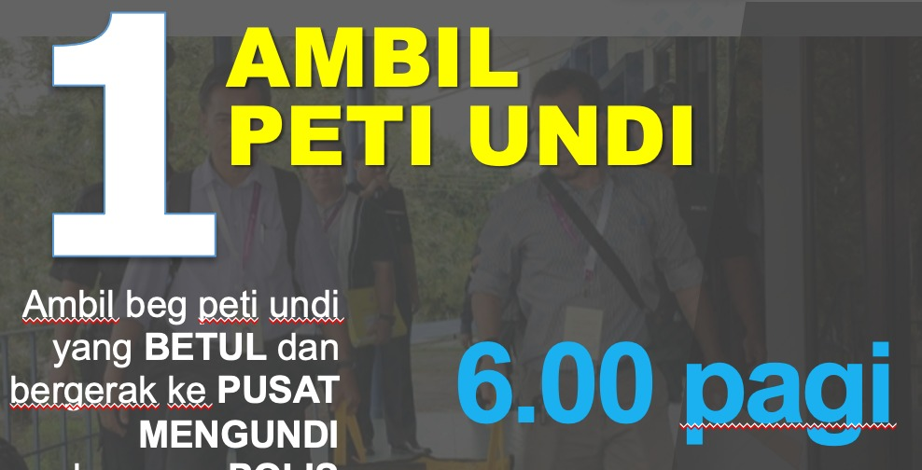
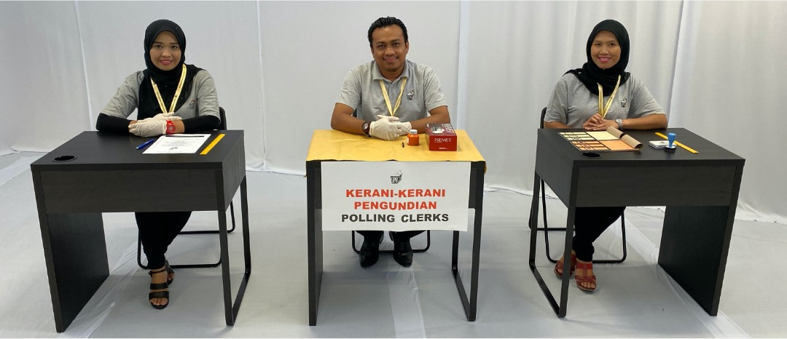
Variation to Roles
Stream should have 4 EC Clerks: EC Clerk 4’s role is to push Ballot Paper into Ballot Box, usually with a ruler
Stream may sometimes have only 2 EC Clerks: Tasks of EC Clerk 2 and 3 will be combined
  Only EC Clerk 1 may have stationery; EC Clerks 2 and 3 will not have stationery
If there is a heavy queue, EC Clerk 2 may assist EC Clerk 1, creating two queues
Roles may rotate during the day, usually during lunch
  Have sympathy, EC officers have no roster or relief

Slide 44

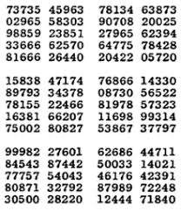
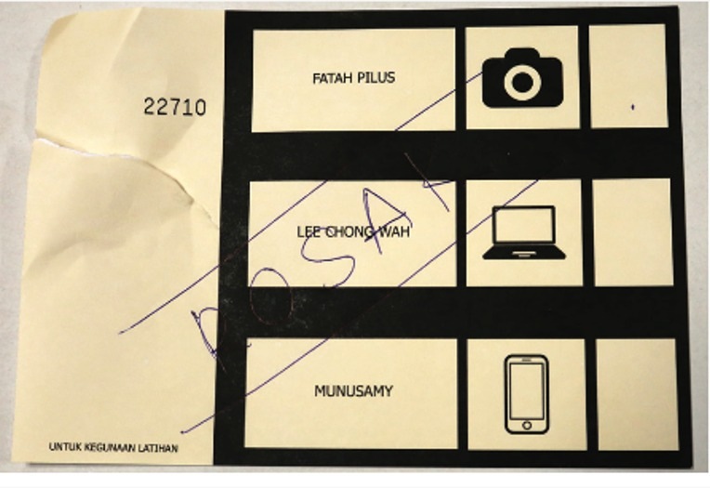
Non-issues regarding Voting process
PA verifying identity
PA will be unable to verify identity or ink markings, only Clerks can
PA only asks to participate in verification if suspicious
  On request, not as a process
Randomising Ballot Papers
Normally not necessary
  It is unlikely PO agrees as it messes up Form 13
Beware of other ‘advisories’ from social media
Dirty/Damaged Ballot Papers
PO may replace Ballot Papers only once for each Voter
  Concerns over sufficiency
Assist to allay Voter’s concern that the vote will not be counted
Lost Ballot Papers
Any Ballot Papers left behind will be recorded in Form 763 with any other incidents
Ballot Paper will be kept in Damaged Ballot envelope
  Request PO to cancel Ballot Paper

Slide 45
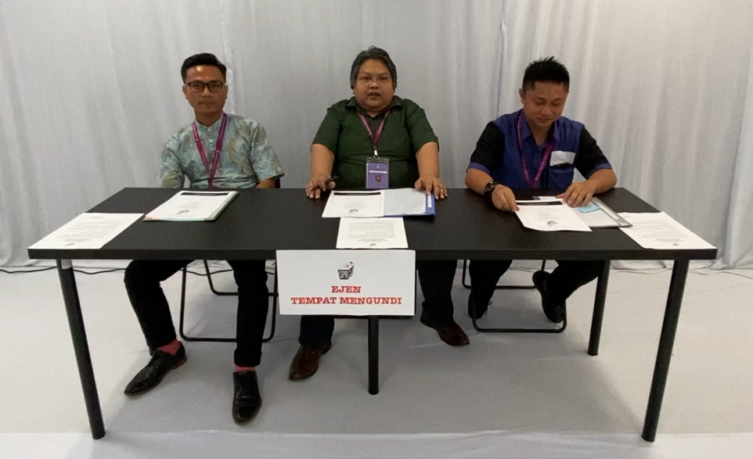

The Other PAs
Make friends with other PAs
  They may not be party supporters
  They can back up for you during toilet breaks
But watch out if they write down Voter number in sequence of arrival
If they communicate or bring out Voter numbers, inform PO
  Violates s5(2) at back of Secrecy Oath

Slide 46


Voter turnout
Keep track of hourly Voter turnout
  Keep your own count and agree with number of Voters cancelled off your Electoral Roll
PO will keep track using Form 720 or app
  PO will inform EC or RO of hourly turnout or instruct police officer to do so
  Agree your count with PO Form 720 regularly
Report the cumulative turnout to Your Station Master every hour, if requested
Final voter turnout on Form 720 should agree with Form 13

Slide 47

Form 10A
To be issued by PO where Ballot Paper is refused
  Voter refused to show finger
  Voter’s finger already marked
  Voter refused to allow finger to be marked
  Voter’s name on Electoral Roll already marked
  Also, if Voter not on Electoral Roll, no adequate identification or name/MyKad differs from Electoral Roll
PO to fill in Form 10A in presence of witness
  Usually, the PA

Slide 48


Handicapped/Blind Voters
Principle: Only Voter can be alone at polling booth
‘Handicapped’ for this purpose means only those physically not able to vote by themselves
  Deaf Voters are not Handicapped for this purpose
Only Assistant nominated by Voter, who can be with Voter behind polling booth screen.
Nominated Assistant must be citizen and above 21 years old. Assistant signs Form 10 in presence of PO. Copy given to PA
If no person is nominated by Voter, PO is authorised to mark Ballot Paper
  PA try to hear Voter’s instructions and ensure PO mark accordingly
  or offer to be assistant

Slide 49

Form 10
Declaration of helper for Handicapped/Blind Voter
Signed by Assistant
  Prepared by PO
  Copy to PA
Voter must be present
Assistant must be
  Malaysian
  Over age of 21
Notes:
This Borang 10 can also be used in case of “wrong sex” in the Electoral Roll of the Voter.

Slide 50

Doubtful Identity
If identity of Voter is doubtful, PO can fill in Form 11
  Copy given to PA
  PA can request, but final decision lies with PO
  If PO refuse, objection or just take note
Examples given
  Voter refuse to remove veil
  Name change due to change of religion
  Change of physical appearance due to surgery
Other examples to try
  Unsure of ink mark on finger
  Unsure of citizenship
Gazetted Electoral Roll is prima facie evidence of the Voters’ right to a Ballot Paper and cannot be objected to on Election Day

Slide 51
Form 11
Declaration of identity by Voter
That the Voter is a bona fide Voter who is entitled to a Ballot Paper
Official Oath
  Falsifiers can be jailed
Filled in by PO
  Signed by Voter
  Copy to PA

Slide 52



Voters voting at another Stream
Covid infected Voters
Form 765
(To allow handicapped Voter to vote in lower floors stream)
PO & PA upstairs informed of handicapped Voter downstairs
Ballot Paper in Special Envelope brought to Voter downstairs after upstairs PO come down for verification
Voter signs Form 11 downstairs witnessed by upstairs PO and downstairs PA , Clerk downstairs mark ink & Voter mark Ballot Paper
PO brings marked Ballot Papers upstairs in envelope to be opened in front of PA and placed in Ballot Box after Clerk 1 verify and call out name/etc
PA signs Form 765 to witness
Form 717
(No longer used but provision still in Regulations)
Staff on duty on Elections Day before use of Early & Postal Voting can vote at the Polling Centre where they are on duty with authorisation from RO

Slide 53

At the Polling Booth where Voters cast their Votes in silence
Be careful if
Window is open
Voter take too long behind screen
Photo taken
PO assisting behind screen
  Especially if PO is too helpful

Slide 54










Prohibitions in the Polling Stream
No display of political party logo
No smoking
No weapons
No talking to Voters
No arguments with authorities
No touching of Ballot Papers or any polling equipment
No use of mobile phones or electronic devices
No disturbing or disrupting the voting process
PO has the right to remove any PA who does not follow instructions

Slide 55

Role of Polling Agent
Ensure all above processes are followed
Ensure secrecy provision are followed by all EC Officers, other PAs and anyone who may come into Polling Stream
Mark off name of Voter in own Electoral Roll, called out by EC Clerk 1
Collect all Forms 10, and 11; Note receipt of Form 10A
If any infringement noticed
  Hand up to talk to PO and raise objection politely
  PO decision final; If not satisfied with PO decision, may
    Issue Letter of Objection, with copy retained. Inform Station Master
    Note down and inform incoming PA/CA and Station Master
Do not be hindrance to voting process
  If you are not present, voting process will continue without you

Slide 56


Shift timing
Depends on availability of PACABAs, shifts may be 2-6 hours long
Polling is normally 8am to 6pm unless reduced hours have been gazetted
  Otherwise PO may close early with permission from RO if all Voters in the Electoral Roll have voted
Each shift by any one PA is for a minimum of 2 hours
  If a PA leaves before 2 hours, PO may not allow replacement
    Ask if you wish to go to toilet: Usually allowed
  PO may misunderstand and ask PO to leave at 2 hours
    You may need to explain to PO

Slide 57


PO Slide – 2 hour rule
PO often misunderstand the two hour rule to mean maximum 2 hours
Refer PO to
  Sec 14 (1A) Election Offenses Act
  Slide 95 PO Training Deck 1
If still misunderstood, inform Station Master immediately

Slide 58

Handover at end of shift
Do not leave until your replacement by another PA or the CA (if the last shift)
  Handover the PACA Kit to your replacement
  Brief replacement on key issues to watch out for
If coming back for subsequent shift or as CA, inform PO as he is holding your Appointment Form & Secrecy Oath
  If returning as CA, you need a new Appointment Form
Backup your replacement by staying outside the Polling Stream until your replacement fully settles in

Slide 59

Electoral procedures in age of Covid
Polling Stream limited to 600 voters each, not 700
Only 2 Election Officers and 2 observers in each Polling Stream may be present to inspect Ballot Boxes before Election Day
Voting cards sent to Voters with information of voting place etc. and voting time 8-10am, 10am-noon, noon-2pm, 2-5.30m
PUI/PUS require approval from District Health Officer to vote
Over 60s and disabled Voters vote in Polling Stream 1 with separate screening station
Sanitiser and disposable gloves provided after dipping finger in ink but before being given Ballot Paper. Voters’ disposable gloves disposed after voting
Only two observers allowed in Tallying Centre

Slide 60

Hygiene procedures in age of Covid
Sanitisation every 2 hours
Clinical wastes kept separately for separate disposal
Social distance is 2m between tables and 1m between individuals
Unhealthy defined as temperature over 37.5º, having cough or cold
Unhealthy voters taken to vote in separate place with officers in PPE. Polling booths and wheelchairs sanitized after every use by unhealthy voter
Masks and gloves compulsory for all officers
Sanitisers compulsory at screening stations, entrance to Polling Streams and exit from Polling Centre

Slide 61
Close of Polling

Slide 62


Timing of Close of Polling
Polling closes 6pm sharp
Normally, those already issued Ballot Papers will be allowed to proceed to close
  Depending on the PO, ‘Issued’ could include those queuing outside the Stream
  If PO intends to extend opening hours due to long queues and slow process not within his control, inform your Station Master
PO to inform PA when Counting will start
  Ask whether consecutive or concurrent
  Inform your Station Master

Slide 63


Procedures Close of Polling
Ask PO to cancel any Ballot Papers stamped but not issued to Voter
Add up your final count of total voter turnout and compare with PO’s Form 720
  Your count is from total number of names cancelled in the Electoral Roll, excluding Postal Voting
  If PO’s count significantly exceed PAs, alert Station Master
    If all Streams report excess, report to EA immediately
PO will
secure opening of Ballot Box and affix with tape
  Tape to be signed by PO and PA on tape & on Ballot Box; take photo if allowed
  Check that morning seals are still intact
complete Form 13
keep unused Ballot Papers, cancelled Ballot Papers, Counterfoils of used Ballot Papers and marked Electoral Roll in single packet
  Affixed with tape, signed by PO & PA

Slide 64

Form 13
PO will determine
  No of Ballot Papers issued
  No of Ballot Papers unused
  No of Ballot Papers cancelled
  This should determine the number of Ballot Papers that has been cast into Ballot Box
  Compare with Voter turnout in Form 720
PO will fill in and sign Form 13
  PA will sign Form 13
  PO will not give a copy: PA to copy onto empty Form 13 in PACA Kit before signing PO’s copy

Slide 65

Form 13
Form 13 Part A already filled in before start of Polling
Form 13 completed at end of Polling
  Signed by PO & all PAs
  Form 13 will NOT be given to PA
  Copy all details onto your own empty Form 13 before signing PO’s Form 13
Report Form 13 details to Station Master

Slide 66

PO Slide – Form 13
PO are trained not to give PA a copy of Form 13 or sign PA’s copy
PO may misunderstand directive & refuse PA to copy or even see Form 13
Refer PO to
  Slide 68 PO training Deck 2
If still misunderstood, inform Station Master immediately

Slide 67
What happens to your Forms?
White Appointment Form
Inserted into Package 5 into EC Bag
Red Secrecy Oath
Will not be retained except that of last PA who is not also CA

Slide 68
Safeguard the Ballot Box
AT ALL TIMES, keep Ballot Box in view, either by yourself or by other PACA assisting you
You may be asked to leave the room while furniture is rearranged into a Counting Room
  Stay in the room if possible
  If have to leave, ensure windows and doors open
PO may close the room to go for prayers or dinner
  Ensure only PO has the key but keep windows open

Slide 69


Reduced Polling hours
In the interior, villages are grouped into clusters of villages (or longhouses into a village) and one of the villages (or longhouse) will be the Polling Stream
If the number of voters is not numerous, polling hours may be reduced. The reduced polling hours must be gazetted in the Election Gazette
Although not mandated by the Regulations, try to persuade the PO not to count the votes until after 5pm
  If you succeed, observe the Ballot Box until Counting time
  If you fail, try to delay announcement of the results until after 5pm

Slide 70


Moving Ballot Boxes
If PO is responsible for more than one venue (may not be a separate stream), a single Ballot Box will move from one venue to the next
  At first location, Ballot Box will be sealed before move
  At new location, Ballot Box will be unsealed before Polling
  New Form 13 will be filled in, superseding earlier Form 13
PO to inform PA where Counting will take place
Counting will take place as if one single Form 13 and one Ballot Box all along
There must be a PACA team in each location
  First team to sign on seal with 4-digit code and/or rubber stamp, inform second team and take a photo if permitted, before Ballot Box is moved
  Second team checks 4-digit code and/or stamp and take photo before the seal is removed

Slide 71

Polling: Potential Issues
Other PA note Voter number in chronological order or list bring out of room or text Voter numbers
  Inform PO and Station Master
PO asks PA to be replaced every two hours
  Regulations is minimum two hours, not maximum
    Sec 14 (1A) Election Offenses Act
Other party’s material within 50m of Polling Centre
  Prohibited under Sec24B(7) Elections Offenses Act
  Take photo and inform Station Officer
PO do not give any copy of Form 13
  PA to copy all details to own Form 13 before signing the PO’s Form 13

Slide 72

Any Questions
Slides are at https://www.jimkhong.com/jim-the-polling-agent

