Slide 1
Election Agents Training
Roles and procedures for Election Agents to support Election Candidates

Slide 2
What we will cover today
Role of Election Agent
Role of PACABAs
What’s a PACABA Coordinator
When is election?
PACA Planning
Strategy; Electoral Rolls
Election Campaign & Day
Potential issues are marked in red

Slide 3
Role Of Election Agent

Slide 4
What’s an Election Agent?

Slide 5
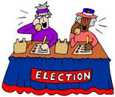
The Candidate’s team
Campaign Manager
Candidate
Election Agent
Mandated to represent Candidate to EC
Help run Election for Candidate
PACABA Coordinator
Administer recruitment, assignment, training & logistics for PACABA

Slide 6
Breaking down the Constituency
Constituency – Parliament & State
School; Village; Housing Estate
Polling Centre (Pusat Mengundi)
Classroom; Hall; Longhouse
Polling Stream (Saluran Mengundi)
Mukim, Town & surroundings
Polling District (Daerah Mengundi)

Slide 7
Who’s Who on Election Day
Constituency
Returning Officer (‘RO’)
+ 4 Asst ROs
Presiding Officer 1
(Coordination Role)
Polling Centre Officer
Presiding Officer (Ketua Tempat Mengundi = ‘KTM’)
Election Agent
PACABA Coordinator
Station Master (Ketua PACABA)
Polling Agent (‘PA’)
Counting Agent (‘CA’)
Centre
Stream=Saluran

Slide 8
What an Election Agent do?
Name given to Election Commission on Nomination Day. The Election Agent and the Candidate are the only persons
the EC is required to communicate with
Likely the EA because EC knows Candidate is not available during Campaign period
Includes receiving and resolving any issues raised by EC during Campaign period
Includes sending and receiving documents to EC
who can enter any Polling Stream on Election Day
Head of PACABA team
Sets general direction and strategy on behalf of Candidate
Administrative work done by Coordinators team headed by PACABA Coordinator

Slide 9
Who will make a good Election Agent
Good relationship building skills with EC
Relate Candidate’s strategy and intentions to developments on the ground
Conscientious and organised
Track administrative items

Slide 10
Dual roles to avoid
Not recommended to take on these roles
Campaign Manager
need to be available for EC
PACABA Coordinator
need to take bigger picture view
PACABA
cannot be stuck in Polling Stream
If trusted by Candidate, can double up as
Campaign accountant
Any other backroom role

Slide 11
Legal Responsibilities

Slide 12
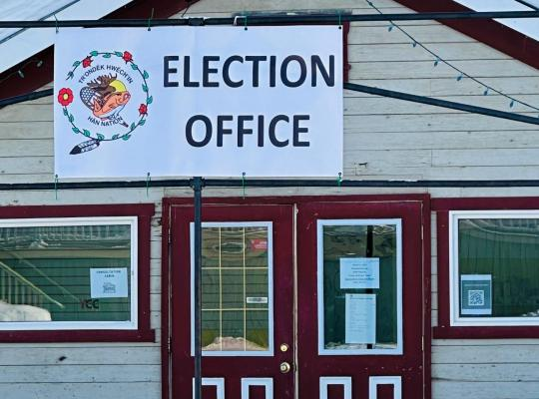
Appointment as an Election Agent
Form 716: Name and Address to be given to Returning Officer on or before Nomination Day.
Address within Constituency to send any notice, claims, documents, etc
Details published in notice outside RO Office
Candidate can change EA by writing
If no names given, Candidate is EA

Slide 13
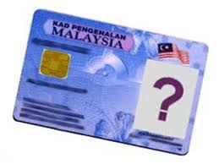
Who can be an Election Agent
Waiting for the change
Malaysian citizen
21 years and above
Not charged in Court for any criminal offense in the last 5 years
Traffic offenses excluded
Not a discharged prisoner within the last 5 years under Elections Offenses Act
Not registered under Prevention of Crime Act
Not an undischarged bankrupt

Slide 14
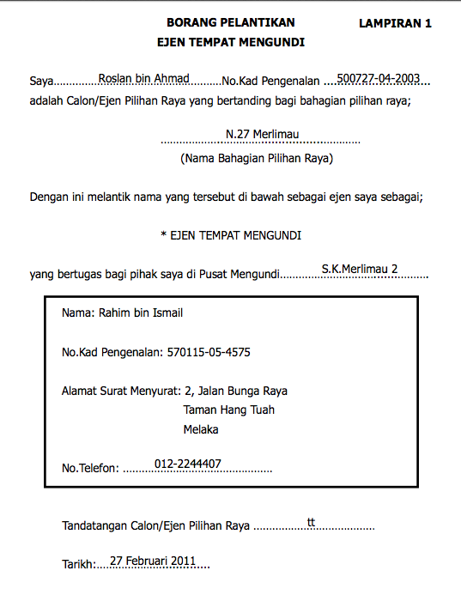
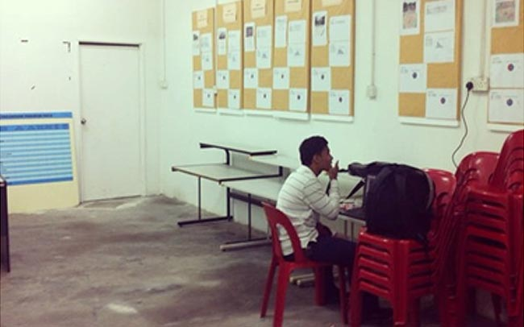
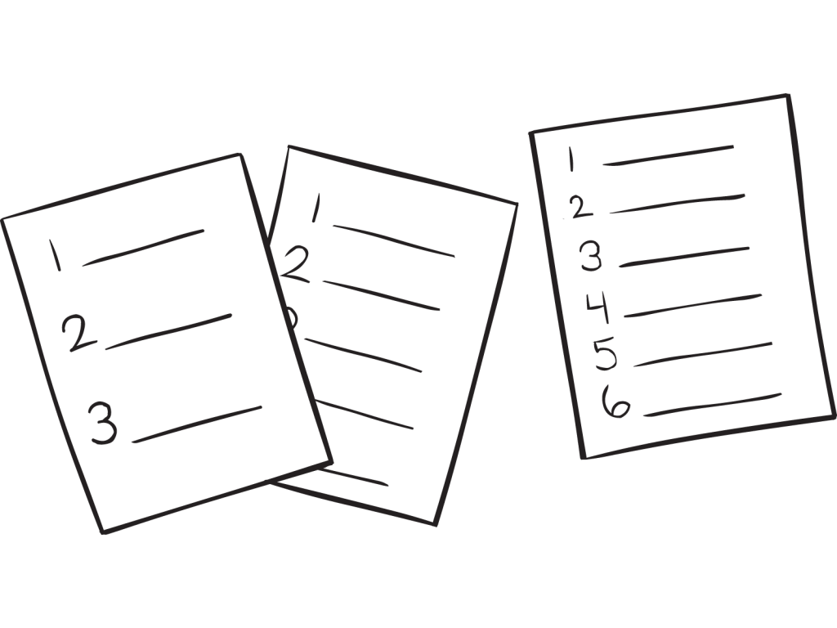
Responsibilities
Responsibilities set out in Part IV Election Offenses Act 1954
EA responsibility to
Appoint every PA and CA
Hire every Bilik Gerakan
Provide PACA list to every PO

Slide 15
Expenses
Deadline for submission of expenses claim to EA: 14 days after Election results gazetted
Deadline for payment of expenses claim by EA: 28 days after Election results gazetted
All payments for election expenses made via EA
Donation/income/etc for election can only be paid to Candidate or EA

Slide 16
Limits on Expenses
Prohibited Expenses
Transportation of Voters to Polling
Include paid/unpaid use of anyone’s transport hire vehicle, except by Voter
Rental of Voter’s property
Limit for Election Expenses
Federal RM200k
State RM100k
Hard to enforce

Slide 17
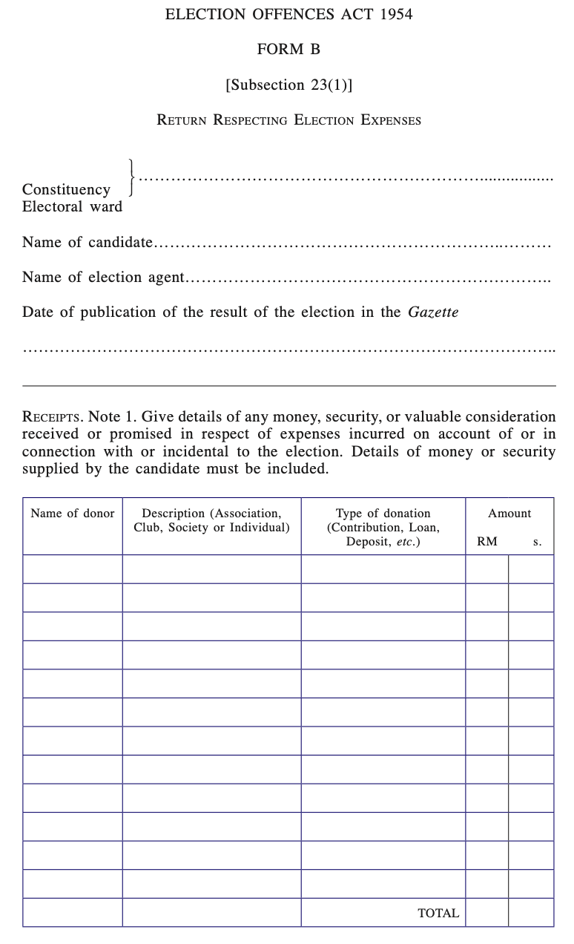
Accounts
Accounts to be submitted to State Elections Director within 31 days after Election results gazetted
Format in Form B of First Schedule EOA
Together with Forms C & D attested as Oaths by Candidate and EA
Include
Disputed & Unpaid amounts
Amounts paid by anyone else
Accounts will be available for inspection at State EC Office
Penalties for non-submission
Cannot sit & vote in Assembly
Disqualification as candidate

Slide 18
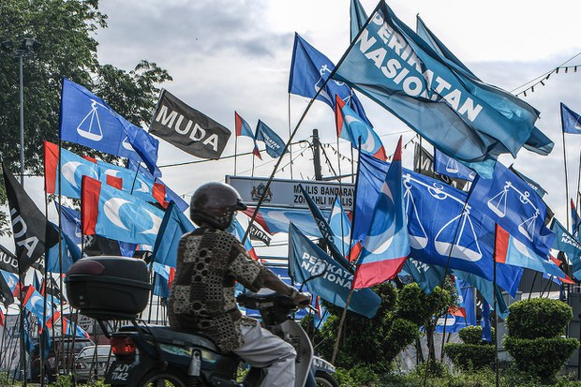
Campaign material
Campaign material requires approval from State Elections Director
Deposit must be paid
Cannot be less than 50m from Polling Centre
Election rallies require permit from district police
Rallies & public address prohibited on Election Day
No canvassing within 50m of Polling Centre
Must be removed within 14 days of Election Day
If not removed
Deposit forfeited
Cost of removal paid from deposit/Candidate

Slide 19
Enforcement Team
Constituency Enforcement Team
Election Enforcement Officer
Police representative
Local council representative
One representative appointed by each Candidate/EA on Nomination Day
Team is for Parliamentary Constituency, including State Elections
Responsibilities
Patrol & monitor Constituency
Bring down non-complying material
Stop non-complying rally/ public address
If no consensus, Enforcement Office decide after advice from State Election Director

Slide 20
Election Petition

Slide 21
Bringing an Election Petition
Who can bring a Petition
Voter or anyone claiming to have right to vote
Candidate or anyone claiming to have right to be candidate
What is asked for
That the Election is void
That the winning candidate did not win
Scrutiny of the votes
Only Court can reopen Box
How to file a Petition
Filed at High Court within 21 days of results being gazetted
Require details (eg., list of votes) but not actual evidence
28 days if corrupt practice
Require deposit for costs
When will Petition be completed
Entire trial process must be completed within 6 months
Including appeal
Ballot Box and Ballot Papers, etc will be disposed off 6 months after results gazeted

Slide 22
Basis for Petitions
Five grounds given in EOA s32
general bribery, general treating or general intimidation have so extensively prevailed that they may be reasonably supposed to have affected the result of the election;
non-compliance with the provisions of any written law;
a corrupt practice or illegal practice was committed
and e) to do with qualifications
Irregularity must exceed the majority
Important
Keep detailed records of irregularities
Only one corrupt/illegal act required

Slide 23
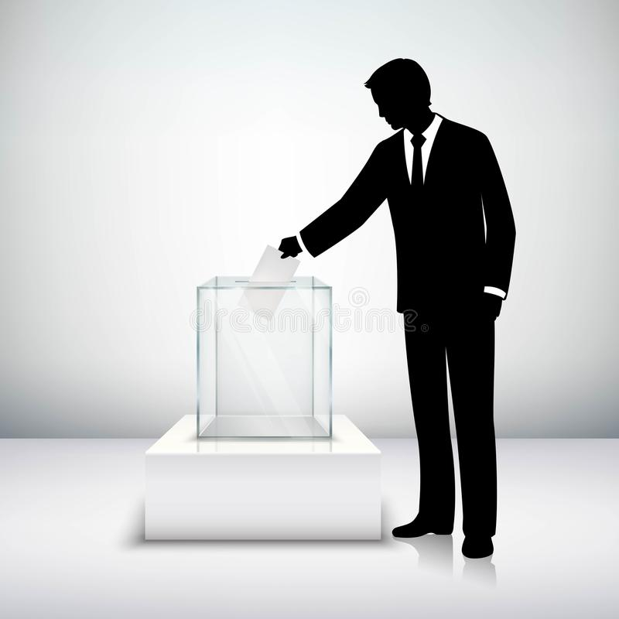
Successful petitions
Only three Election Petitions have been successful
Flawed Electoral Roll
Likas GE10
EC certified electoral roll despite objections
Law changed after this case to disallow courts from reviewing electoral rolls
Irregularities with payments
Cameron GE14
Evidence that Orang Asli voters were bribed by BN P & N candidates
Court ruled no need to prove how voters voted
Nomination papers rejected
Rantau GE14
PH candidate not given an EC tag to enter Nomination Centre, so unable to file papers
Court ruled no law requiring EC pass

Slide 24
Role Of PACABAs

Slide 25
Election Agent is head of PACA team
Provide strategic direction
Represent Candidate to team
Specific instructions for Election Day
Communication channel with RO/ARO
Issues
Complaints

Slide 26
Basic Principle
Campaign go to places with no votes to get votes
PACAs go to places with votes to defend the votes

Slide 27
What a Polling and Counting Agent is
An agent of Candidate
Act of agent is act of candidate
Interest of candidate is interest of agent
PACAs are not independent
Two separate roles – PA and CA
Observe Polling and Counting process
Not part of Election process
No veto

Slide 28
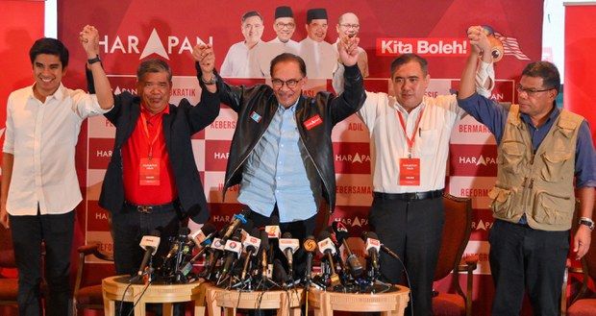
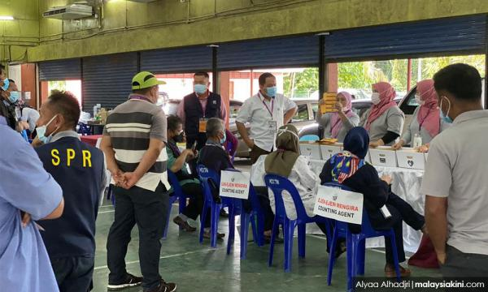
Objectives of a good PACA force
Ultimate objective is to help Candidate win
Defend votes Campaign has won
Defend Ballot Boxes with more of your votes
Ensure you don’t get cheated of your votes
Follow EC procedures
Legal but disadvantaging
Fight for votes at counting
Protect supporters
Mobilise members and supporters
Remain on most advantageous Electoral Roll
Protect integrity of Electoral Roll
Extension of Candidate presence on Election Day
Important but only a small part of the big picture

Slide 29
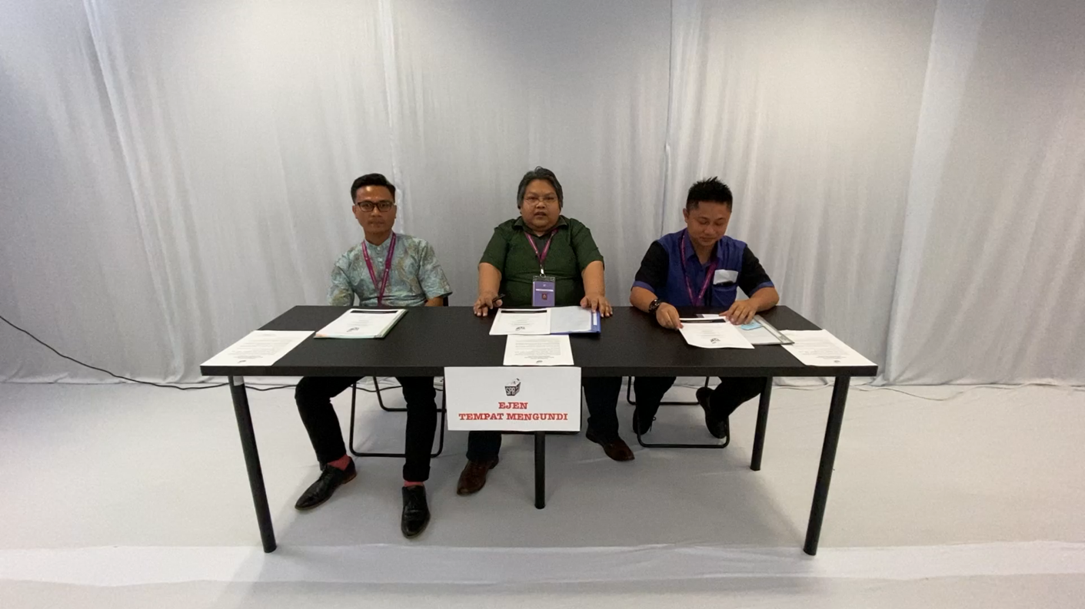
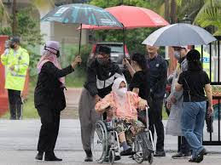
What good PACAs are trained to do
EC Procedures
Managing EC personnel
Identify disadvantageous or fraudulent situations
Fight for votes
Identify own supporters
Reassure and support supporters
Maintain party and supporters morale

Slide 30
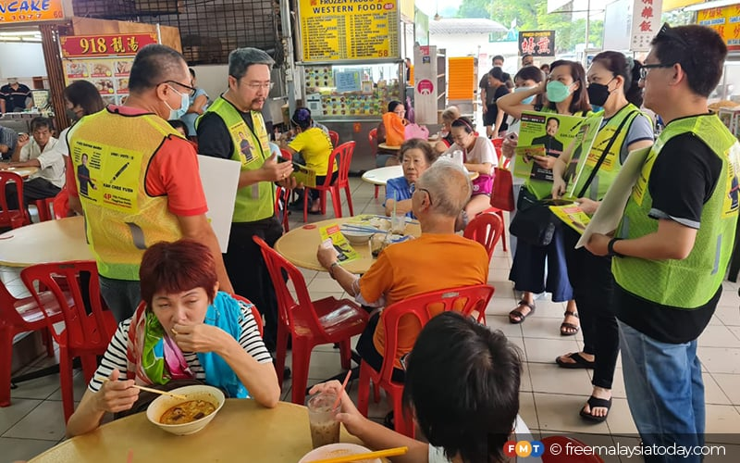
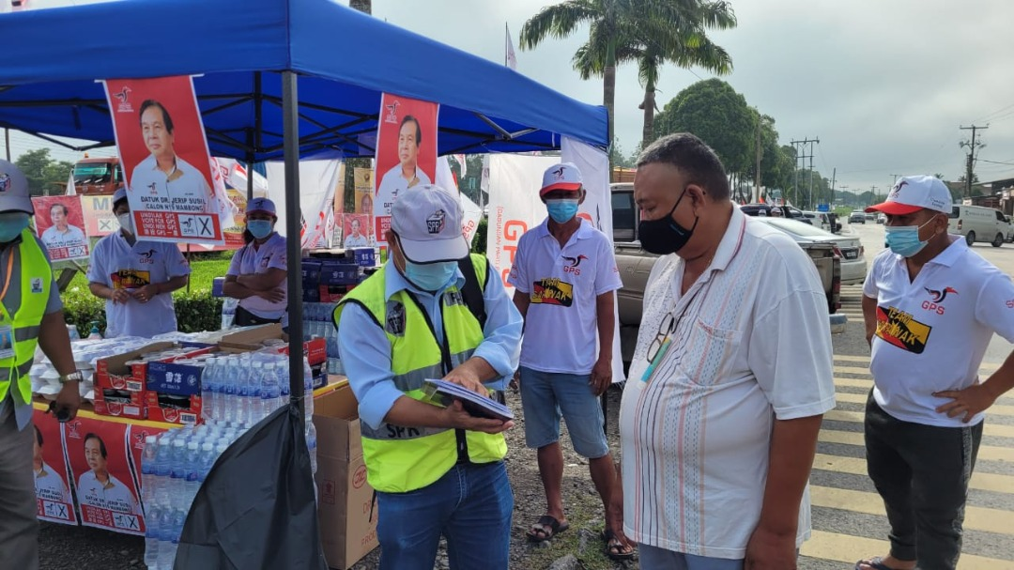
Working Closely with Campaign
Campaign to identify
state of election race
Polling Centres with votes
marginal Polling Centres
PACA Coordinators to
agree PACA and Counting strategies
deploy best PACAs
agree Pondok Panas placing
Voters do not differentiate between campaign and PACAs like you do. To them, you are all the same party.

Slide 31
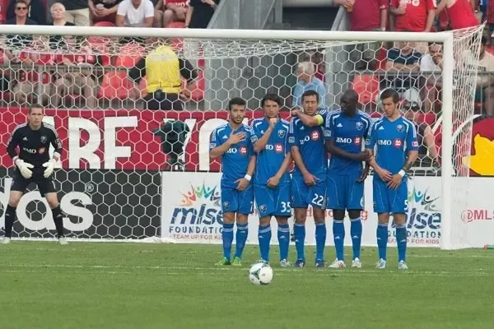
Goal-scorers are often the heroes
but Great Teams are founded on Strong Defence

Slide 32
When is the Elections

Slide 33
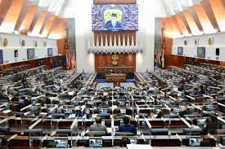
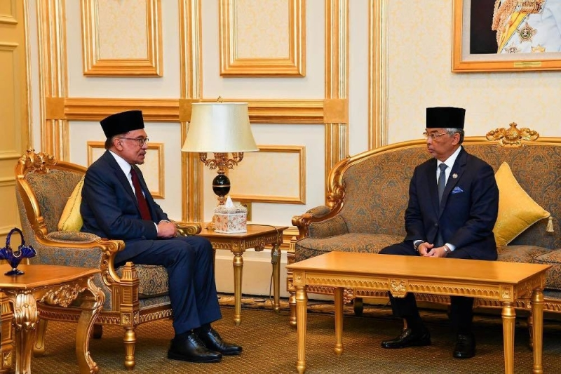
When is Parliament dissolved
Elections must be held within 60 days of dissolution of Parliament or Assembly
The life of a Parliament or an Assembly is FIVE YEARS from date of first sitting after last elections
unless Elections suspended according to terms of a declared emergency
Only happened once – local elections suspended during 1963 Emergency declared due to Konfrontasi
Automatic dissolution only happened once – Negeri Sembilan 2018
or dissolved on advice of Prime Minister/Premier /Chief Minister/Menteri Besar
Agong/Ruler/Governor must consent

Slide 34
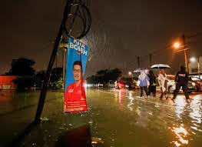
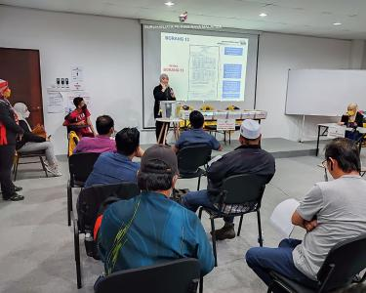
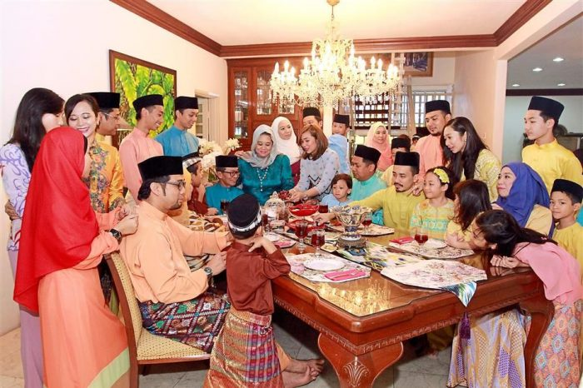
Good & bad times to have Elections
Conditions preferred by EC
Good weather
School holidays – Availability of staff and facilities
Simultaneous elections
Lead time to train
4 months for GE15
Black Out periods
Monsoon season
November to March
Took place in 1999 & 2022
Chinese New Year
Fasting & Shawal
Hajj period

Slide 35
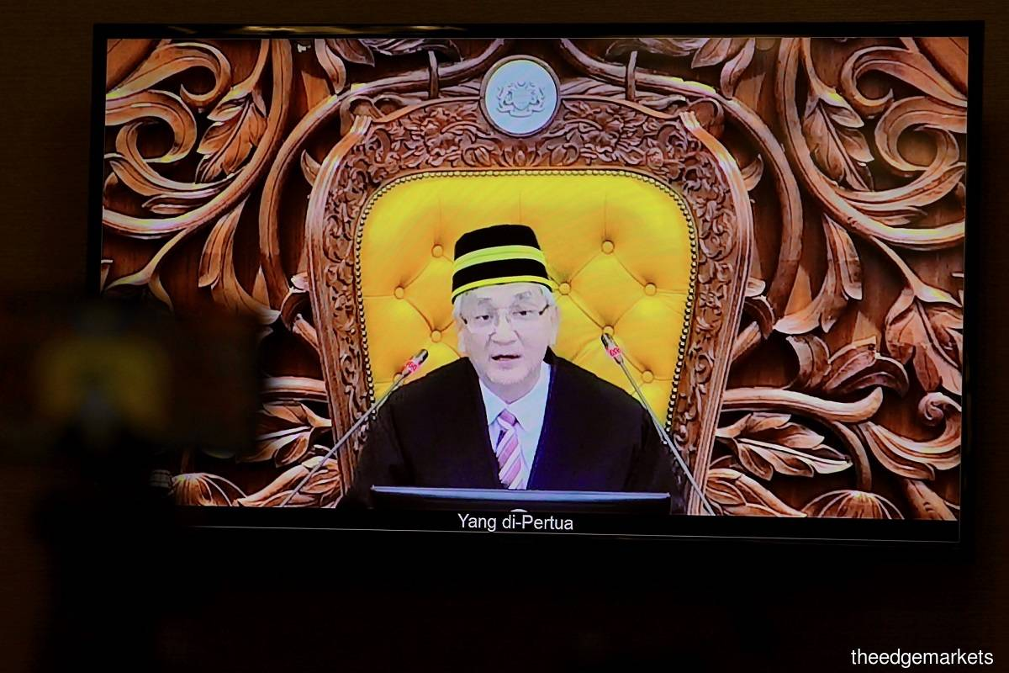
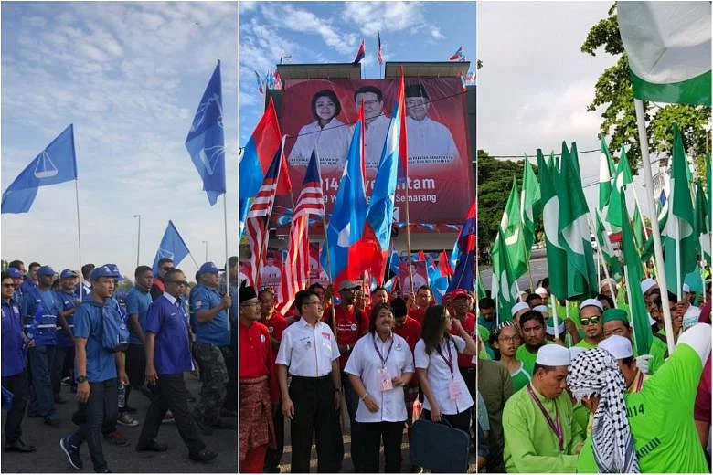
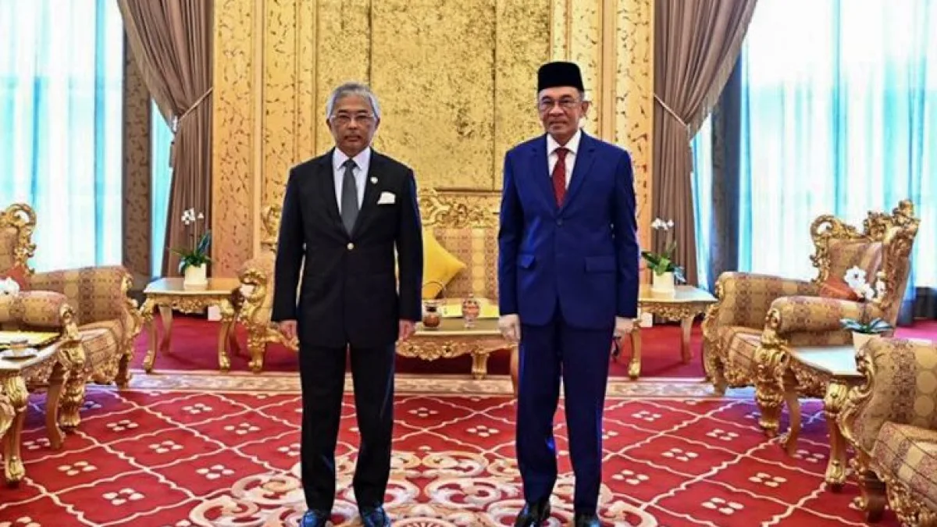
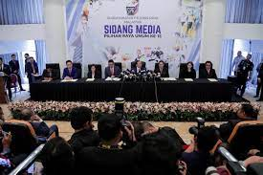
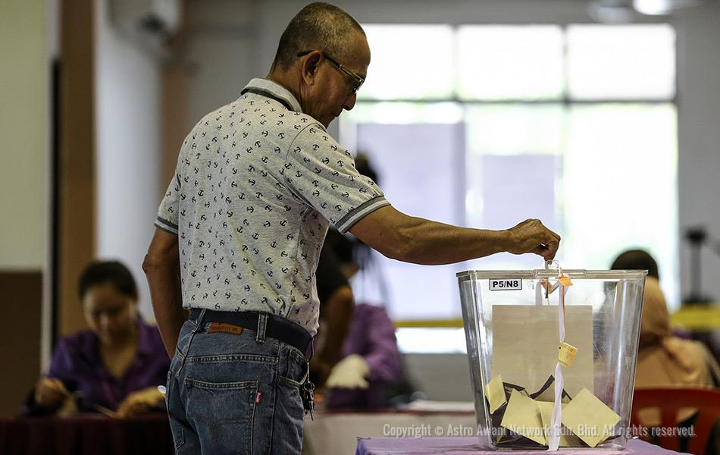
Election timeline
PM announce dissolution
Next Working Day
Speaker informs EC
Next Working Day
EC meet
Normally Wed 1-2 weeks later
Nomination Day
Normally 2 weeks later
Election Day
Normally 2 weeks campaign
Early Polling 3-4 days earlier
Official letter to Speaker
Official letter to EC
Announce Nomination, Early Polling & Election Day dates
No name or pictures of Candidate until Nomination Day
Min 11 days by law
T day
T+ 2 w d
T+ 2 wk
T+ 4 wk
T+ 6 wk
Total about 6 weeks from Announcement to Election Day

Slide 36
PACA Planning

Slide 37
Our planning phases
Before Dissolution
After Dissolution
Week 1 Campaign
Week 2 Campaign
Daily PACA training
Train Coordinators & Team
Registration & Paperwork
Logistics on-site
Finalise Station Master list
Finalise PACA strategy
Duty Roster
Mobilise Team & integrate members
Train Trainers
Start small scale PACA training
Agree working framework
Finalise Polling Centres and target numbers
4 weeks to 4 years
Aim for full activity from dissolution
2-4 weeks
Polling Centre list
Electors uploaded onto EC website
2 weeks
EC recognise Candidate & EA

Slide 38
Overall planning timetable
Phases | Before Dissolution | After Dissolution | Campaign Week 1 | Campaign Week 2
Strategy | Campaign strategy | PACA strategy Finalise PACA targets | Counting strategy | Add Candidate & EA to WhatsApp Group
Electoral Roll | Analyse numbers Identify names Core WhatsApp Group | Supporters to check
Station Masters | Key Station Masters trained & start recruiting Forum to discuss PACA issues | Training for Early Polling & Postal Ballots Station Master WhatsApp Group PACA allocation process | Finalise Station Masters Check Polling Centres Set up Station WhatsApp groups | Finalise PACA teams & duty roster Team meetings Final Station Master briefing
Trainers | Trainers trained & conduct monthly/ weekly training | Recruitment & Document flow Full recruitment | Paperwork to RO | Travel and accommodation arrangements
Coordinators & Logistics | Core team trained Overall planning Develop tools | Full mobilisation Google Form & Google Drive | Assign PACA to groups Assemble PACA Kits Obtain quotations | Set Pondok Panas Finalise lunch & drinks
WORKSTREAMS

Slide 39
Strategy
Ultimate Goal
PACAs are an extension of your Campaign to win the Elections

Slide 40
Strategy Workstream Deliverables
Before Dissolution
Campaign Week 1
Objective
Objective
After Dissolution
Objective
Knowing which are the White, Grey and Black polling district and estimated vote bank at each district
Determine PACA recruitment targets
Determine Counting Strategy
Rank Polling Centres for PACA deployment
Determine where to deploy Candidate & EA

Slide 41
Your strategies
Party Branding
Platform
PACA Strategy
Where do you deploy your best PACAs
Counting Strategy
Who do you support during counting
Campaign Strategy
How is Party Branding translated into ground Campaign
Parameters
Communications

Slide 42
Before Dissolution
Objective
Knowing which are the White, Grey and Black polling districts and estimated vote bank at each district

Slide 43
Working out your Campaign Strategy
Analyse
last election results
Electoral Roll changes since analysis done at last election
to identify baseline White, Grey and Black areas
Determine success criteria for this campaign
Available from State EC Office
Election results by Polling Streams gazetted by EC
Electoral Roll
PACA Coordinators need to know
White areas
Pool to draw resources
Free to go
Grey areas
Higher risk areas
Coordinate with campaign
Black areas
No go except under direction of campaign

Slide 44
PACA is part of Campaign team
PACABA Coordinator should have at least observer status in the Campaign team
Need to understand progress of Campaign to assess impact on PACA activities and vice versa
Be in Campaign WhatsApp group to monitor progress
Campaign team
Analyst team
Logistics team
Ground team
PACABA Coordinator
Comms team
Election Agent

Slide 45
After Dissolution
Objective
Determine how many PACAs are required and where to deploy them

Slide 46
How many PACABAs do you need
As a general rule, aim for 3 PACAs per polling stream, more if possible
You can get the total streams from the last election results and add 10% for growth over 5 years.
Minimum target is 2 per polling stream
There is no maximum
PACA recruitment is your basis for your activities and mobilisation
BEWARE: Targets are very difficult to achieve if you have weak machinery

Slide 47
Risk Assessment
General Rule
Grey areas: high risk
Will get the best and the most PACAs
White areas: medium risk
Need good Station Masters
Use as training ground for local PACAs
Black areas: low risk
May even consider abandoning if no votes
Outside PACAs normally deployed here
Other considerations
Need to show PACAs for messaging purposes
Consider positioning only Campaign Team if sensitive
Part of longer term strategy to build presence and/or machinery

Slide 48
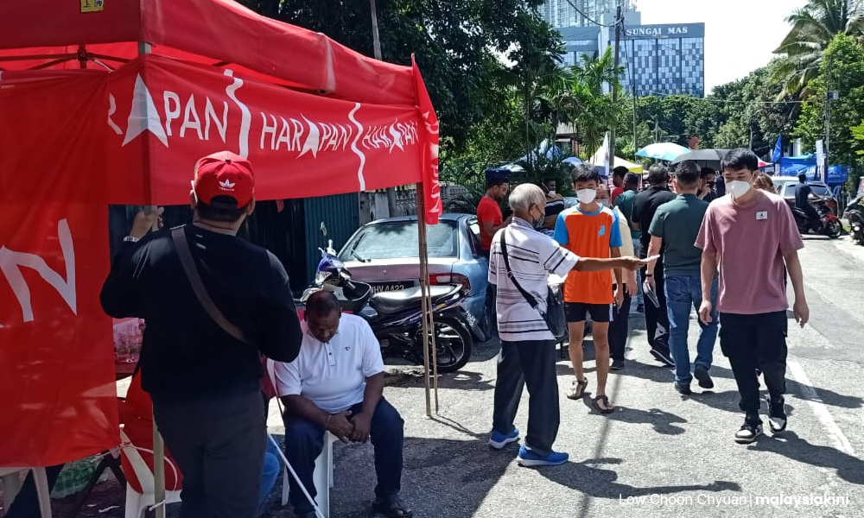
Pondok Panas
Why are Pondok Panas useful?
Meeting place on Election Day
Supporters check voting place
Provide transport to correct Polling Centre
Voters have a place to complain if any issue
Focal point for the party on Election Day
Last minute engagement with voters and persuasion
Candidate’s last outreach
Pondok Panas – usually rented canopies with table & chairs
Often used during campaign
Ideally, should have Pondok Panas at all Polling Centres
If inadequate budget, position Pondok Panas at target areas, manned by Campaign Team
Should be deployed in Grey areas with conversion potential
White areas like to have their own: ask them to sponsor

Slide 49
Campaign Week 1
Objective
Determine Counting Strategy
Determine where to position the Candidate and the EA on Election Day

Slide 50
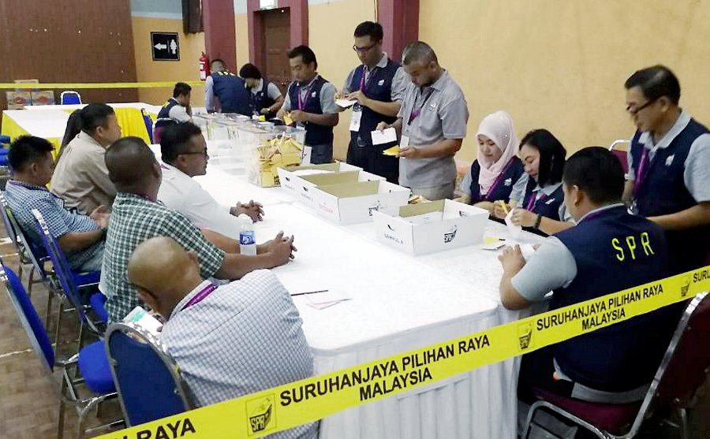
Counting Strategy
Monitor progress of campaign and surveys of voter intention in your constituency
If your candidate is in the top two position, your Counting Strategy will be based on the other party in the top two
Inform CAs through Station Master final briefing

Slide 51
Should you pay PACABAs
NO NEVER
Generally, paid PACABAs are less reliable than volunteers
Some volunteers may even get offended
A good thank-you dinner or merchandise may be better appreciated
Local PACABAs may expect to be paid
You will need to have at least some
Recruit more Local PACABA if insufficient
Allow for their allowance in your budget

Slide 52
Electoral Roll
Ultimate Goal
A clean Electoral Roll that you know very well

Slide 53
Electoral Roll Workstream Deliverables
Before Dissolution
Objective
After Dissolution
Objective
Electoral roll analysed for campaign
Communication for supporters to check their Polling Centre
Identify outsiders in Electoral Roll

Slide 54
Before Dissolution
Objective
Electoral roll analysed for campaign
Identify outsiders in Electoral Roll

Slide 55
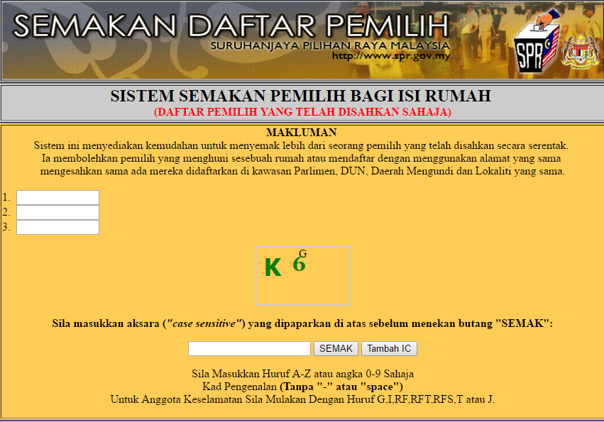
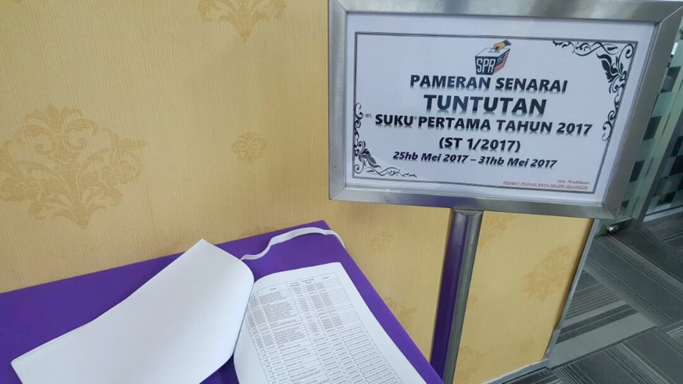
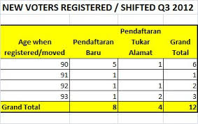
Electoral Roll
Electoral Roll updated monthly under Automatic Registration
Lists new registration, change of address inwards & outwards, death and other changes
Available at State EC Office
Breakdown by Polling District, race and age
Voter may request for change to new MyKad address at EC Office or Post Office
But consider whether your vote is more valuable at the old or the new address

Slide 56
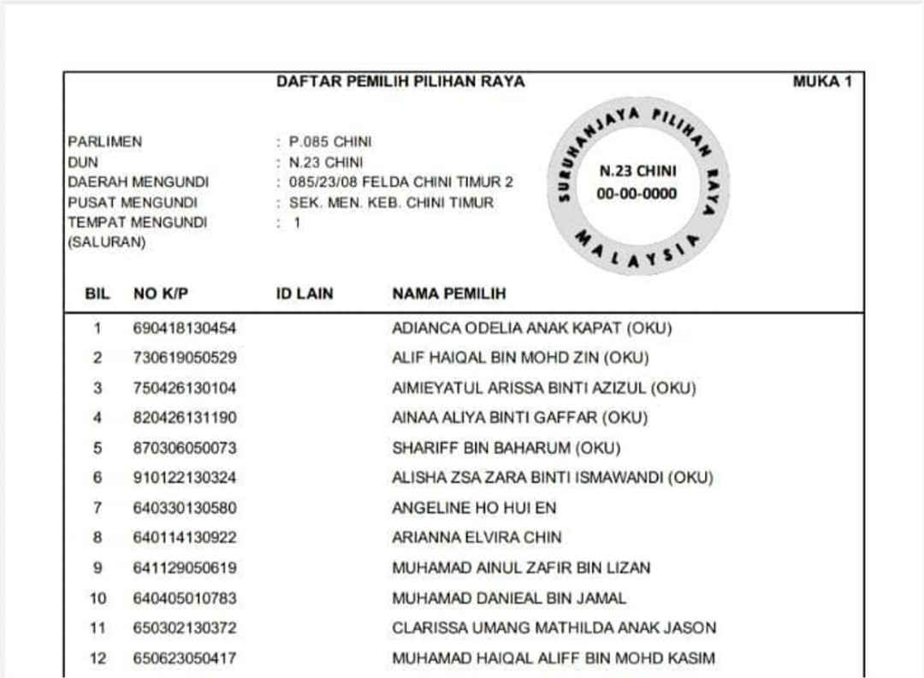
Scrutiny Period
Changes posted for objections for two weeks before being gazetted
Anyone can be object to up to 20 voters
No evidence required for objection
State EC Office will invite Voter under objection to meeting
If objection is sustained, name will be deleted from Electoral Roll
If Voter does not show up, name will be deleted and Voter will have to reapply to the Electoral Roll
Do not ignore any letter coming from EC
Once gazetted for use in Elections, can no longer be objected to
1
2
3
4

Slide 57
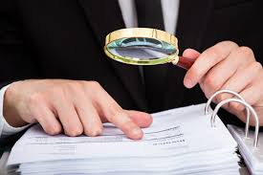
Checking the Electoral Roll
Compare with Electoral Roll used for the last Elections whether
Significant increase in voters
Sign that your area is targeted
Check who the additional voters are
and arrange verification visits
Transfer of voters, especially supporters
Even if not transferred to outside your area, such transfers to another polling centre will confuse voters
Investigate where supporters have been moved
Boundary changes
Localities added or removed from your constituency
Even though Polling Districts remain the same

Slide 58
Outsiders in your Electoral Roll
Illicit transfers
Outsiders who had MyKad address changed to your constituency
Normally transferred from neighbouring constituency
Usually bunched up in a few addresses
If after scrutiny period, EC will not take action
What do you do?
Escalate for confirmation by central team
Response may need to be customised for the specific constituency

Slide 59
After Dissolution
Objective
Ensure your supporters know where their Polling Centre is

Slide 60
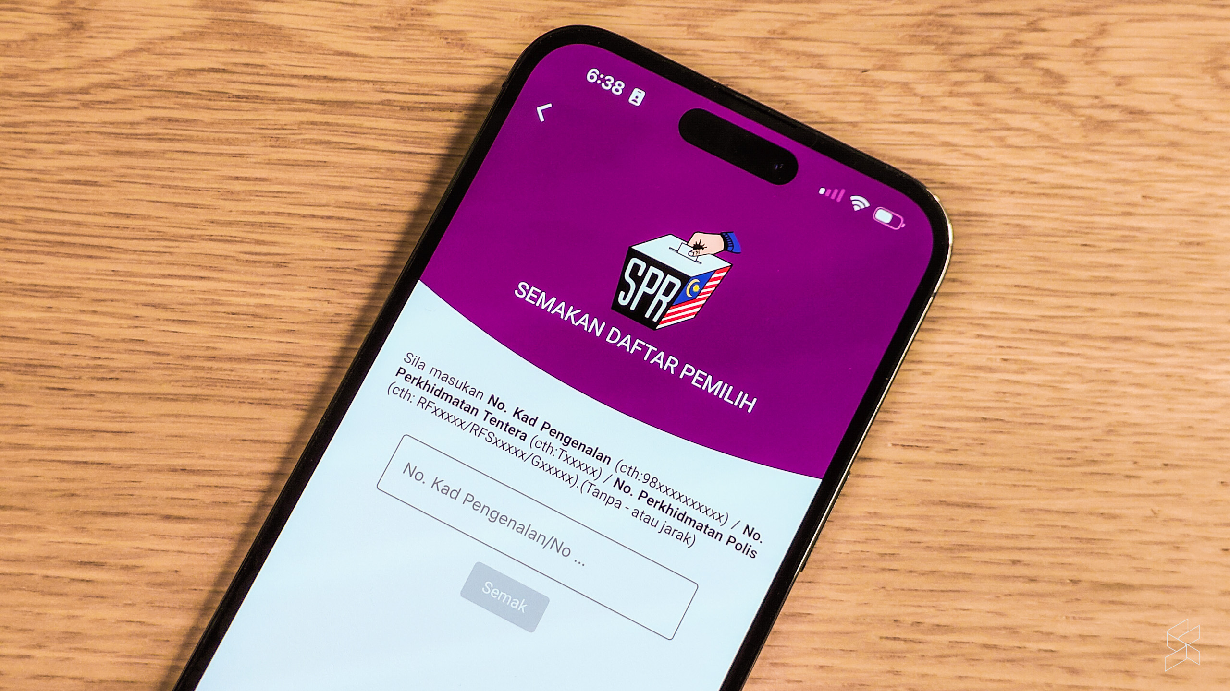
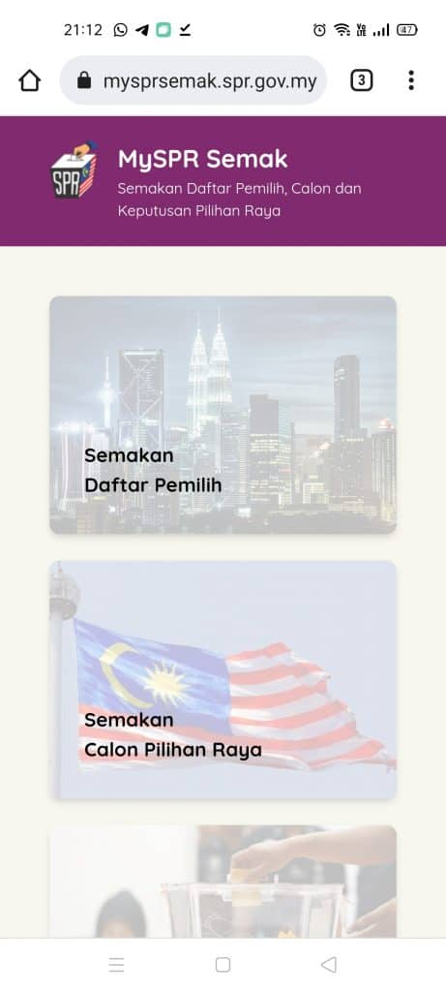
Checking Polling Centre
EC may transfer Voter to another Polling Centre within same constituency
Only need to inform Voter if transfer to another Constituency
If your supporter only finds out about transfer on arriving at Polling Centre, they may go home in frustration
YOU LOSE THE VOTE
What you do
During walkabouts, checking to be done by campaigner with different coloured shirt and appropriate app
During ceramah and rallies, set up booth to check Polling Centre
Checking tends to help add excitement to your base

Slide 61
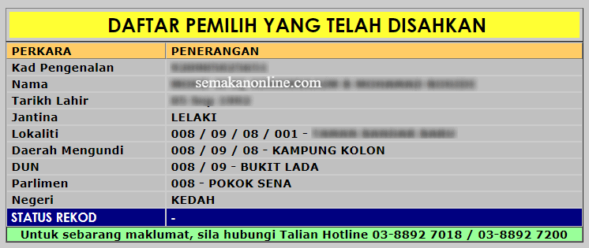
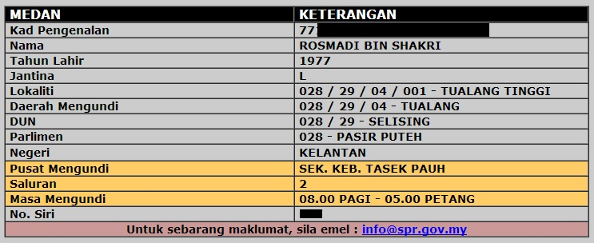
When and What to check
Only “Lokaliti”. No “Saluran”
Conclusion: Only that you are on Electoral Roll
“Saluran” & “Pusat Mengundi” shown
Conclusion: This is where you vote
When to check?
Now
That they are still on the Electoral Roll
After redelineation
That they are still in the same constituency
After Nomination Day
Where their Polling Centre is
Voters should still check even if they have ‘checked earlier’
Make sure they check after Nomination

Slide 62
During Election Campaign period

Slide 63
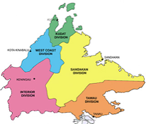
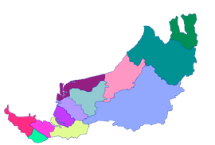
Whatsapp Groups
Candidate & EA usually added morning on Election Day
Each person will belong to two Whatsapp groups only
Information will be sent up and down the levels
State level
All Candidates, Election Agents, PACA Coordinators
Constituency level
Candidate, Election Agent, PACABA Coordinator
All Station Masters
Polling Centre level
Station Master
All PACABAs

Slide 64
Agenda First meeting with EC
After Nomination Day
Deadline for Oath of Secrecy to be signed by RO
Date when the list of voters for Early Voting & Postal Voting and Electoral Roll will be available; Issuance of Postal Votes; Opening of Postal Votes envelopes
Telephones can be used for texting (outside if not allowed inside)
PA can copy/photograph Forms 13 and 753
Last PA period need not be 2 hours as PA will not be replaced
Arrangements to safeguard Early/Postal Voting Ballot Boxes
Each candidate (not party) will have its own agents
RO to notify EA if any Form 717 is to be issued
Polling Streams with reduced polling hours
Agree that no counting or announcement of results before 5pm
Polling Streams where the Ballot Box will be moving
Agree that you can use your own stamp to stamp Ballot Box
Request RO to issue circular to POs on whatever has been agreed
RO & ARO have WhatsApp Group with their POs

Slide 65
White Appointment Forms to be a Polling or Counting Agent
You first job will be to sign off White Appointment Forms filled in by PACABA Coordinator
One for each role PA, CA and BA
Specific to the Polling Centre
Any change will require a fresh Appointment Form
You will be signing hundreds of forms
Including empty ones in case of last minute transfers of Polling Centres

Slide 66
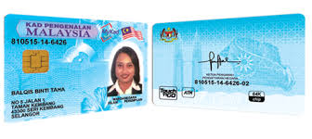
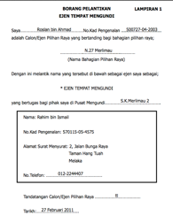
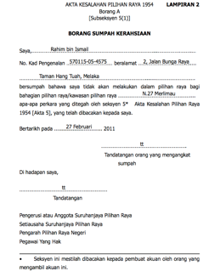
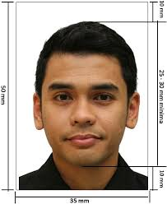
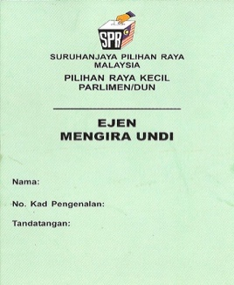
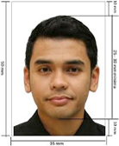
Paperwork flow for each PACABA
RO may only accept Forms from you if you cannot persuade RO to accept from PACABA Coordinator
Only after Nomination Day – Election Agent to liaise with RO
Both sides MyKad
1
PACA get via Station Master
RO determine deadline
Appointment Form signed by Candidate
Oath of Secrecy signed by PACA
Passport sized photo
EA submit to RO
RO
4
Station Master
3
2
Logistics insert in Stn Pack
EA
RO return to EA
Photo on EC Tag
Counter sign Oath

Slide 67
On Election Day

Slide 68
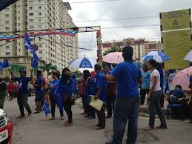
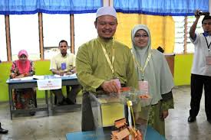
Where are you on Election Day?
The Candidate and Election Agent are the only two persons who can enter any Polling Stream without prior notice
During Election Day, position them near Polling Centres where their presence will be most needed
Lunchtime: distribute lunch separately to obtain feedback on the ground
Chance to meet Station Masters and obtain feedback
After Polling, Election Agent should not be in Tallying Centre if needed to assist in Polling Stream
Deploy Candidate as well if required, but will need to name agent to represent them in Tallying Centre

Slide 69
Common issues on Election Day
Internal Admin
PA or CA not yet arrive or will be late
Wrong/incomplete Documents just discovered
Lunch/water not yet arrive
Need to transport PACA to Polling Centre
More CA required for Postal Ballots
Friction at Pondok Panas between PACABAs or with Campaign team
At Polling Centres
PO refuse to let PA see Form 13
Station Master not allowed in Polling Centre if not on PA duty
PO ask PA to leave after 2 hours
PO refuse to give CA Form 14
Be clear & maintain list of Polling Streams/Centres with these issues for EA to act on
Urgent EA to talk to RO/ARO

Slide 70
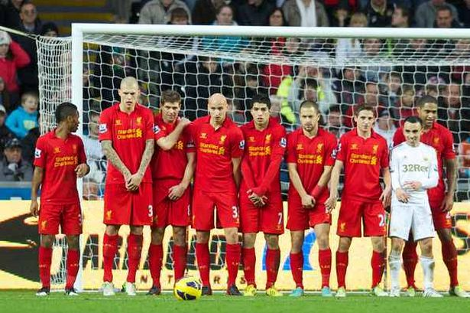
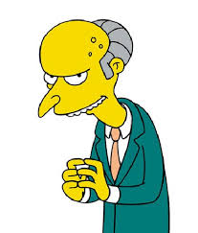
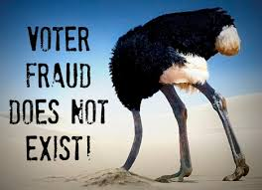
A few observations
A few principles
PACA is last line of defense
PACA cannot stop well-planned frauds
PACA can only observe and record down
Look for patterns, not just incidences
Reports of non-compliance
Wrongly reported
Innocent errors or miscommunication
Lack of training and competence
Isolated random frauds
Pre-planned frauds

Slide 71
Any Questions?
Jim Khong 012-320 3867 PACA4GE15@gmail.com
https://www.jimkhong.com/jim-the-polling-agent

