Slide 1
Polling and Counting Agents Training for Station Masters
Role and Procedures of Polling and Counting Agents in General Election and tasks of Station Masters to manage them

Slide 2

What we will cover today
  Introducing PACA
What is PACA
Before Election Day
  Tasks of Polling Agent
Before start of Polling
Polling procedures
  Tasks of Counting Agent
After close of Polling
Counting procedures
Tasks of Station Masters
Potential issues marked in red
Pictures may be taken from EC training to facilitate reference for EC Officers

Slide 3
What’s a Polling & Counting Agent and a Station Master

Slide 4

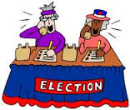


The Candidate’s team
Campaign Manager
Candidate
Election Agent
Mandated to represent Candidate to EC
Help run Election for Candidate
PACABA Coordinator
Administer recruitment, assignment, training & logistics for PACABA

Slide 5



Breaking down the Constituency
Constituency – Parliament & State
School; Village; Housing Estate
Polling Centre (Pusat Mengundi)
Classroom; Hall; Longhouse
Polling Stream (Saluran Mengundi)
Mukim, Town & surroundings
Polling District (Daerah Mengundi)

Slide 6

Who’s Who on Election Day
Constituency
Returning Officer (‘RO’)
+ 4 Asst ROs
Presiding Officer 1 (Coordination role)
Polling Centre Officer
Presiding Officer (Ketua Tempat Mengundi = ‘KTM’)
Election Agent
PACABA Coordinator
Station Master (Ketua PACABA)
Polling Agent (‘PA’)
Counting Agent (‘CA’)
Centre
Stream=Saluran

Slide 7

What a Polling and Counting Agent is
An agent of Candidate
  Act of agent is act of candidate
  Interest of candidate is interest of agent
  You are not independent
Two separate roles
Observe the Polling and Counting process
  Not part of the process
  No veto
Subject to Election law

Slide 8
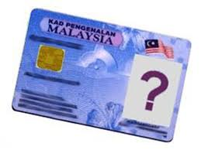
Who can be a Polling and Counting Agent
Waiting for the change
Malaysian citizen
21 years and above
Not charged in Court for any criminal offense in the last 5 years
  Traffic offenses excluded
Not a discharged prisoner within the last 5 years under Elections Offenses Act
Not registered under Prevention of Crime Act
Not an undischarged bankrupt

Slide 9
What a Station Master do
Variously also called Ketua PACABA
Lead all PACABAs in Polling Centre
Manage, Schedule, etc all tasks for PACABAs under him/her
Communicate with EC authorities in Polling Centre
Report results of Polling in Polling Centre with Forms 14 as well as situation at the Polling Centre
Intermediary between PACABAs at Polling Centre and Election Agent

Slide 10

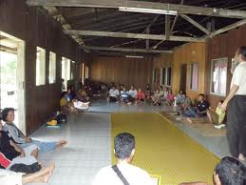
Two types of Station Masters
Urban areas
Several Polling Streams in one Polling Centre, one location
  Normally a school
PACABA recruitment tend to be more centralized in urban areas
Rural areas
Several Polling Centres, including single Polling Stream
Normally will cover entire Polling District
Local Station Masters may have responsibility to recruit PACABAs
Task more complicated
  Communicating with several locations

Slide 11



Who will make a good Station Master
Used to leading and managing others
Prompt response when unusual situations arises
Communicate with difficult people
Familiar with all Election & PACABA procedures
Trustworthy and fair

Slide 12
After your appointment

Slide 13

Appointment as Station Master
Normally you will be appointed by PACABA Coordinator
  Normally chosen from experienced PACABAs
No appointment letter as this is not a formal position acknowledged by EC

Slide 14

Initial tasks
3 areas of preparation
PACABA
Polling Centre
PACA kit and Material
Make sure you are appointed as Polling Agent AND Counting Agent
  Without EC Tag and Appointment Form, you may not be allowed into Polling Stream to speak to any PO
  You may be required as standby CA

Slide 15
PACABA – Recruitment, Rostering and Communication

Slide 16

PACABA Name List
PACABA Coordinator will provide you with list of PACABAs assigned to you
Make sure they all have contact numbers
  If no telephone, consider whether you still want the person as PACABA
If contact details are missing, trace in GoogleForm or the original form in PACABA Coordinator’s office

Slide 17


Contact them
Whatsapp and/or Email details of the team & material in pdf to all PACABAs
  Training slides
  and if interested
  Checklists
  Relevant pages of Acts/Regulations
Ask for everyone’s previous experience as PACABA & whether any restriction regarding time slots for duty roster

Slide 18

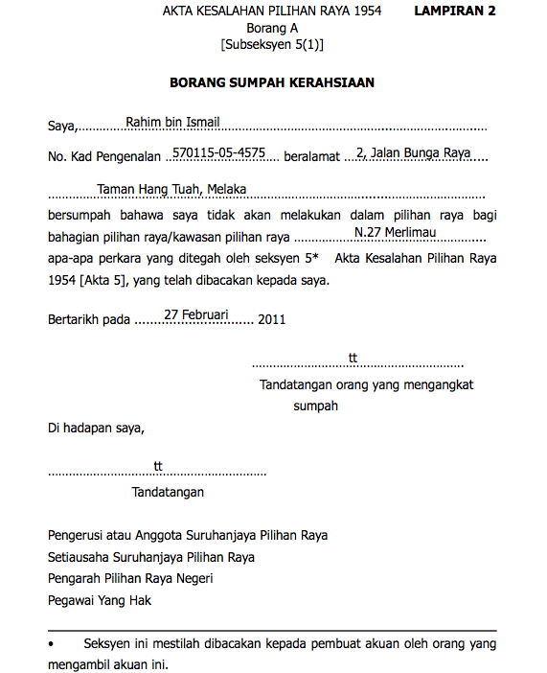
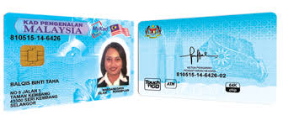
Details required from PACABA
Fill in Google Form
Documents
Copy both sides MyKad
  Handphone photo acceptable
Signed Oath of Secrecy
Passport-sized photo – one for each role PA, CA, BA
  Write name & IC no at back
Details
Telephone number
Experience as PACABA
  Any previous experience as Counting Agent or Station Master
Time and place of duty
  May wish to be on duty at place of voting
At worst, handphone photo acceptable
Mandatory hardcopy not negotiable
At worst, cut from MyKad photo

Slide 19
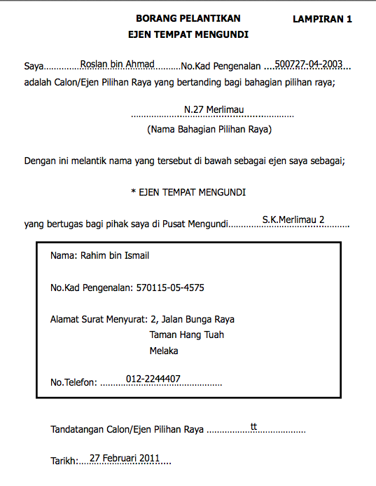
Appointment to be a Polling or Counting Agent
White Appointment Form filled in by PACABA Coordinator and signed by Candidate or Election Agent
  One for each role PA, CA and BA
Specific to the Polling Centre
  Any change will require a fresh Appointment Form

Slide 20
Form A Oath of Secrecy
Red Form
Required to comply with Election Offenses Act s5
  Cannot try to find out candidate for whom Voter has or intend to vote
  Cannot communicate any details regarding name or voting number of any Voter before Polling close
  Cannot communicate with Voter between receipt of Ballot Paper & inserting into Ballot Box (except PO)
  Cannot communicate Polling Stream stamp before Polling close
  Full s5 on reverse of the Form
Only those who have taken oath may enter Polling Stream or see serial number on Ballot Paper

Slide 21




Potential Change
Low possibility
Secrecy Oath may require role and polling stream to be stated
Implications
Difficulties in switching PACAs between polling streams when required by Station Master
Appointment Form
Can be changed by EC
Will require Candidate/Election Agent to sign sufficient blank Forms to be held by Station Masters
Secrecy Oath
Cannot be changed as it is specified under the Act
  EC may require as an non-Act requirement
Will continue to talk to EC

Slide 22
PACABA Communications

Slide 23


Communication channel
Contact each PACABA to confirm consent before adding them to WhatsApp group
Insert Polling Station number in Group Name - Pxx/Nxx/xx
Insert in Group Description
  Name of Candidate on Ballot Paper
  Link to Training Slides
  Link to Duty Roster
Only Admin can add participant
  no joining by link
Be firm on Group rules
  Only post PACA instructions or matters dealing with this Polling Station only
  Admin to ask poster of non-relevant posts to delete it. If poster refuse, admin to delete. Consider deleting persistent offenders
Consider replying by private message
Arrange meeting if possible at agreed place (eg., by PACABA Coordinator)
  to get to know everyone and deal with any questions on process & logistics
There should be another meeting at Polling Centre on eve of Election Day if possible
Note those with no smartphones
  You will be the one responsible to text them anything relevant from the group discussion
  Consider if you need the PACA if no handphone

Slide 24
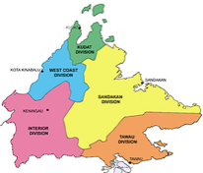

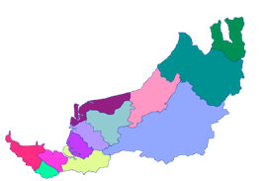

Whatsapp Groups
Candidate & EA usually added morning on Election Day
Each person will belong to two Whatsapp groups only
Information will be sent up and down the levels
State level
  All Candidates, Election Agents, PACA Coordinators
Constituency level
  Candidate, Election Agent, PACA Coordinator
  All Station Masters
Polling Centre level
  Station Master
  All PACABAs

Slide 25


First meeting
Introduce yourself and provide names of the candidate(s) PACABA are representing
Get each PACABA to introduce himself/herself & any previous experience as PACABA
Briefly run through all Polling and Counting procedures and the latest development – EC can change procedures up to 72 hours before start of polling
Explain shifts PA1, PA2, PA3-CA. Anyone not on shift should go to vote and return to be on standby at pondok panas
Agree on logistics, meeting time, procedure to swap duties, dress code, PACA kit, communication without phones etc.
Set meeting time for PA1 on Election Day at 7am at pondok panas (or any other alternative arrangements)
  You need some time to sort out the documentation etc
  Ask more experienced PA2 to come as stand-by

Slide 26
How to prepare the Duty Roster

Slide 27



The Duty Roster
You manage the team around Duty Roster
Indicates all the work on Election Day
Will change with addition of PACABAs by PACABA Coordinator or when PACABAs drop out
First version could be from PACABA Coordinator
  If none, prepare your own
Control versions closely
  Only you can make amendments

Slide 28
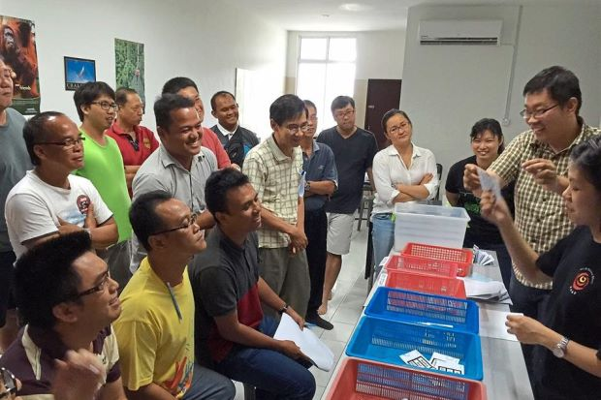
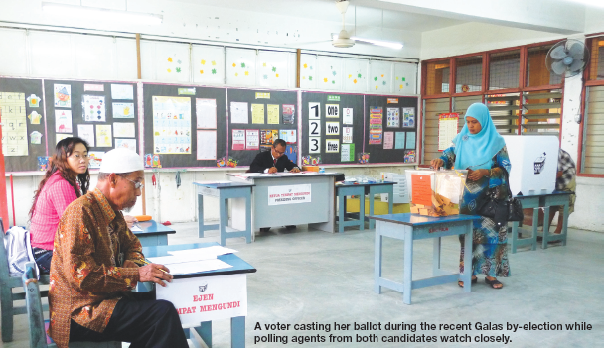
Underlying principles
12 hours roster: divided into
  3 PACAs for Stream: 3 four-hour shifts
  2 PACAs for Stream: Split shifts
If insufficient PACAs, roster is driven by availability
  PACA who can do 2 shifts are most valuable
PACAs go to places where there are votes to defend the votes
  Your best PACAs should be defending Ballot Boxes which contains the most of your votes or your most risky votes
Assess who your strongest PACAs are
  CA must be reliable, especially in rural areas
  Strongest: CA then PA1 then PA2
  Stream 1 may require stronger PACAs

Slide 29

The shifts
Basic shifts are 3 four-hour shifts
7.30am until 12 noon
12 noon until 4pm
    May consider starting earlier if PA1 is also PA3-CA
4pm until 6pm Closing; Then CA until end
  Allows CA into room before Closing, avoiding any confusion of changing shifts while PO prepare room
PA1
PA2
PA3-CA

Slide 30

Preparing the Duty Roster
If you have 3 PAs per Stream
If only 2 PAs per Stream
Allocate Strongest PACA as PA3-CA
Available and preferably from outside
Allocate next PA as PA1
Ensure will be available early morning
Allocate remainder as PA2
Especially if they have other jobs on Election Day
Allocate PAs who can do two shifts
Go in as PA1 and PA3-CA
Allocate PAs who can only do one shift
Go in as PA2
Lengthen PA2 shift
5 hours to maximise PA1/PA3-CA rest time

Slide 31
Other numbers of PAs
If less then 2 PAs
If only one PACA per Stream
  PA goes in as PA1 at 7.30am
  Leave at 10am or when situation stable: risk is lower
  REST, REST, Sleep
  Return as PA3-CA at 4pm
If only one PACA per Station
  CA requests all POs to prepare Form 14s as CA will sign & collect after end of Counting
  Stay outside and monitor: Sign & collect Form 14 for whichever Stream that finishes Counting
  Do not go in for Counting to avoid getting stuck
Available as file in slide
  If more than 3 PAs
  4: Split PA2 shift
  5: Split PA1 & PA2 shift
  6: Split all 3 shifts
    Maximum you can have
    Drawback: changing shift while PO changing room layout

Slide 32

Assessing availability
Determine how many PACABAs you have in all
Check which roles each team member has trained for
    Those trained as PACABA can act as BA also
        trained as BA only should not be PA or CA
Check if any PACABAs will be voting and so be temporarily unavailable
  Your most valuable PACAs are those who can do two shifts
CAs must be reliable, especially in remote areas
  If in doubt, you may need to bring in from outside

Slide 33

Assessing the ability of PACABAs
Assessed the ability of your team based on the following criteria
Knowledge of Election process and regulations
Self control and disciplined in carrying out the task
Firm and persistence when challenged by others
Communication & persuasion skills
Clear thinking in complex situations

Slide 34

Two hour rule
Regulations require PA to be on duty for two hours before they can be replaced
  PO will record change of shift in Form 763
  Implication: If PA leaves after less than 2 hours, there may be no replacement until 2 hours elapsed
  Action: Do not allow PA in if not well/etc and may not be able to complete 2 hours
EC/RO/PO may interpret rule to require the last PA to be on duty for at least two hours
  Consider this for the duty roster – last PA to start at 4pm or 2 hours before close of Polling if reduced polling hours
If PO require each shift to be maximum 2 hours, explain sec 14(1A) Election Offenses Act states the shift to be AT LEAST 2 hours, not maximum two hours

Slide 35
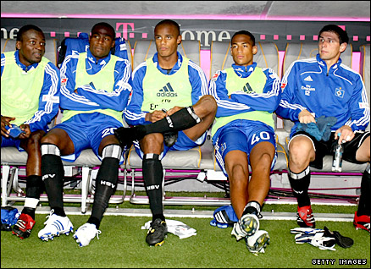
Duty Roster – Standby PACAs
  Always have standby PACABAs
  Get some of more experienced PA2s to be standby for PA1
  Once all PA1s are safely in the Streams and Polling started, release standbys to return for their own shift
If you are fortunate to have sufficient PACABAs for 3 shifts, use your least experienced PAs in middle shift & as standbys
If the situation is stable, send standby in to relieve a PA after 2 hours service, preferably the older or less experienced ones
  Before relief, inform PA being relieved & ask him/her to inform PO of the change

Slide 36
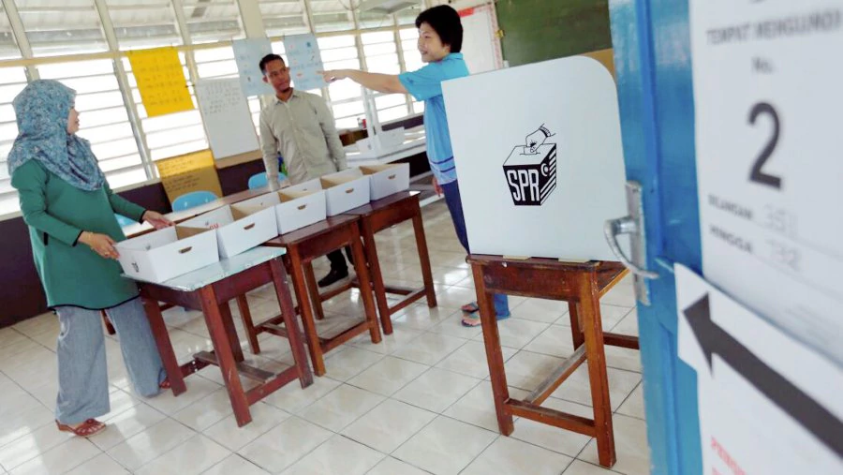
Duty Roster – Counting Agents
CA
If doubtful of reliability of CA, get reliable CAs from outside
If Parliamentary & State are under same party, always roster two CAs per Stream
  one CA cannot cope if simultaneous counting for Parliamentary & State
  If you cannot get two, ask PA1 to come back to be CA to get two CAs per stream
    Ensure available Appointment Form as CA
Should you go in as a PACA?
As a rule: NEVER
You are more valuable to make decisions when issues arise and as communication channel with EA
Exception: If high risk & no one else around with documents, go in as CA
  Inform EA and Coordinator
  Appoint Replacement & add to WhatsApp Group as admin

Slide 37


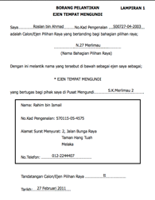
Scheduling Counting Agents
If P & N under same party, schedule 2 CAs with 3 Appointment Forms
CA1 have 2 Forms signed by both candidates
CA2 have 1 Form signed by only one candidate
If one candidate is more vulnerable, CA1 (more experienced CA) will hold that Form
Don’t forget Appointment Form as PA as well
CA1
CA2
N
P
N
Consecutive counting
Concurrent counting
If consecutive counting
CA1 enters with both Forms
If simultaneous counting
CA1 & CA2 enter with own Form

Slide 38
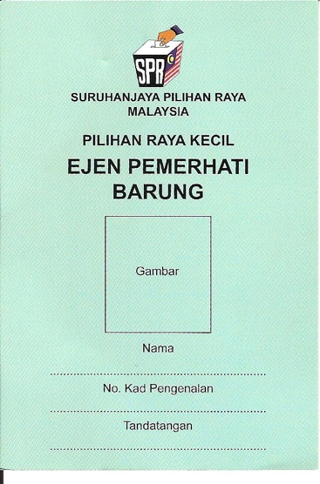
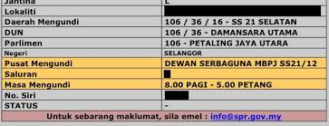
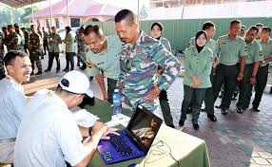
Barung Agents
BA role is to observe checking of Electoral Roll and issuance of stream chits to Voters
But barungs are not mandatory
  Voter can check polling stream at website
If there is insufficient PACABAs, do not have BAs
If there is sufficient PACABAs, or standby PAs are available (after all PA1s have gone into the streams)
  Deploy less experienced PAs and those trained only as BAs to be BAs
  There should be two shifts for BAs. More shifts if there are more BAs
  You only require 2 BAs; Maximum 4 BAs allowed

Slide 39






On Polling Day
Be prepared to amend your Duty Roster as circumstance change
  Availability of people
  Relationship with PO
  Questions over effectiveness or reliability of PACABA
Depending on availability, switch between 2-shifts and 3-shifts as appropriate
Basic principle: every volunteer must have an opportunity to serve

Slide 40

Change will happen
New PACABAs could be added & existing PACABAs could be dropped/pull out
  PACABA Coordinator will continue to recruit and give you more names
  PACABA dropouts will inform you
Set up GoogleDrive to hold the ONLY version of Duty Roster
  Duty Roster there will always be the latest
Circulate duty rosters with version number, preferably in file name
  Night before Election Day, inform everyone final version number

Slide 41
Polling Centre

Slide 42
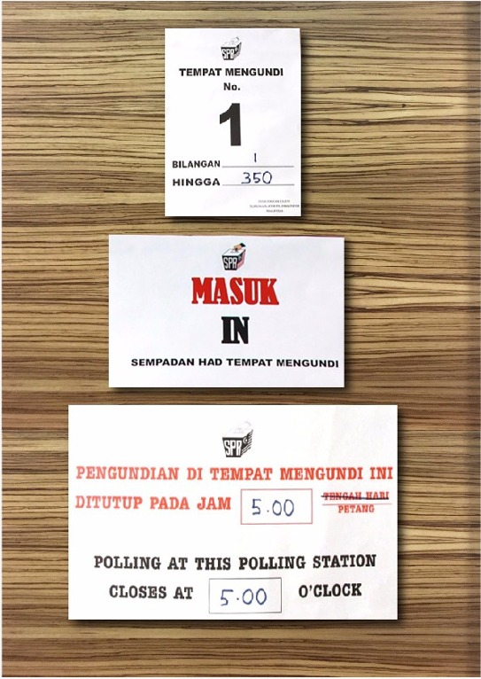
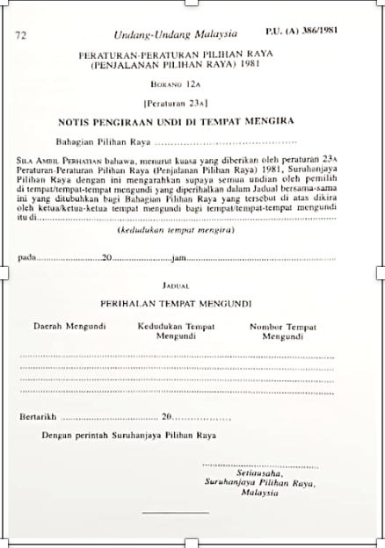
Check the Polling Centre
Check out Polling Centre the weekend before, if possible to identify Polling Streams, Kiosk & toilets
Arrange final briefing for your team at Polling Centre on the morning before Election Day
  Run through flow of voters’ movement from gate to Polling Streams
Test data connection for Whatsapp for all Streams at Polling Centre
  If not working satisfactorily, revert to SMS
  If no SMS coverage, designate runners as messengers
  If Polling Centre itself has no data or SMS coverage, pre-identify nearby spot where you can communicate

Slide 43

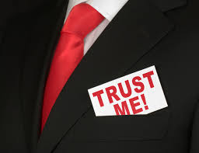
Managing your team at Polling Centre
Take photo of your whole team as this is the last time everyone will be together in daylight at Polling Centre
POs often also meet on the same morning at Polling Centre
  If you see them, introduce yourself. If possible, talk to PO1
Identify if there is another Polling Centre/school or location that can be confused with yours (eg., SK instead of SMK)
Check out where your pondok panas will be

Slide 44
PACA Kit and Material

Slide 45

PACA Kit
Each PACABA Kit will be labeled with Polling Stream
Electoral roll (specific to each Polling Stream)
Sample Forms 13, 14, 753
Sample of accepted and rejected Ballot Papers
Pencil, Eraser, Sharpener, Pen & Ruler
Permanent marker pen
Empty paper & Paper clip
Three Objection Letters
Optional/May be with Station Master only
Glue or Tape
Training slides
PA checklist & CA checklist
Relevant pages of Act & Regulations

Slide 46
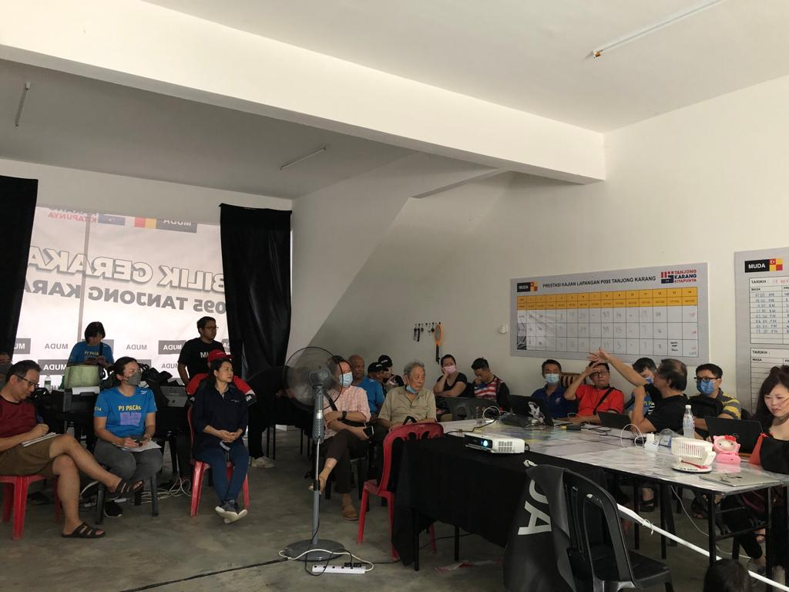
Final Station Master briefing
Pick up your PACABA Pack
  One PACA Kit for you
  One for each Stream, labeled
  PACABA documents
Ensure
  Each Kit is complete
  Each Kit has Electoral Roll for that Stream
    Early & Postal Voters marked
  Each PACABA has
    Red Form A Oath of Secrecy
      Signed by RO
    White Appointment Form
      Signed by Candidate/EA
    PACABA Tag with photo
Will be held 1-3 days before Election Day
  EC may change Election procedures 72 hours before start of Polling
Your final meeting with your PACABA team must be after this briefing

Slide 47

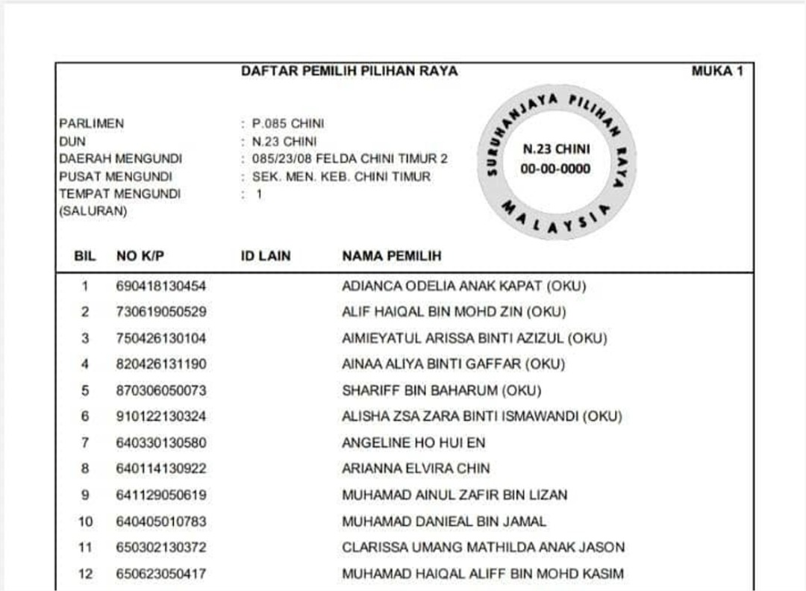
Check the Electoral Rolls
There should be an Electoral Roll in each PACA Kit for that Polling Stream. This may be the complete list of ALL Voters without identifying Early & Postal Voters.
Ensure
correct one for that Polling Stream
complete for all Polling Streams
  Check every page
they are for the latest month that has been gazetted
Check both Early and Postal Voters. Procedures may change!! EC may exclude one but not the other

Slide 48

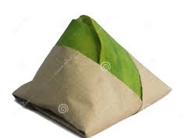
Information to know
Find out from the PACABA Coordinator
Name & contact number of Candidate & Election Agent
What time water and lunch will arrive
Where to send Forms 13 & 14 after counting
Information & format to be sent to Bilik Gerakan
Whatsapp group set up for all Station Masters
Whether pondok panas has been set up
Most popular question

Slide 49
Before start of Polling

Slide 50

Reminder Eve of Election Day
Reminder text to PACABAs
Prepare the following
  MyKad
  Handphone charged and sufficient credits; smartphones should have sufficient data plan/quota; Powerbank
  Small torch
  Additional passport size photo
  Spare pens, paper, ruler & marker pen
Make sure adequate sleep
8pm
text to all PA1/BA1 to remind them to sleep early and be at pondok panas by 7am (or any other alternative arrangement)

Slide 51
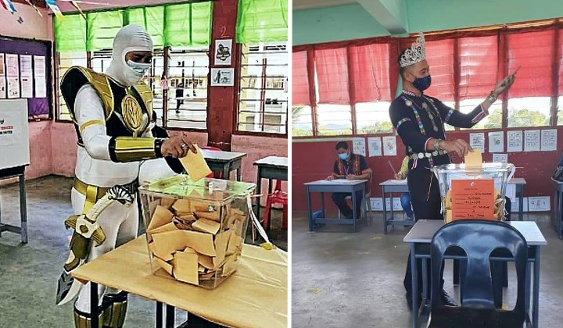
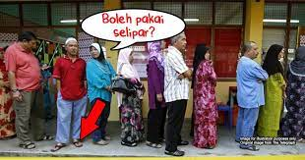
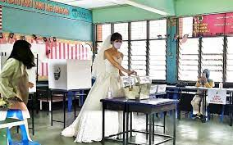
PACABA Dress Code
Smart casual – remember you are on official duty
  Dress comfortably – can get hot in the room
Legal requirement: No political statements or logos
Subject to discretion of PO
  No colours that can be interpreted as political statement
    If in doubt, wear or bring something neutral as spare
  No round-neck or sleeveless T-shirts.
  No shorts, mini-skirts, sandals nor slippers

Slide 52

Eve of Election Day
Follow dress code
Prepare the following
  MyKad
  Handphone charged and sufficient credits; smartphones should have sufficient data plan/quota; Powerbank
  Small torchlight (handphone light may not be enough)
  Additional passport size photo
  Spare pens, paper, ruler & marker pen
  The PACA kits
Make sure adequate sleep
  You will need to be at Polling Centre at 6.45am
  You will be on duty the whole day until night
PO equipment list also include emergency torch

Slide 53
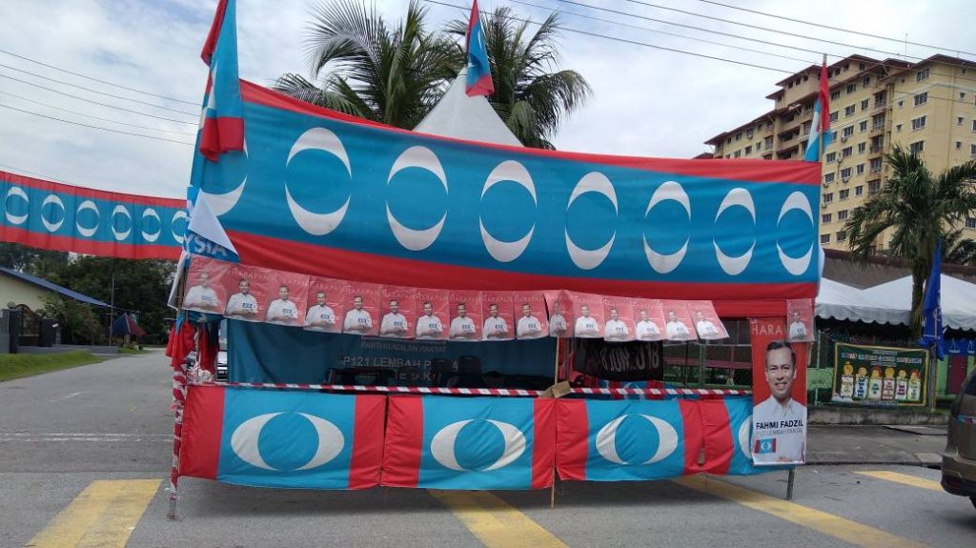
Early on Election Day
Be at designated meeting point at least 15 minutes before designated time instructed to PA1/BA1s, with
PACA Kits
For each PACABA
  Red Form A Oath of Secrecy, signed by RO and PACA
    If PACA has not yet signed the red Secrecy Oath, ensure they sign it before going in
    Sometimes, red Secrecy Oath is unsigned, even if PACA has previously signed one
  White Appointment Form appointing them as PA, CA or BA, signed by Candidate/EA
    One for each role
    If standby PACABA is transferred from another Polling Centre, ensure they have filled up empty Appointment Form for your Station signed by Candidate/EA.
  EC tags (colour coded for PA, CA or BA) with PACABAs’ photo – one for each role
Spare umbrellas & paper clips/tape/glue/staplers (for any last minute change of photos on EC tags)
Plastic chairs in your car if you have removed them from pondok panas the day before

Slide 54

Typical Polling Centre (School)
6
5
4
6
5
4
2 SPR clerks + BA, one for each contesting candidate
3
2
1
3
2
1
Streams in classrooms
Max 700 Voters per Stream
Electoral Roll organized by MyKad number
Stream 1 includes handicapped: 350
All the rest distributed equally
Voters
EC Kiosk
Voters
For Concurrent Elections:
No of PA allowed 2: 1 for P & 1 for N
No of CA allowed 2 if concurrent count
Covid Change

Slide 55
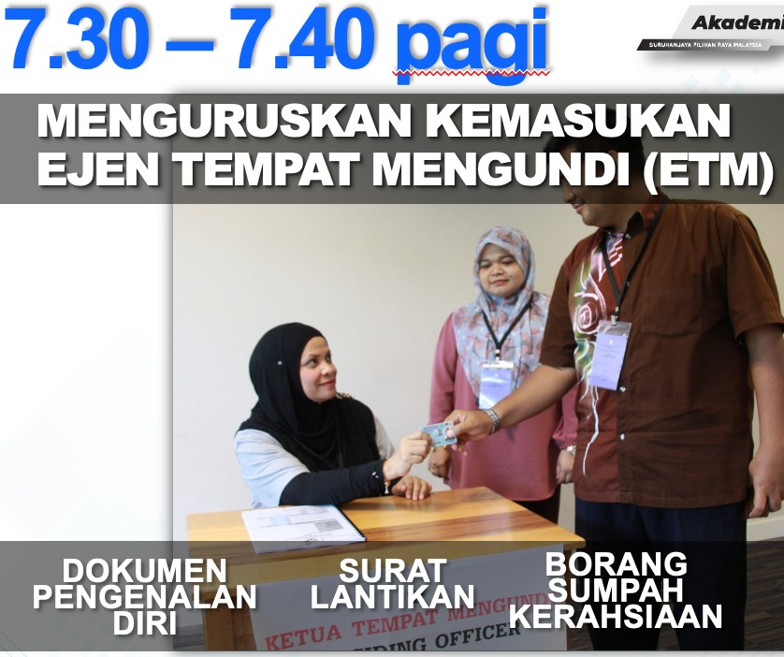
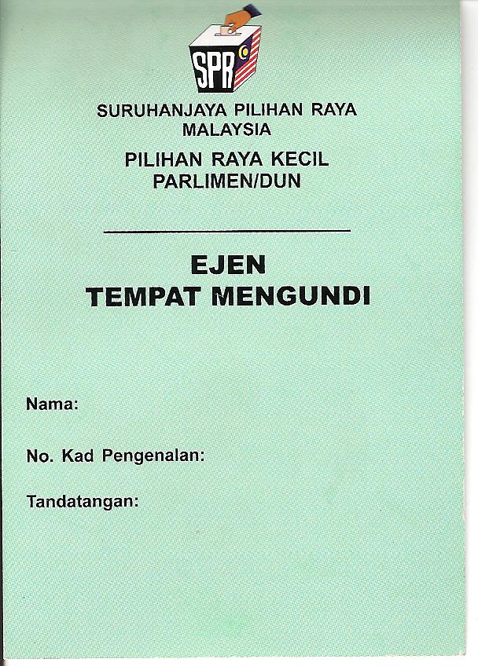
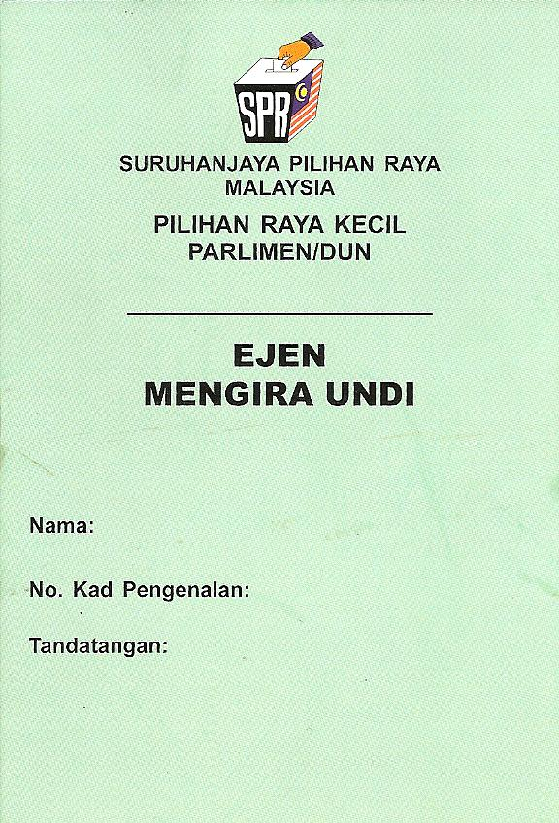
Entering Polling Stream
PA1 can enter Polling Stream at appointed time
  7.30am or any other time agreed with PO
Make sure that they enter with
  MyKad as identity
  Red Form A, Oath of Secrecy, allowing them into the Stream
  White Appointment Form authorizing them as PA
  EC tag, allowing them into the Polling Centre
  PACA kit
PO will brief PAs and Clerks

Slide 56

The Presiding Officer
Presiding Officer (Ketua Tempat Mengundi)
Normally non-partisan
Most are civil servants, called to work on day off
  Some are volunteers from outside government
May not be that familiar with laws or Regulations
  One training every five years
Make him your friend
PO1 more experienced

Slide 57


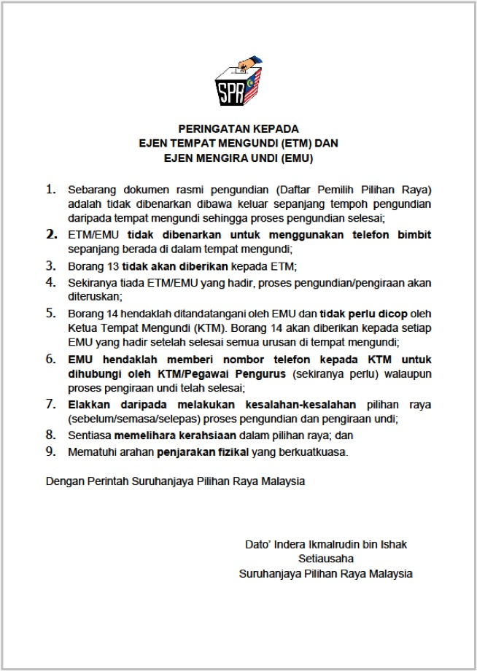
Use of handphones
EC procedures prohibit handphones from Polling Stream
  Always understood to mean prohibited from talking
  Surrender of phones only apply to Voters
  More zealous POs may ask for handphones in basket
Action
  Inform PO phones will not be used to talk & only text
  If no, ask PO if phones can be used outside the room
    PA to bring paper out to record voter number while texting
  If no, runner to be sent to the room every 30-60 minutes to talk to PA if anything to report
PAs to try to keep your handphones and not give it up. Turn off and keep in pocket or bag
Do not get thrown out of the room on this issue

Slide 58
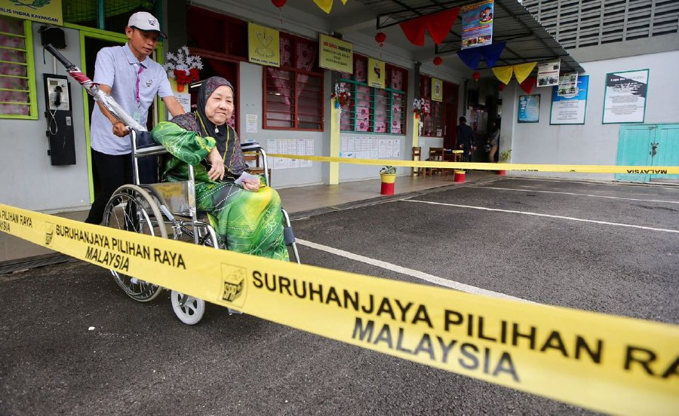
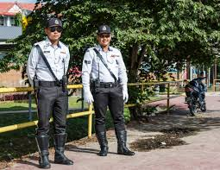
Centre officers and Police officers
Polling Centre Officer is in charge outside Polling Streams
Introduce yourself to Polling Centre Officer and police officers on duty
  Let them know who you are & where your pondok panas is
  Ask them to contact you if there is any problem
Throughout the day, go into the Polling Centre and wave at them as you pass
  Get yourself familiar to them
  If they don’t allow you in because you are not on duty, inform EA immediately, to call RO
  You will need their cooperation to bring your PACABAs in after close of Polling to watch Ballot Boxes
No campaign material allowed within 50m of Polling Centre, (eg., from school gate)
  Example: cars with party logos
  Inform Polling Centre Officer

Slide 59
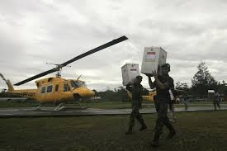
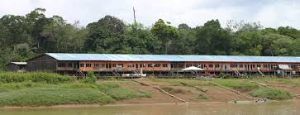
In remote areas
Agree with PO where polling hours are shortened
  Closing time displayed at Polling Stream for 3 days
  Make arrangements to observe Ballot Box after Polling
  Counting of results should not take place before 5pm
If PO responsible for more than one polling location, ensure
  one PA in each location
  PA1 to sign seal on opening of the Ballot Box with a 4-digit code or special rubber stamp and take a photo
  PA2 to take photo before opening the seal
If no telephone coverage
  Find out earlier: location with coverage to communicate with Bilik Gerakan
  Prepare standby PA as messenger
    Be outside each Polling Stream every 30 or 60 minutes

Slide 60


Reminders to PACABA
(Based on three shifts)
8am to remind PA2/BA2 to vote and be at pondok panas by 11.30am (or any other alternative arrangement)
11am to remind PA2/BA2 to meet in 30 minutes
11.50am to inform PA1/BA1 their replacement has arrived/not arrived. If not arrived, ask them to hold on and update them every 10 minutes
2pm to remind any PA3-CA to return by 3pm
3.50pm to all PA2 that PA3-CA has arrived/not arrived

Slide 61


Communicating with Election Agent
Inform Election Agent & Whatsapp group of any non-compliance immediately
  State Polling Centre or Stream, your name, time and nature of non-compliance
  Stream format = [No parliament]/[No DUN]/[Polling Centre]/[Stream] = Pxx/Nxx/xx/xx
  Call if there is an unusual matter requiring explanation or immediate action
Normal regular items to report for each Stream
  Hourly voter turnout
  Form 13 beginning and end of the day
  Form 14 final results
Report any suspicion actions or circumstances
  Limit only to the facts & your responsibilities
Candidate & Election Agent can enter any Polling Stream

Slide 62
Before Polling Starts

Slide 63
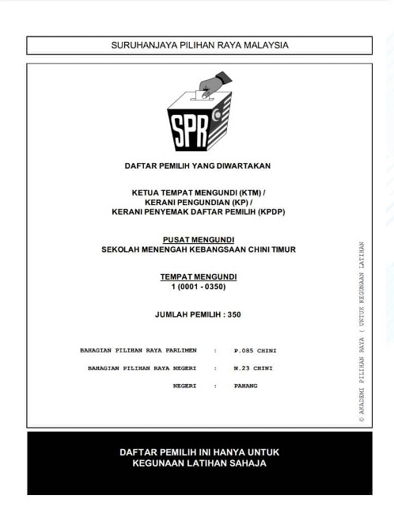

Before 8am: Check facilities
Facilities
Facilities enable Voter to mark ballot paper in secret: Check windows closed
No posters, symbols, wordings or pictures of any political party or candidate (except of King, Sultan or Governor)
PO and all clerks do not have any insignia, symbols or wordings of any political party or candidate
Position yourself so that you have good visibility of the PO’s desk, all 3 clerks, all polling booths, Ballot Box and the door
Not more than one PA per candidate (note: not party)
Electoral Roll
Compare Electoral Roll with PO’s copy
  Total voters in the Stream (350 in Stream 1, balance distributed equally among remaining streams)
  Same number of pages
  Check first & last name & voter number on each page plus any others at random
  Check your Electoral Roll is not marked other than Early/Postal Voting
Note against Voter name if informed that the Voter is absent & will not be voting (usually Station Master will inform you)

Slide 64
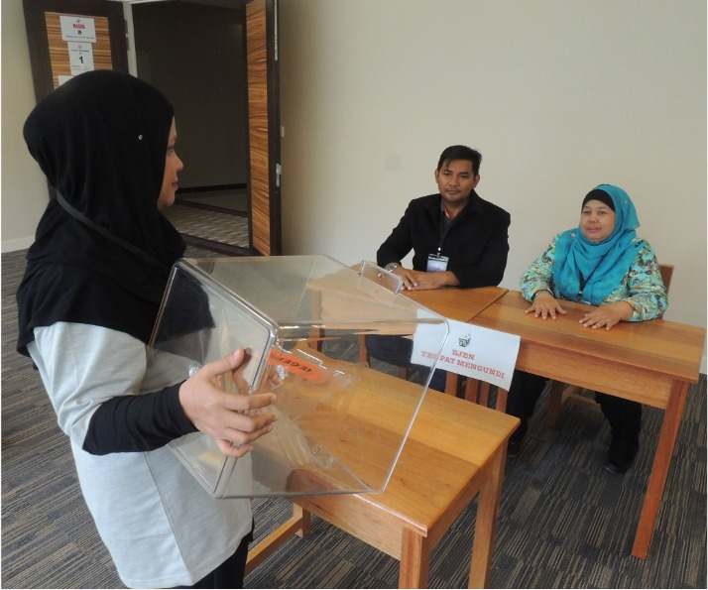
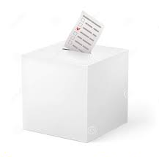
Before 8am: Check Ballot Papers
PO training to check before Polling Day
Ballot Papers
PO to count ballot books: ensure running number order, none missing, 50 to each book, clean & not defaced
  Ballot Papers must have number in top left hand corner with same number on counterfoil; & capable of being folded twice
  Non-complying Ballot Papers to be removed, stamped ‘Rejected’ & kept in separate envelope
PO to fill up Form 13 Part A. Check Ballot Papers details match Form 13 Part A. Copy the details into your empty Form 13
Ballot Box
Ballot Box must not enable Ballot Paper to be taken out except by unlocking
PO must show everyone present Ballot Box is empty
PO must lock Ballot Box & affix with mousetail & tape; Tape signed by PO & PA with permanent marker. Or stamp with party stamp. Take photo of Ballot Box if allowed
PO stamps on EC Form 753. Ask PO to stamp on your empty Form 753 & sign. If not, note the serial number of the stamp

Slide 65
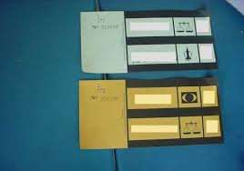
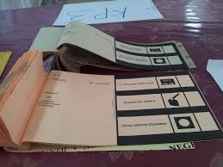
Ballot Books
Ballot books are like cheque books, 50 in each book
  Clerks required to count and check in earlier session
Ballot Papers are sequentially serialised, with serial number on top left hand corner and on counterfoil
Ballot Papers must be clean, with no markings or writing

Slide 66
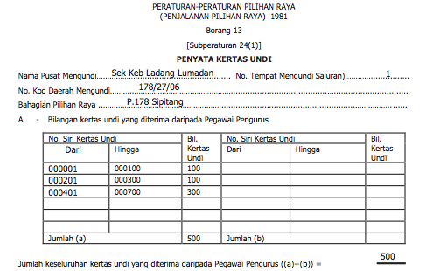
Before 8am: Form 13 Part A
PO fill in Form 13 Part A. Form 13 records total number of Ballot Papers issued for Polling by end of the day
Form 13 Part A is section of Form 13 which records total & serial number of Ballot Papers available to be issued that day
PO will not give copy to PA; ask for details to fill in your empty Form 13

Slide 67
Form 13 Part A: Station Master task
Obtain details of Form 13 Part A from each PA1, whether the Form is given by PO or not
Text reminder or send messenger to any of them if you do not get it by 7.50am
Text total of each Polling Stream to Station Master Whatsapp group

Slide 68

Rubber Stamp Patterns
Note:
This serial number is unique to each Polling Stream and has no relationship with the Stream number
Rubber stamp is unique for each Stream and design changes with each election
  Used to be selected at random in morning before Polling
Must not be known by anyone outside the Stream before close of Polling
If stamp is damaged, PO will sign on Form 753 and each Ballot Paper

Slide 69
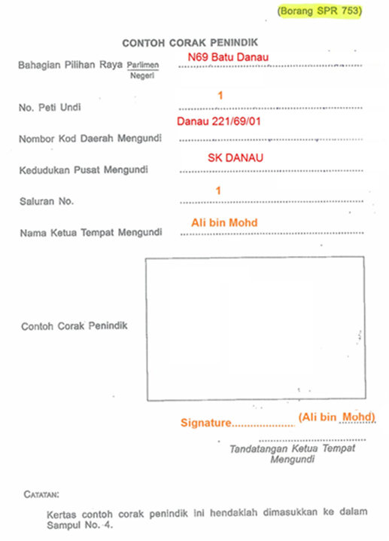
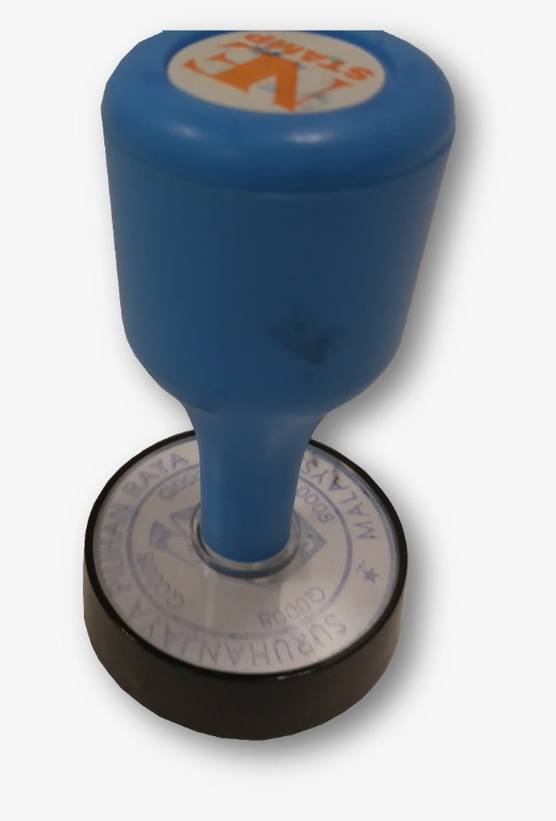
Form 753 Sample Official Mark
Ask Clerk to stamp on the empty Form 753 from your PACA Kit
If won’t stamp, just record down the serial number
  For CA to refer to during Counting to verify Ballot Papers are from this Stream
Do not communicate this serial number to anyone outside the Stream until after close of Polling
Note:
If PO refuses to allow a sample to be stamped on EC Form 753, ask to sight and record the serial number on the stamp for your Stream

Slide 70
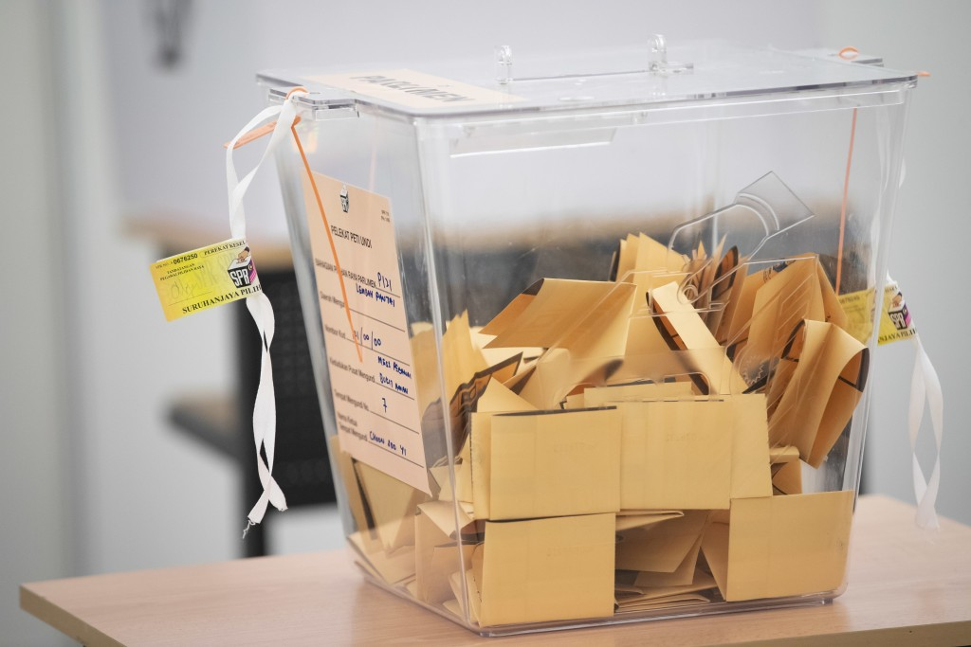
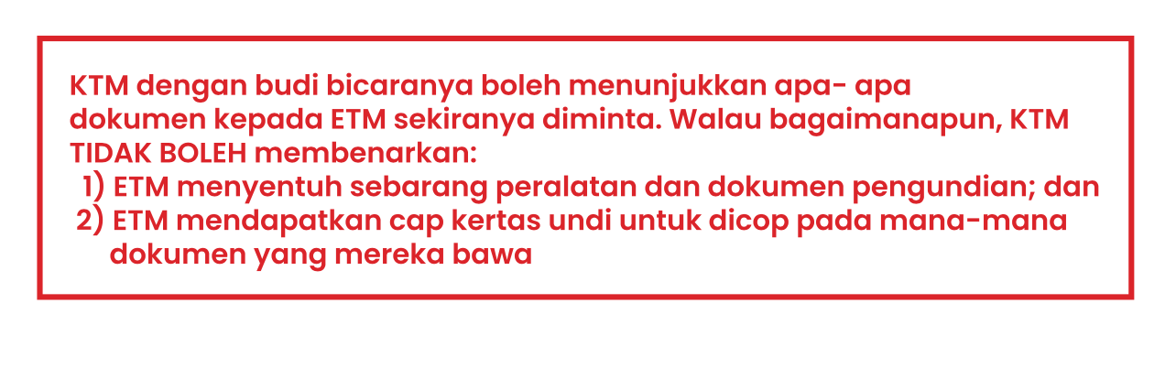
Ballot Box
PO will show Ballot Box is empty to anyone present and willing.
Box is locked at side by tie and sealed using EC seal
PO and PA sign on EC seal using ballpoint pen. You cannot touch Ballot Box
Page 37 PO Workbook

Slide 71

Before 8am: Potential Issues
PO refuse to give your PA his Form 13
  PA to obtain info to fill in own copy
PO refuse to stamp the Stream number for PA
  No issue, PA to take down the serial number
PO do not allow PA to sign Ballot Box seal
  Against the Regulations, Report to Station Master
PO refuse to allow use of handphone
  Speak to the PO and explain that PA will only be texting but will not be calling
  If refused, ask that PA will message outside the room
  If still refused, send standby PACABA to Polling Stream every 30 or 60 minutes for messages
    If necessary, PA comes out of room to discuss
No data coverage or phones disallowed altogether
  Send standby PACABA to Stream every 30-60 minutes
  Send standby PACABA to place with coverage to text to Bilik Gerakan

Slide 72
What happens in Polling

Slide 73


Voting Flow in 2-door Polling Stream
Barung – Situated outside the Stream
1
2
3
EC Clerks
Police Officer
Enter
Ballot Boxes
EC Barung
4
Polling stream room
2 doors
2
Polling Agents
1
Polling Booths
Exit
Presiding Officer (PO)

Slide 74
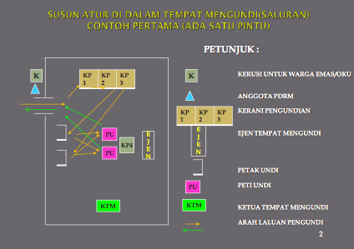
Possible arrangement of A Polling Stream with 1 Door

Slide 75

Flow in the Polling Stream
Voter enters Polling Stream & goes to EC Clerk 1
EC Clerk 1
  Checks Voter’s hands, verify the Voter’s MyKad & make face identification
  Reads out Voter’s Serial number, MyKad number & name
EC Clerk 2
  Mark Voter’s left index finger with indelible ink
EC Clerk 3p Ballot Paper
  Stamps and tears Ballot Paper from ballot book
  Folds and hands Ballot Paper over to Voter
Voter
  Goes to Polling Booth to mark Ballot Paper
  Drops Ballot Paper into Ballot Box
  Voter leaves the Polling Stream

Slide 76
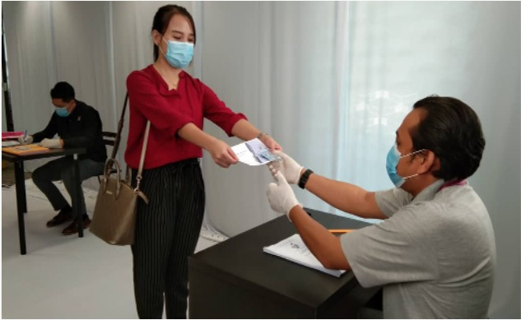
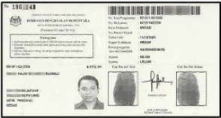
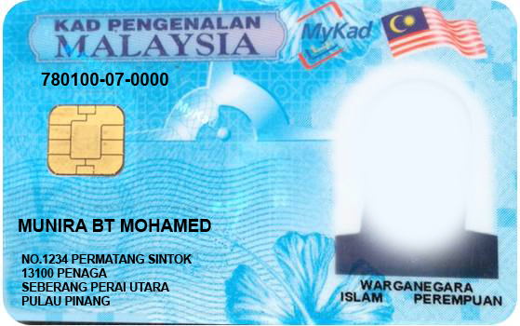
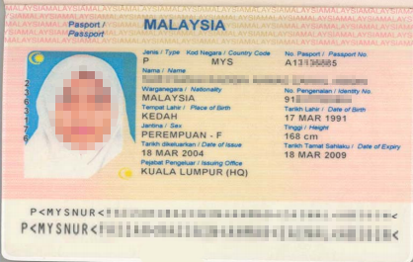
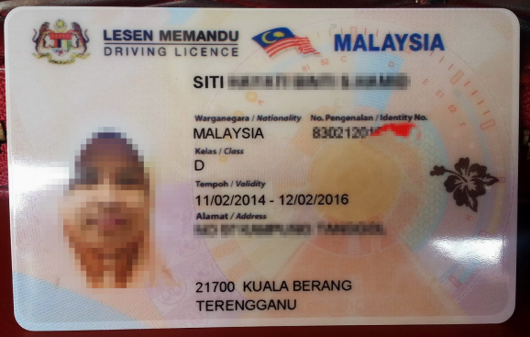
Identity Documents accepted by EC
Official document with name photo, MyKad number issued by authorised government department
MyKad or Police/Army Service Card
  Report receipt KPPK11 or Temporary IC KPPK09 certified by JPN
    KPPK11 do not carry photo
International passport
Driving license with photo
Department access card

Slide 77



EC Clerk 1: Verifying Identity of Voter
EC Clerk 1 will
check Voter’s fingers not marked with ink
verify identity of Voter from Voter’s identity documents and MyKad name & number same as in Electoral Roll
  Must look at face of Voter
    Bring to attention of PO if not done
call out number, name of Voter & new (or old) MyKad number
  Name and MyKad number from Electoral Roll, not from MyKad
pass MyKad to Clerk 2 for second verification
mark off Voter’s name from Electoral Roll after Clerk 2 mark Voter’s finger
  May not write down Ballot Paper serial number against Electoral Roll

Slide 78
Electoral Roll
1
2
3
4
PP
Notes:
Sample of a voter roll.

Slide 79


EC Clerk 2: Using Indelible Ink
EC Clerk 2 will check Voter’s left forefinger for any previous marking
If none, Voter’s left forefinger will be dipped into ink until first joint
  Use other fingers on left hand if Voter do not have left forefinger
  If none, use fingers on right hand
  Brush used only if Voter has no arms
Ballot Paper is issued by EC Clerk 3 and name marked off by EC Clerk 1 AFTER finger is marked
No marking of finger = No issue of Ballot Paper

Slide 80


Finger Marking with Indelible Ink
2
4
1
5
3
KIRI
KANAN

Slide 81




EC Clerk 3: Issue Ballot Paper
EC Clerk 3 will stamp Ballot Paper and counterfoil with Stamp of Stream, consistently in the same position and orientation
Ballot Paper must be free of any notation or marking
If Ballot Paper is torn or smudged or incorrectly marked, Voter may request a replacement Ballot Paper
  PO may issue new one if satisfied not on purpose
  Damaged Ballot Paper will be cancelled, recorded and kept in envelope
EC Clerk 3 will tear here
Rubber stamp made by EC Clerk 3 before handing Ballot Paper to voter

Slide 82


Ballot Papers
N
P
Voter will be issued TWO ballot papers in simultaneous elections:
  1 Ballot Paper for Parliament (MP)
  1 Ballot Paper for State Assembly (ADUN)
Voters in Kuala Lumpur, Labuan, Putrajaya will receive ONLY ONE Ballot Paper for Parliament as there are NO state seat in FTs
Voters in Sabah, Sarawak and states where DUNs not dissolved also get only one Ballot Paper
Notes:
Sarawak just had their State Election in April this year.

Slide 83

Stamping Ballot Paper
Rubber stamp should be stamped
neatly and wholly
in the middle under serial number
consistently positioned in the Stream

Slide 84


Issues regarding Ballot Papers
  Writing stationery
  Clerk 3 may not write on Ballot Paper or Counterfoil or inform Clerk 1 of serial number
    Clerk 3 must not have any pen or pencil
    Clerks should not talk to each other unless can be heard by all
  Stamping one book
Do not allow multiple stamping to avoid multiple Ballot Papers issued
  But may be hard to control as may wish to expedite polling
  Do not allow any unused but stamped Ballot Papers at close of Polling
  Stamped Ballot Papers to be cancelled immediately

Slide 85



Variation to Roles
Stream should have 4 EC Clerks: EC Clerk 4’s role is to push Ballot Paper into Ballot Box, usually with a ruler
Stream may sometimes have only 2 EC Clerks: Tasks of EC Clerk 2 and 3 will be combined
  Only EC Clerk 1 may have stationery; EC Clerks 2 and 3 will not have stationery
If there is a heavy queue, EC Clerk 2 may assist EC Clerk 1, creating two queues
Roles may rotate during the day, usually during lunch
  Have sympathy, EC officers have no roster or relief

Slide 86



Non-issues regarding Voting process
PA verifying identity
PA will be unable to verify identity or ink markings, only Clerks can
PA only asks to participate in verification if suspicious
  On request, not as a process
Randomising Ballot Papers
Normally not necessary
  It is unlikely PO agrees as it messes up Form 13
Beware of other ‘advisories’ from social media
Dirty/Damaged Ballot Papers
PO may replace Ballot Papers only once for each Voter
  Concerns over sufficiency
Assist to allay Voter’s concern that the vote will not be counted
Lost Ballot Papers
Any Ballot Papers left behind will be recorded in Form 763 with any other incidents
Ballot Paper will be kept in Damaged Ballot envelope
  Request PO to cancel Ballot Paper

Slide 87


The Other PAs
Make friends with other PAs
  They may not be party supporters
  They can back up for you during toilet breaks
But watch out if they write down Voter number in sequence of arrival
If they communicate or bring out Voter numbers, inform PO
  Violates s5(2) at back of Secrecy Oath

Slide 88


Voter turnout
Keep track of hourly Voter turnout
  Keep your own count and agree with number of Voters cancelled off your Electoral Roll
PO will keep track using Form 720 or app
  PO will inform EC or RO of hourly turnout or instruct police officer to do so
  Agree your count with PO Form 720 regularly
Report the cumulative turnout to Your Station Master every hour, if requested
Final voter turnout on Form 720 should agree with Form 13

Slide 89

Form 10A
To be issued by PO where Ballot Paper is refused
  Voter refused to show finger
  Voter’s finger already marked
  Voter refused to allow finger to be marked
  Voter’s name on Electoral Roll already marked
  Also, if Voter not on Electoral Roll, no adequate identification or name/MyKad differs from Electoral Roll
PO to fill in Form 10A in presence of witness
  Usually, the PA

Slide 90


Handicapped/Blind Voters
Principle: Only Voter can be alone at polling booth
‘Handicapped’ for this purpose means only those physically not able to vote by themselves
  Deaf Voters are not Handicapped for this purpose
Only Assistant nominated by Voter, who can be with Voter behind polling booth screen.
Nominated Assistant must be citizen and above 21 years old. Assistant signs Form 10 in presence of PO. Copy given to PA
If no person is nominated by Voter, PO is authorised to mark Ballot Paper
  PA try to hear Voter’s instructions and ensure PO mark accordingly
  or offer to be assistant

Slide 91

Form 10
Declaration of helper for Handicapped/Blind Voter
Signed by Assistant
  Prepared by PO
  Copy to PA
Voter must be present
Assistant must be
  Malaysian
  Over age of 21
Notes:
This Borang 10 can also be used in case of “wrong sex” in the Electoral Roll of the Voter.

Slide 92

Doubtful Identity
If identity of Voter is doubtful, PO can fill in Form 11 for Voter to sign
  Copy given to PA
  PA can request, but final decision lies with PO
  If PO refuse, objection or just take note
Examples given
  Voter refuse to remove veil
  Name change due to change of religion
  Change of physical appearance due to surgery
Other examples to try
  Unsure of ink mark on finger
  Unsure of citizenship
Gazetted Electoral Roll is prima facie evidence of the Voters’ right to a Ballot Paper and cannot be objected to on Election Day

Slide 93
Form 11
Declaration of identity by Voter
That the Voter is a bona fide Voter who is entitled to a Ballot Paper
Official Oath
  Falsifiers can be jailed
Filled in by PO
  Signed by Voter
  Copy to PA

Slide 94



Voters voting at another Stream
Covid infected Voters
Form 765
(To allow handicapped Voter to vote in lower floors stream)
PO & PA upstairs informed of handicapped Voter downstairs
Ballot Paper in Special Envelope brought to Voter downstairs after upstairs PO come down for verification
Voter signs Form 11 downstairs witnessed by upstairs PO and downstairs PA , Clerk downstairs mark ink & Voter mark Ballot Paper
PO brings marked Ballot Papers upstairs in envelope to be opened in front of PA and placed in Ballot Box after Clerk 1 verify and call out name/etc
PA signs Form 765 to witness
Form 717
(No longer used but provision still in Regulations)
Staff on duty on Elections Day before use of Early & Postal Voting can vote at the Polling Centre where they are on duty with authorisation from RO

Slide 95

At the Polling Booth where Voters cast their Votes in silence
Be careful if
Window is open
Voter take too long behind screen
Photo taken
PO assisting behind screen
  Especially if PO is too helpful

Slide 96










Prohibitions in the Polling Stream
No display of political party logo
No smoking
No weapons
No talking to Voters
No arguments with authorities
No touching of Ballot Papers or any polling equipment
No use of mobile phones or electronic devices
No disturbing or disrupting the voting process
PO has the right to remove any PA who does not follow instructions

Slide 97

Role of Polling Agent
Ensure all above processes are followed
Ensure secrecy provision are followed by all EC Officers, other PAs and anyone who may come into Polling Stream
Mark off name of Voter in own Electoral Roll, called out by EC Clerk 1
Collect all Forms 10, and 11; Note receipt of Form 10A
If any infringement noticed
  Hand up to talk to PO and raise objection politely
  PO decision final; If not satisfied with PO decision, may
    Issue Letter of Objection, with copy retained. Inform Station Master
    Note down and inform incoming PA/CA and Station Master
Do not be hindrance to voting process
  If you are not present, voting process will continue without you

Slide 98


Shift timing
Depends on availability of PACABAs, shifts may be 2-6 hours long
Polling is normally 8am to 6pm unless reduced hours have been gazetted for 72 hours
  Otherwise PO may close early with permission from RO if all Voters in the Electoral Roll have voted
Each shift by any one PA is for a minimum of 2 hours
  If a PA leaves before 2 hours, PO may not allow replacement
    Ask if you wish to go to toilet: Usually allowed
  PO may misunderstand and ask PO to leave at 2 hours
    You may need to explain to PO

Slide 99


PO Training – 2 hour rule
PO often misunderstand the two hour rule to mean maximum 2 hours
Refer PO to
  Sec 14 (1A) Election Offenses Act
  PO Training slide 95 Deck 1
If still misunderstood, inform Station Master immediately

Slide 100

Handover at end of shift
Do not leave until your replacement by another PA or the CA (if the last shift)
  Handover the PACA Kit to your replacement
  Brief replacement on key issues to watch out for
If coming back for subsequent shift or as CA, inform PO as he is holding your Appointment Form & Secrecy Oath
  If returning as CA, you need a new Appointment Form
Backup your replacement by staying outside the Polling Stream until your replacement fully settles in

Slide 101

Electoral procedures in age of Covid
Polling Stream limited to 600 voters each, not 700
Only 2 Election Officers and 2 observers in each Polling Stream may be present to inspect Ballot Boxes before Election Day
Voting cards sent to Voters with information of voting place etc. and voting time 8-10am, 10am-noon, noon-2pm, 2-5.30m
PUI/PUS require approval from District Health Officer to vote
Over 60s and disabled Voters vote in Polling Stream 1 with separate screening station
Sanitiser and disposable gloves provided after dipping finger in ink but before being given Ballot Paper. Voters’ disposable gloves disposed after voting
Only two observers allowed in Tallying Centre

Slide 102

Hygiene procedures in age of Covid
Sanitisation every 2 hours
Clinical wastes kept separately for separate disposal
Social distance is 2m between tables and 1m between individuals
Unhealthy defined as temperature over 37.5º, having cough or cold
Unhealthy voters taken to vote in separate place with officers in PPE. Polling booths and wheelchairs sanitized after every use by unhealthy voter
Masks and gloves compulsory for all officers
Sanitisers compulsory at screening stations, entrance to Polling Streams and exit from Polling Centre

Slide 103
Close of Polling

Slide 104


Timing of Close of Polling
Polling closes 6pm sharp
Normally, those already issued Ballot Papers will be allowed to proceed to close
  Depending on the PO, ‘Issued’ could include those queuing outside the Stream
  If PO intends to extend opening hours due to long queues and slow process not within his control, inform your Station Master
PO to inform PA when Counting will start
  Ask whether consecutive or concurrent
  Inform your Station Master

Slide 105


Procedures Close of Polling
Ask PO to cancel any Ballot Papers stamped but not issued to Voter
Add up your final count of total voter turnout and compare with PO’s Form 720
  Your count is from total number of names cancelled in the Electoral Roll, excluding Postal Voting
  If PO’s count significantly exceed PAs, alert Station Master
    If all Streams report excess, report to EA immediately
PO will
secure opening of Ballot Box and affix with tape
  Tape to be signed by PO and PA on tape & on Ballot Box; take photo if allowed
  Check that morning seals are still intact
complete Form 13
keep unused Ballot Papers, cancelled Ballot Papers, Counterfoils of used Ballot Papers and marked Electoral Roll in single packet
  Affixed with tape, signed by PO & PA

Slide 106

Form 13
PO will determine
  No of Ballot Papers issued
  No of Ballot Papers unused
  No of Ballot Papers cancelled
  This should determine the number of Ballot Papers that has been cast into Ballot Box
  Compare with Voter turnout in Form 720
PO will fill in and sign Form 13
  PA will sign Form 13
  PO will not give a copy: PA to copy onto empty Form 13 in PACA Kit before signing PO’s copy

Slide 107

Form 13
Form 13 Part A already filled in before start of Polling
Form 13 completed at end of Polling
  Signed by PO & all PAs
  Form 13 will NOT be given to PA
  Copy all details onto your own empty Form 13 before signing PO’s Form 13
Report Form 13 details to Station Master

Slide 108
Form 13 – your task
Obtain details of Form 13 from each PA, whether the Form 13 is given by PO or not
  Follow up if you do not get it by 6.30pm
Text Form 13 details of each stream to Election Agent / Station Master Whatsapp group

Slide 109

PO Training – Form 13
PO are trained not to give PA a copy of Form 13 or sign PA’s copy
PO may misunderstand directive & refuse PA to copy or even see Form 13
Refer PO to
  PO training slide 68 Deck 2
If still misunderstood, inform Station Master immediately

Slide 110
What happens to your Forms?
White Appointment Form
Inserted into Package 5 into EC Bag
Red Secrecy Oath
Will not be retained except that of last PA who is not also CA

Slide 111
Safeguard Ballot Box
AT ALL TIMES, keep Ballot Box in view, either by yourself or by other PACABA assisting you
You may be asked to leave the room while furniture is rearranged into a Counting Room
  Stay in the room if possible
  If have to leave, ensure windows and doors open
PO may close the room to go for prayers or dinner
  Ensure only PO has the key but keep windows open

Slide 112

PACABA Arrangements
Ensure all available PACABAs to be stationed outside Polling Stream to assist PACA in observing Ballot Boxes
  Ensure replacements if PA has dinner, prayers, or toilet break
If allowed, you should station yourself and your remaining team outside Polling Stream rooms where counting is taking place instead of at the pondok panas (especially if it is dark)
Release all PAs once counting start. Ask them to clean up pondok panas
  leave it cleaner than you found it

Slide 113


Reduced Polling hours
In interior, villages are grouped into clusters of villages (or longhouses into a village) and one of the villages (or longhouse) will be the Polling Stream
If number of voters is not numerous, polling hours may be reduced.
  Reduced polling hours gazetted in Election Gazette
  Notice of reduced hours posted at entrance of Polling place for at least 72 hours
Although not mandated by Regulations, try to persuade PO not to count the votes until after 5pm
  If you succeed, watch Ballot Box until Counting time
  If you fail, try delay announcement of results until 6pm

Slide 114


Moving Ballot Boxes
If PO is responsible for more than one venue (may not be a separate stream), a single Ballot Box will move from one venue to the next
  At first location, Ballot Box will be sealed before move
  At new location, Ballot Box will be unsealed before Polling
  New Form 13 will be filled in, superseding earlier Form 13
PO to inform PA where Counting will take place
Counting will take place as if one single Form 13 and one Ballot Box all along
There must be a PACA team in each location
  First team to sign on seal with 4-digit code and/or rubber stamp, inform second team and take a photo if permitted, before Ballot Box is moved
  Second team checks 4-digit code and/or stamp and take photo before the seal is removed

Slide 115

Polling: Potential Issues
Other PA note Voter number in chronological order or list bring out of room or text Voter numbers
  Inform PO and Station Master
PO asks PA to be replaced every two hours
  Regulations is minimum two hours, not maximum
    Sec 14 (1A) Election Offenses Act
Other party’s material within 50m of Polling Centre
  Prohibited under Sec24B(7) Elections Offenses Act
  Take photo and inform Station Officer
PO do not give any copy of Form 13
  PA to copy all details to own Form 13 before signing the PO’s Form 13

Slide 116
Early Polling and Postal Voting

Slide 117


Early Polling
Separate Polling Stream
  Special sticker for Form 13 & Ballot Box
  PO is Assistant Returning Officer
Same procedures as Normal Polling
  Except (usually) 3 days before Election Day
    Regulations: 7 days after Nomination Day until 3 days before Election Day
    Ink must last that long
  Usually normal hours, but could differ
    2pm if < 50 voters
Ensure recording of
  Form 13 total after Early Voting
Counting after 5pm Election Day
  Complications over watching Ballot Boxes
Eligibility
EC officers
Police
Army
on duty on Election Day
and their spouses
ENSURE TURNOUT IS NOT MORE THAN THOSE REGISTERED

Slide 118

Postal Votes
Eligibility
On duty on Early & Election Day and wishes to vote by postal votes
  EC, Police, Military, Malaysian Maritime Enforcement Agency, Prisons Dept, Malaysian Fire and Rescue Dept, government hospitals & clinics, police volunteers, Civil Defence Force, Immigration Dept, National Disaster Management Agency, and Registration Dept
  Media workers
Malaysians with permanent address overseas
  Must have returned to Malaysia 30 days in last 5 years
And their spouses
Application must be made – Form 1A (foreign) or 1C (domestic) from EC website
  Copy of MyKad/Passport
Deadline:
  1A: Nomination day
  1C: 5 days before Election Day

Slide 119






Postal Voter Procedures
Voter receives four items
    Ballot Paper(s)
    Envelope A
    Parliament: White
    State: Pink
    Form 2
    Envelope B
To arrive at RO Office by Close of Polling Election Day
Post/Courier
Deposit at Embassy
Personal delivery
Mark
Signed by Voter & Witness

Slide 120

Postal Voting – Form 2
Ensure
Signed by Voter and Witness
Same serial number on Ballot Paper

Slide 121

Overall Postal Process
24 hour notice
1️⃣
Fix postal ballots total
RO to provide date for final postal ballots approved
Obtain final total approved and Postal Electoral Roll
Issue ballot papers
Only one Ballot Paper issued to only those on postal electoral roll
Total ballot papers issued = postal ballots approved
2️⃣
24 hour notice
Counting of votes
Counting as normal but using Form 15
Total ballots counted ≤ Total envelopes opened
Opening postal envelopes
Check 2 criteria to be valid
  Ballot paper number = Form 2 = Envelope A
  Form 2 signed by Voter & witness
Total envelopes opened ≤ Ballot papers issued
4️⃣
3️⃣

Slide 122

Administering Postal Voting
Ballot Box is used to hold Postal envelopes returned to RO Office but not yet opened or sorted
  By day: Under control of ARO Postal Ballots
  By night: Kept in Police lockup, key kept by ARO Postal Ballot
Opening Postal Ballots normally start 2pm Election Day
  May have additional day (or morning session) if high volume
Counting of Postal Ballots after 6pm Polling Day
Separate stream
  PO is Assistant Returning Officer
Dates of issuing & opening of Postal Ballots determined by RO
  Must give 24 hours notice for the first instance
  May be more than once, subsequent dates “appropriate notice”
Normally in RO Office

Slide 123

Postal Votes – Issuing procedures
Issuing Procedures
Similar to Ordinary Voting
Rubber Stamp Form 753
Ballot Box shown to be empty
Postal Clerk 1 call out name & number and mark name & ‘PP’
Postal Clerk 2 issue Ballot Paper
Specific to Postal Voting
Postal Clerk 3 write Ballot Paper number on Form 2 & Envelope A
Postal Clerk 4 insert Ballot Paper, Form 2, Envelopes A and B into postal envelope
Documenting Postal Votes
Form Format A
Pos Malaysia list of Postal Ballot recipients
Pos Malaysia acknowledgment of receipt
Form 754
Number of Postal Ballots issued by departments and overseas

Slide 124

Postal Votes – Opening procedures
Sorting of Postal Votes
Valid Postal Ballots inserted into Ballot Box
Rejected Postal Ballots into Rejected basket
  No Envelope A/Ballot Paper AND Form 2
  Ballot Paper serial number differs from Form 2
  Form 2 not signed
  Recorded on Form 755
After opening, RO will inform when counting will take place
  Counting as normal
  Results on Form 15
Opening Postal Ballots
All trays shown to be empty
Total Envelopes B counted
Ensure that total opened not more than total issued
Each Envelope B must have Form 2 & Ballot Paper and/or Envelope A
  Form 2 may be in Envelope A
Criteria
  Form 2 signed by Voter & Witness
  Same Ballot Paper serial number on Envelope A and Form 2

Slide 125









Opening Postal Votes
Envelope A
2
A
A
Open Envelope B
Open Envelope A
✖
Form 2 signed?
Form 2 = Envelope A
2
✔
Contain Form 2 & Ballot Paper?
A
✖
✔
Envelope A = Ballot Paper
Form 2 signed?
Form 2 = Ballot Paper
✖
✖
✖
✔
✔
Ballot Box
Form 2
Reject

Slide 126


Manage your numbers
Deadline for registration
Total valid application for Postal Ballots
Issuance of Postal Ballots
Total Postal Ballots issued
Total valid Postal Ballots in Ballot Box
Total valid Postal Ballots counted
Opening of Postal Ballots
Counting of Postal Ballots
Record your numbers at every stage
Every PA must enter with the total from the previous stage
The numbers can only reduce not increase
Report your numbers to PACA Coordinator
Form 15 after the final stage
You will not be getting any document from EC until after final stage
First PA must obtain full Postal Voter list after issuance of Postal Ballots
Form 754
Form 755
Form 15

Slide 127


Forms 754 and 755
Form 755
After opening of Postal Envelopes
Records valid & rejected Postal Envelopes
  Close equivalent of Form 13
Form 754
After issuance of Postal Ballots
Records Postal Ballots sent by department and overseas

Slide 128
Form 15
Given to PA as in Form 14
All Polling Streams details are correct
Number of Postal Ballots issued
Order of candidates follow Ballot Paper
Rejected Ballots
PO signs
CAs sign
Could be on reverse of Form

Slide 129
Before Counting Start

Slide 130

Concurrent or Consecutive
PO have two options where there are simultaneous State and Parliamentary elections
Concurrent Counting (preferred by EC)
  Both Ballot Boxes are counted at the same time
  PO will split his team into two, with 2 EC clerks each
  Will require two Counting Agents
Consecutive Counting
  Ballot Boxes are counted one at a time
  Will be default if less than 4 EC clerks available
  Will require only one Counting Agent

Slide 131

Counting Room Layout
EC clerks will move furniture to convert Polling Room into Counting Room
  PO may require all others to leave room to move furniture
    Ask to stand in a corner & not disturb
  Ensure doors/windows open and you can keep Ballot Boxes in view
May be followed by toilet/prayers break. If late, dinner break
Get a seat in middle
Only PO, Clerks and CA allowed in
  Windows are closed & doors locked

Slide 132



What you get in Counting Room
1 or 2 sealed Ballot Boxes
Packet containing unused Ballot Papers, cancelled Ballot Papers, Counterfoils of used Ballot Papers and marked Electoral Roll
Form 13 outside envelope
PO and EC Clerks

Slide 133
Counting Procedures

Slide 134



Step 1: Opening Ballot Box
PO will show that all baskets are empty before starting
  Number of baskets = no of candidates plus 2 (Rejected & doubtful)
PO will show Ballot Box seals & signature are intact
  Take photo before opening if allowed
PO will open Ballot Box and pour contents into basket
The fan will be on full blast and Ballot Papers may fall off the table: DO NOT pick up
  You cannot touch Ballot Paper
  Point them out to the EC Clerks
EC Clerk will extract and count Ballot Papers
  Ballot Papers bunched in bundles of 10s and 100s
PO compare number of Ballot Papers with total in Form 13
  If same or less then Form 13, update From 757

Slide 135

Form EC 757 <= Form 13

Slide 136


If Ballot Papers more than Form 13
If number of Ballot Papers > Form 13,
Recount all Ballot Papers
PO to open packet with unused & cancelled Ballot Papers & re-fill Form 13 in CA presence
PO to set aside all Ballot Papers without valid Stream stamp in presence of CA
Inspect every Ballot Paper and recombine with counterfoil to identify Ballot Papers not from the same book
All unused Ballot Papers, Spoilt Ballot Papers, Counterfoils, etc to go back into packet with security tape signed by PO & CA

Slide 137


Step 2: Sorting into Candidates
EC Clerk will call out party voted one at a time and show Ballot Paper to all CAs
  Sit in the middle so that you can see all Ballot Papers
  Ballot Papers will be stamped at the back accordingly
Invalid Ballot Papers to be rejected, placed separately
  Before rejecting, PO must show CA and consider views of CA but PO decision is final
  PO will then stamp “DITOLAK” and will count as Spoilt Vote
Check Ballot Papers sorted correctly
  Ensure placed in correct basket
  Maintain your own count

Slide 138


Invalid Votes
Not stamped with Stamp of Stream or initialed by PO
Votes given for more than one candidate
Something is written or marked by which the Voter can be identified
Not marked or marked in place other than correct place (as long as intention is unclear)
Not clearly indicate intention of Voter

Slide 139



Contoh undi yang boleh diterima
Sebarang tanda yang dibuat di dalam ruang nama calon
Sebarang tanda yang dibuat oleh pengundi yang dapat menunjuk dengan jelas undi yang hendak diberikan kepada Calon. Perlu diingatkan di samping contoh-contoh di bawah mungkin ada tanda-tanda lain yang boleh diterima.

Slide 140


Contoh undi yang boleh diterima
Sebarang tanda yang dibuat di dalam ruang simbol calon.
Sebarang tanda yang dibuat di dalam lebih daripada satu ruang bagi calon yang sama

Slide 141


Contoh undi yang boleh diterima
Satu tanda atau lebih di dalam ruang yang sama
Sebarang tanda yang melangkaui ruang tetapi tidak memasuki ruang bagi calon yang lain

Slide 142

Contoh undi yang boleh diterima
Kertas undi yang terkoyak sedikit tetapi tidak menjejaskan butiran di dalamnya

Slide 143



Contoh undi yang akan ditolak
Kertas undi yang tidak dicap atau ditindik dengan tanda rasmi atau tidak ditandatangani oleh Ketua Tempat Mengundi. (Tanda cap rasmi atau tindik rasmi atau tandatangan KTM itu ialah di bahagian atas sebelah kiri kertas undi)
Sebarang tanda yang diberi kepada lebih daripada satu Calon

Slide 144


Contoh undi yang akan ditolak
Tanda yang dibuat pada ruang satu-satu calon tetapi melangkaui ruang calon yang lain
Tanda yang dibuat di luar ruang nama calon, ruang simbol dan ruang untuk memangkah

Slide 145


Contoh undi yang akan ditolak
Tanda yang dibuat di luar ruang nama calon, ruang simbol dan ruang untuk memangkah
Sebarang tanda atau catatan yang boleh mengenalkan diri pengundi yang dibuat di mana-mana bahagian kertas undi

Slide 146


Contoh undi yang akan ditolak
Sebarang bentuk gambar yang dilukis di mana-mana di bahagian kertas undi
Kertas undi yang dituliskan dengan sebarang perkataan

Slide 147


Contoh undi yang akan ditolak
Kertas undi yang ditulis dengan perkataan lucah, sensitif dan yang menunjukkan persendaan di mana-mana bahagian kertas undi
Kertas undi yang dikoyak dan diceraikan.

Slide 148


Contoh undi yang akan ditolak
Kertas undi yang dikoyakkan nombor siri kertas undi
Kertas undi kosong (tidak bertanda). Dalam kes ini, semakan teliti hendaklah dibuat untuk menentukan bahawa kertas undi itu memang tidak bertanda.

Slide 149


Doubtful Basket
If you are not sure about the candidate voted, just say “RAGU” and it will go into the Doubtful basket
  Will expedite sorting
Make sure they repeat sorting for Doubtful basket and not just empty into one candidate’s basket
Some Ballot Papers may be smudged with ink
  Acceptable as long as intention is clear
  Voter may have agreed with PA earlier that smudged Ballot Paper is to be accepted
PO will show CA that basket is empty

Slide 150

Watch out for!!!
Check Ballot Papers for all candidates, not just your own
Make sure Ballot Papers go into the correct tray
As Ballot Papers go into the correct tray, keep count on your own sheet
Be at peak alertness. Sorting into baskets normally take about 30-45 minutes
If you have any issue, raise your hand to talk to PO, not Clerk
  PO’s decision is final
  If still not satisfactory to you, consider Objection
  Inform your Station Master later
Do not be hindrance to Counting process
  If you are not present, Counting process will continue without you

Slide 151


Step 3: Counting the Votes
EC Clerk will count each Ballot Paper aloud and sorted into groups of ten
  Make sure there are ten in each group and Ballot Papers are secured down
  If they fall off table or got mixed up, ask for recount of the whole group of ten
EC Clerk will count each group of ten aloud and sorted into groups of 100 and then for the final tally
Every count will be recorded in a Form 764

Slide 152

Form 764
This shows the total of Ballot Papers counted for each candidate
A Form 764 is filled in for each count
PAS
BN

Slide 153

Recount
CA can ask for only one recount if the difference between first two candidates is 4% or less
  Consider before asking for recount – it is not the majority at your stream that count but the majority in constituency
Can you get more votes from a recount?
  You should ask for recount if you lose most of the Doubtful Votes, even if your candidate won Stream
PO can order recount anytime and any number of times
Recount does not involve Cancelled or Rejected Ballot Papers
  Counting start from Step 2 again

Slide 154
After the Count

Slide 155

Announcing the Result
PO will inform CA total number of Votes for each candidate
  Report result to Station Master as soon as practical. If there is a problem, inform Station Master
PO prepares & certify sufficient copies of Form 14; CA to sign; PO to issue one copy of Form 14 to each CA
  Ensure sequence of candidates is the same as on Ballot Paper
  Ensure the numbers are the same as what you counted

Slide 156
Form 14
PO will fill in Form 14
  Transferring numbers from Form 764
  One copy for each CA and one for PO
All copies signed by PO and all CAs
  All copies are identical
Mandatory to be given to all CAs
  The only document mandatory to be given
  The only basis for Tallying Centre
Form 14 is the only and the final evidence of everything that happened in the Stream that day

Slide 157

Form 764 to Form 14
PAS
BN

Slide 158

Checking Form 14
All Polling Streams details are correct
Form 13 total
Order of candidates follow Ballot Paper
Rejected Ballots
PO signs
CAs sign
Could be on reverse of Form

Slide 159

PO Training – Form 14
PO may confuse instructions for Form 13 & 14 and refuse to give you a Form 14 or sign your Form
Refer to
  Election Regulation 25(4)
  PO Training Slide 42 Deck 3
If PO still refuse, inform Station Master and/or Election Agent immediately

Slide 160


The Packets and Ballot Box
Contents of yellow EC bag
Ballot Box with two packets in it
  Packet containing unused Ballot Papers; cancelled Ballot Papers; Counterfoils of used Ballot Papers; marked Electoral Roll
  Packet containing all counted Ballot Papers: valid & rejected
    Sealed with tape; PO & CA to sign tape
  Ballot Box sealed with tape; PO & CA to sign tape
Two separate envelopes with Forms 13 & 14
  Sealed with tape; PO & CA to sign tape
Two more packets for Forms and Manuals

Slide 161
Potential Issues
PO asks PACA to leave the room to rearrange furniture
  PACA to stay in corner in room to observe
PO closes Stream for prayers or dinner
  Ensure doors locked but windows left open
PO does not give Form 14
  Explain mandatory under Election Regulation 25(4)
  CA to provide blank copy of Form 14 for PO’s signature
  Inform Whatsapp group and Candidate/Election Agent

Slide 162
On Completion

Slide 163




Tallying after counting
Total from Form 13
  This is the number of votes that should be in the Ballot Box
  Not more than total voters in Electoral Roll for that Stream
Total from Form 14
  This is the number of votes obtained by each candidate
  Agree with reported Form 13 totals

Slide 164


Polling Results
Text results of counting results to Bilik Gerakan/Election Agent or the Station Master Whatsapp Group the moment you receive from CA
Check the total votes add up to Form 13 for each stream
Consolidate all results into one final text and send to Election Agent, PACABA Coordinator or Bilik Gerakan

Slide 165


After the Counting
All CAs hand over PACABA Kit with their copies of Form 14 to you
  Their task end when they hand over observations to your Station Master
Procedures: Yellow EC bag handed over to PO1
  But normally each PO prefer to carry their own
PO1/POs will bring everything to Tallying Centre in police convoy
  You may ask help of your CAs to follow the EC car to Tallying Centre
  You cannot sit in the EC car

Slide 166



Form 14 and Ballot Box
Collect all Forms 14 & check that all forms are correctly filled in
  Correct name and number of Polling Stream
  Sequence of candidates are in same order as in Ballot Paper
  Numbers all add up
  Total Ballot Papers counted equal or less than Form 13
  Signed by PO & all CAs
Follow PO1 in your car all the way to the Tallying Centre and ensure all Ballot Boxes and Forms are handed over without any stops or interference
Hand over your Forms 13 & 14 to the Election Agent /PACABA Coordinator/Bilik Gerakan as instructed

Slide 167

Counting cannot complete
If counting cannot start or complete (eg., natural disasters), PO to inform CA & RO
  If Ballot Box not opened, PO to pass Ballot Box & Form 13 to RO or Police Station
    CA to follow in separate car
  If opened, PO to put everything (including Form 13 if filled up) back in the Ballot Box in presence of CA, affix with tape (PO & CA to sign) & hand to RO
Counting will take place at new venue

Slide 168


Your responsibilities are now over
Your work is now completed. You may stay to observe the inclusion of your Polling Centre numbers into the final tally
Text the final result to all your PACABAs and thank them on behalf of the Candidate and the Rakyat Malaysia. Arrange for a get together for drinks for another day
Ensure all personal data deleted off your handphone
  Especially MyKad photo and details

Slide 169





A few observations
A few principles
PACA is last line of defense
PACA cannot stop well-planned frauds
PACA can only observe and record down
Look for patterns, not just incidences
Reports of non-compliance
Wrongly reported
Innocent errors/ miscommunication
Lack of training/competence
Isolated random frauds
Pre-planned frauds

Slide 170

Any Questions
Slides are at https://www.jimkhong.com/jim-the-polling-agent

