Slide 1
Station Master Training
Role and Guidance for Management of Polling Agents & Counting Agents in General Election

Slide 2

What we will cover today
What’s a Station Master
Before Election Day
Material for Elections
On Election Day
After Polling Closes
Potential issues marked in red
Pictures may be taken from EC training to facilitate reference for EC Officers

Slide 3
What’s a Station Master

Slide 4

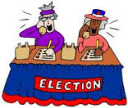


The Candidate’s team
Campaign Manager
Candidate
Election Agent
Mandated to represent Candidate to EC
Help run Election for Candidate
PACABA Coordinator
Administer recruitment, assignment, training & logistics for PACABA

Slide 5



Breaking down the Constituency
Constituency – Parliament & State
School; Village; Housing Estate
Polling Centre (Pusat Mengundi)
Classroom; Hall; Longhouse
Polling Stream (Saluran Mengundi)
Mukim, Town & surroundings
Polling District (Daerah Mengundi)

Slide 6

Who’s Who on Election Day
Constituency
Returning Officer (‘RO’)
+ 4 Asst ROs
Presiding Officer 1 (Coordination role)
Polling Centre Officer
Presiding Officer (Ketua Tempat Mengundi = ‘KTM’)
Election Agent
PACABA Coordinator
Station Master (Ketua PACABA)
Polling Agent (‘PA’)
Counting Agent (‘CA’)
Centre
Stream=Saluran

Slide 7

What a Polling and Counting Agent is
An agent of Candidate
  Act of agent is act of candidate
  Interest of candidate is interest of agent
  You are not independent
Two separate roles – PA and CA
Observe Polling and Counting process
  Not part of the process
  No veto
Subject to Election law

Slide 8
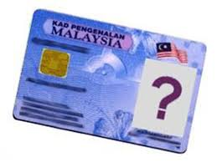
Who can be a Polling and Counting Agent
Waiting for the change
Malaysian citizen
21 years and above
Not charged in Court for any criminal offense in the last 5 years
  Traffic offenses excluded
Not a discharged prisoner within the last 5 years under Elections Offenses Act
Not registered under Prevention of Crime Act
Not an undischarged bankrupt

Slide 9
What a Station Master do
Variously also called Ketua PACABA
Lead all PACABAs in Polling Centre
Manage, Schedule, etc all tasks for PACABAs under him/her
Communicate with EC authorities in the Polling Centre
Report results of Polling in Polling Centre with Form 14 as well as situation at the Polling Centre
Intermediary between PACABAs at Polling Centre and Election Agent

Slide 10

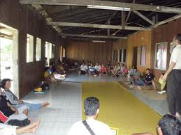
Two types of Station Masters
Urban areas
Several Polling Streams in one Polling Centre, one location
  Normally a school
PACABA recruitment tend to be more centralized in urban areas
Rural areas
Several Polling Centres, including single Polling Stream
Normally will cover entire Polling District
Local Station Masters may have responsibility to recruit PACABAs
Task more complicated
  Communicating with several locations

Slide 11



Who will make a good Station Master
Used to leading and managing others
Prompt response when unusual situations arises
Communicate with difficult people
Familiar with all Election & PACABA procedures
Trustworthy and fair

Slide 12
After your appointment

Slide 13

Appointment as Station Master
Normally you will be appointed by PACABA Coordinator
  Chosen from experienced PACABAs
No appointment letter as this is not a formal position acknowledged by EC

Slide 14

Initial tasks
3 areas of preparation
PACABA
Polling Centre
PACA kit and Material
Make sure you are appointed as Polling Agent AND Counting Agent
  Without the EC Tag and Appointment Form, you will not be allowed into Polling Stream to speak to any PO
  You may be required as standby PACABA

Slide 15
PACABA – Recruitment, Rostering and Communication

Slide 16

PACABA Name List
PACABA Coordinator will provide you with list of PACABAs assigned to you
Make sure they all have contact numbers
  If no telephone, consider whether you still want the person as PACABA
If contact details are missing, trace in GoogleForm or the original form in PACABA Coordinator’s office

Slide 17


Contact them
Whatsapp and/or Email details of the team & material in pdf to all PACABAs
  Training slides
  and if interested
  Checklists
  Relevant pages of Acts/Regulations
Ask for everyone’s previous experience as PACABA & whether any restriction regarding time slots for duty roster

Slide 18

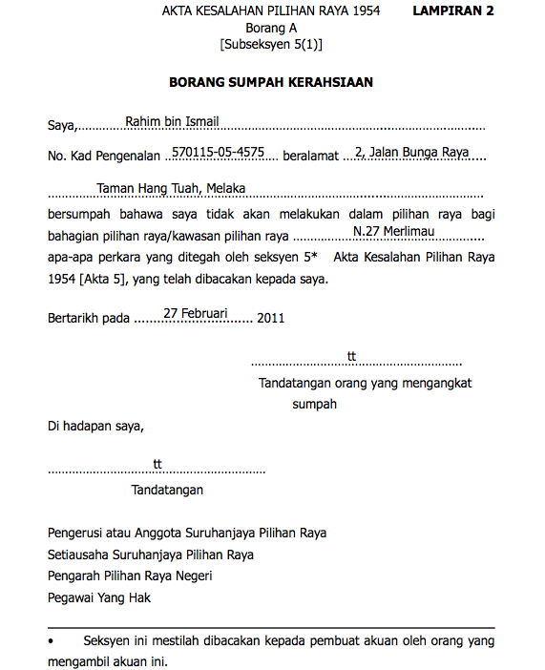
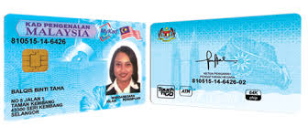
Details required from PACABA
Fill in Google Form
Documents
Copy both sides MyKad
  Handphone photo acceptable
Signed Oath of Secrecy
Passport-sized photo – one for each role PA, CA, BA
  Write name & IC no at back
Details
Telephone number
Experience as PACABA
  Any previous experience as Counting Agent or Station Master
Time and place of duty
  May wish to be on duty at place of voting
At worst, handphone photo acceptable
Mandatory hardcopy not negotiable
At worst, cut from MyKad photo

Slide 19
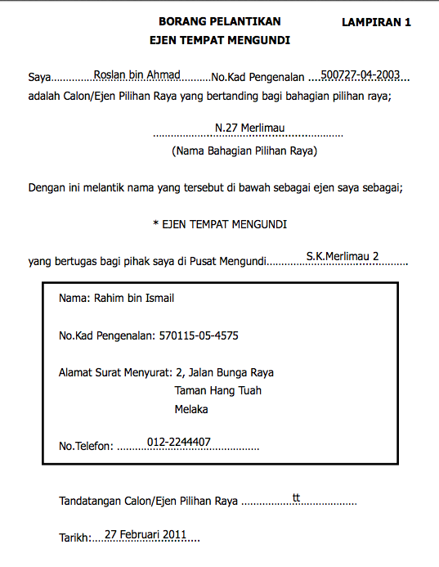
Appointment to be a Polling or Counting Agent
White Appointment Form filled in by PACABA Coordinator and signed by Candidate or Election Agent
  One for each role PA, CA and BA
Specific to the Polling Centre
  Any change will require a fresh Appointment Form

Slide 20
Form A Oath of Secrecy
Red Form
Required to comply with Election Offenses Act s5
  Cannot try to find out candidate for whom Voter has or intend to vote
  Cannot communicate any details regarding name or voting number of any Voter before Polling close
  Cannot communicate with Voter between receipt of Ballot Paper & inserting into Ballot Box (except PO)
  Cannot communicate Polling Stream stamp before Polling close
  Full s5 on reverse of the Form
Only those who have taken oath may enter Polling Stream or see serial number on Ballot Paper

Slide 21



Potential Change
Appointment Form and Secrecy Oath may require role and polling stream to be stated
Implications
Difficulties in switching PACAs between polling streams when required by Station Master
Appointment Form
Can be changed by EC
Will require Candidate/Election Agent to sign sufficient blank Forms to be held by Station Masters
Secrecy Oath
Cannot be changed as it is specified under the Act
  EC may require as an non-Act requirement
Will continue to talk to EC

Slide 22
PACABA Communications

Slide 23


Communication channel
Contact each PACABA to confirm consent before adding them to WhatsApp group
Insert Polling Station number in Group Name - Pxx/Nxx/xx
Insert in Group Description
  Name of Candidate on Ballot Paper
  Link to Training Slides
  Link to Duty Roster
Only Admin can add participant
  no joining by link
Be firm on Group rules
  Only post PACA instructions or matters dealing with this Polling Station only
  Admin to ask poster of non-relevant posts to delete it. If poster refuse, admin to delete. Consider deleting persistent offenders
Consider replying by private message
Arrange meeting if possible at agreed place (eg., by PACABA Coordinator)
  to get to know everyone and deal with any questions on process & logistics
There should be another meeting at Polling Centre on eve of Election Day if possible
Note those with no smartphones
  You will be the one responsible to text them anything relevant from the group discussion
  Consider if you need the PACA if no handphone

Slide 24
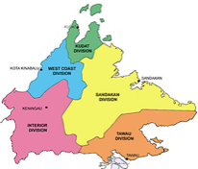

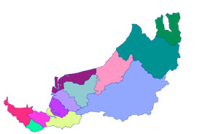

Whatsapp Groups
Candidate & EA usually added morning on Election Day
Each person will belong to two Whatsapp groups only
Information will be sent up and down the levels
State level
  All Candidates, Election Agents, PACA Coordinators
Constituency level
  Candidate, Election Agent, PACA Coordinator
  All Station Masters
Polling Centre level
  Station Master
  All PACABAs

Slide 25


First meeting
Introduce yourself and provide names of the candidate(s) PACABA are representing
Get each PACABA to introduce himself/herself & any previous experience as PACABA
Briefly run through all Polling and Counting procedures and the latest development – EC can change procedures up to 72 hours before start of polling
Explain shifts PA1, PA2, PA3-CA. Anyone not on shift should go to vote and return to be on standby at pondok panas
Agree on logistics, meeting time, procedure to swap duties, dress code, PACA kit, communication without phones etc.
Set meeting time for PA1 on Election Day at 7am at pondok panas (or any other alternative arrangements)
  You need some time to sort out the documentation etc
  Ask more experienced PA2 to come as stand-by

Slide 26
How to prepare the Duty Roster

Slide 27



The Duty Roster
You manage the team around Duty Roster
Indicates all the work on Election Day
Will change with addition of PACABAs by PACABA Coordinator or when PACABAs drop out
First version could be from PACABA Coordinator
  If none, prepare your own
Control versions closely
  Only you can make amendments

Slide 28
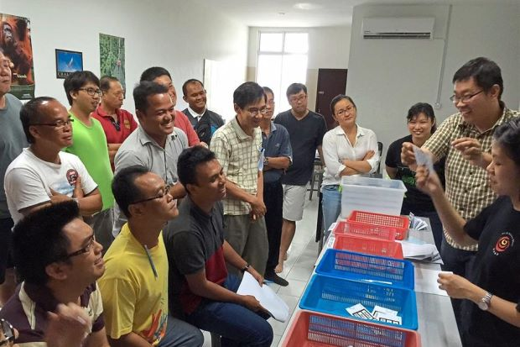
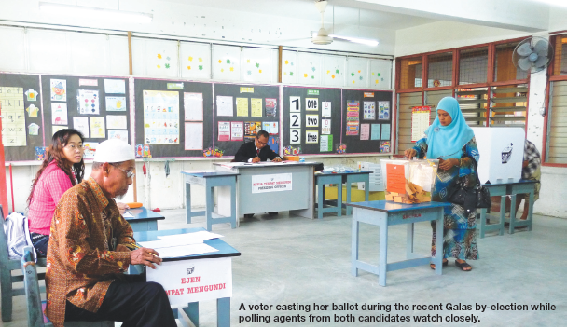
Underlying principles
12 hours roster: divided into
  3 PACAs for Stream: 3 four-hour shifts
  2 PACAs for Stream: Split shifts
If insufficient PACAs, roster is driven by availability
  PACA who can do 2 shifts are most valuable
PACAs go to places where there are votes to defend the votes
  Your best PACAs should be defending Ballot Boxes which contains the most of your votes or your most risky votes
Assess who your strongest PACAs are
  CA must be reliable, especially in rural areas
  Strongest: CA then PA1 then PA2
  Stream 1 may require stronger PACAs

Slide 29

The shifts
Basic shifts are 3 four-hour shifts
7.30am until 12 noon
12 noon until 4pm
    May consider starting earlier if PA1 is also PA3-CA
4pm until 6pm Closing; Then CA until end
  Allows CA into room before Closing, avoiding any confusion of changing shifts while PO prepare room
PA1
PA2
PA3-CA

Slide 30

Preparing the Duty Roster
If you have 3 PAs per Stream
If only 2 PAs per Stream
Allocate Strongest PACA as PA3-CA
Available and preferably from outside
Allocate next PA as PA1
Ensure will be available early morning
Allocate remainder as PA2
Especially if they have other jobs on Election Day
Allocate PAs who can do two shifts
Go in as PA1 and PA3-CA
Allocate PAs who can only do one shift
Go in as PA2
Lengthen PA2 shift
5 hours to maximise PA1/PA3-CA rest time

Slide 31
Other numbers of PAs
If less then 2 PAs
If only one PACA per Stream
  PA goes in as PA1 at 7.30am
  Leave at 10am or when situation stable: risk is lower
  REST, REST, Sleep
  Return as PA3-CA at 4pm
If only one PACA per Station
  CA requests all POs to prepare Form 14s as CA will sign & collect after end of Counting
  Stay outside and monitor: Sign & collect Form 14 for whichever Stream that finishes Counting
  Do not go in for Counting to avoid getting stuck
Available as file in slide
  If more than 3 PAs
  4: Split PA2 shift
  5: Split PA1 & PA2 shift
  6: Split all 3 shifts
    Maximum you can have
    Drawback: changing shift while PO changing room layout

Slide 32

Assessing availability
Determine how many PACABAs you have in all
Check which roles each team member has trained for
    Those trained as PACABA can act as BA also
        trained as BA only should not be PA or CA
Check if any PACABAs will be voting and so be temporarily unavailable
  Your most valuable PACAs are those who can do two shifts
CAs must be reliable, especially in remote areas
  If in doubt, you may need to bring in from outside

Slide 33

Assessing the ability of PACABAs
Assessed the ability of your team based on the following criteria
Knowledge of Election process and regulations
Self control and disciplined in carrying out the task
Firm and persistence when challenged by others
Communication & persuasion skills
Clear thinking in complex situations

Slide 34

Two hour rule
Regulations require PA to be on duty for two hours before they can be replaced
  PO will record change of shift in Form 763
  Implication: If PA leaves after less than 2 hours, there may be no replacement until 2 hours elapsed
  Action: Do not allow PA in if not well/etc and may not be able to complete 2 hours
EC/RO/PO may interpret rule to require the last PA to be on duty for at least two hours
  Consider this for the duty roster – last PA to start at 4pm or 2 hours before close of Polling if reduced polling hours
If PO require each shift to be maximum 2 hours, explain sec 14(1A) Election Offenses Act states the shift to be AT LEAST 2 hours, not maximum two hours

Slide 35
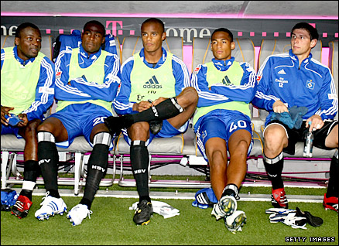
Duty Roster – Standby PACAs
  Always have standby PACABAs
  Get some of more experienced PA2s to be standby for PA1
  Once all PA1s are safely in the Streams and Polling started, release standbys to return for their own shift
If you are fortunate to have sufficient PACABAs for 3 shifts, use your least experienced PAs in middle shift & as standbys
If the situation is stable, send standby in to relieve a PA after 2 hours service, preferably the older or less experienced ones
  Before relief, inform PA being relieved & ask him/her to inform PO of the change

Slide 36
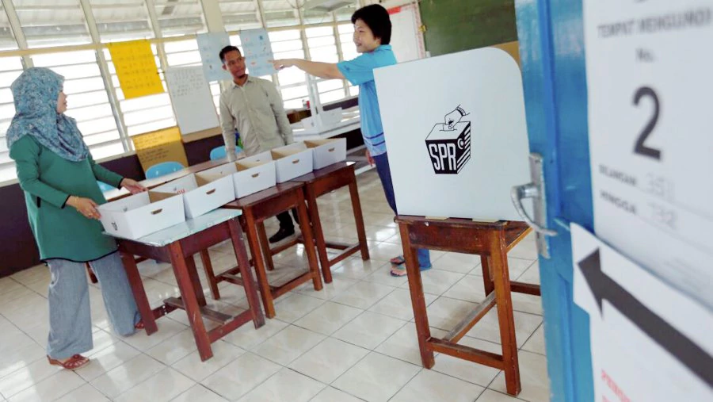
Duty Roster – Counting Agents
CA
If doubtful of reliability of CA, get reliable CAs from outside
If Parliamentary & State are under same party, always roster two CAs per Stream
  one CA cannot cope if simultaneous counting for Parliamentary & State
  If you cannot get two, ask PA1 to come back to be CA to get two CAs per stream
    Ensure available Appointment Form as CA
Should you go in as a PACA?
As a rule: NEVER
You are more valuable to make decisions when issues arise and as communication channel with EA
Exception: If high risk & no one else around with documents, go in as CA
  Inform EA and Coordinator
  Appoint Replacement & add to WhatsApp Group as admin

Slide 37


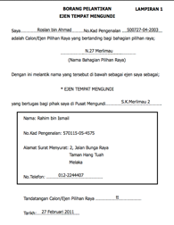
Scheduling Counting Agents
If P & N under same party, schedule 2 CAs with 3 Appointment Forms
CA1 have 2 Forms signed by both candidates
CA2 have 1 Form signed by only one candidate
If one candidate is more vulnerable, CA1 (more experienced CA) will hold that Form
Don’t forget Appointment Form as PA as well
CA1
CA2
N
P
N
Consecutive counting
Concurrent counting
If consecutive counting
CA1 enters with both Forms
If simultaneous counting
CA1 & CA2 enter with own Form

Slide 38
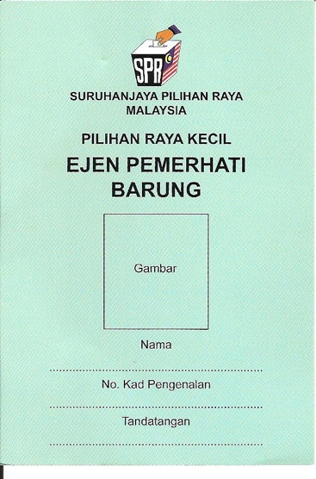
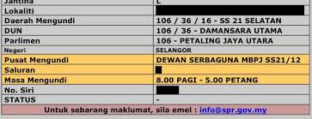
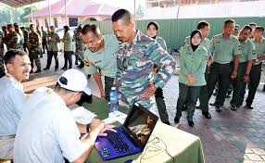
Barung Agents
BA role is to observe checking of Electoral Roll and issuance of stream chits to Voters
But barungs are not mandatory
  Voter can check polling stream at website
If there is insufficient PACABAs, do not have BAs
If there is sufficient PACABAs, or standby PAs are available (after all PA1s have gone into the streams)
  Deploy less experienced PAs and those trained only as BAs to be BAs
  There should be two shifts for BAs. More shifts if there are more BAs
  You only require 2 BAs; Maximum 4 BAs allowed

Slide 39






On Polling Day
Be prepared to amend your Duty Roster as circumstance change
  Availability of people
  Relationship with PO
  Questions over effectiveness or reliability of PACABA
Depending on availability, switch between 2-shifts and 3-shifts as appropriate
Basic principle: every volunteer must have an opportunity to serve

Slide 40

Change will happen
New PACABAs could be added & existing PACABAs could be dropped/pull out
  PACABA Coordinator will continue to recruit and give you more names
  PACABA dropouts will inform you
Set up GoogleDrive to hold the ONLY version of Duty Roster
  Duty Roster there will always be the latest
Circulate duty rosters with version number, preferably in file name
  Night before Election Day, inform everyone final version number

Slide 41
Polling Centre

Slide 42
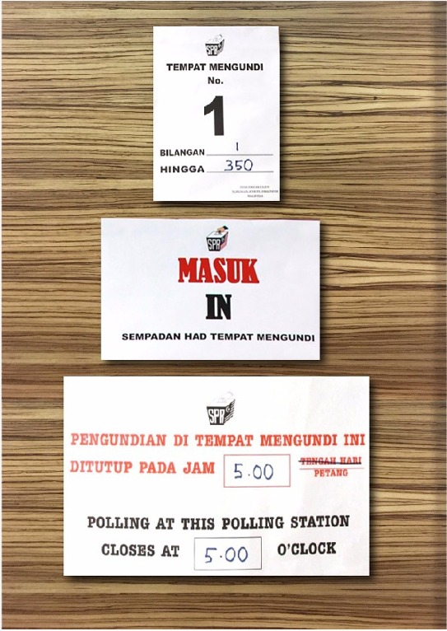
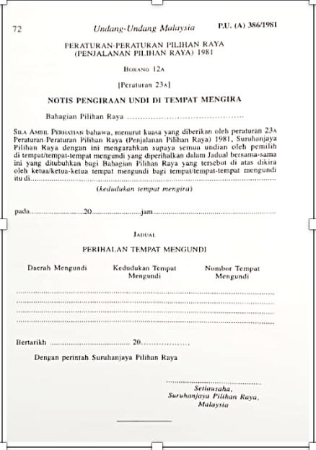
Check the Polling Centre
Check out Polling Centre the weekend before, if possible to identify Polling Streams, Kiosk & toilets
Arrange final briefing for your team at Polling Centre on the morning before Election Day
  Run through flow of voters’ movement from gate to Polling Streams
Test data connection for Whatsapp for all Streams at Polling Centre
  If not working satisfactorily, revert to SMS
  If no SMS coverage, designate runners as messengers
  If Polling Centre itself has no data or SMS coverage, pre-identify nearby spot where you can communicate

Slide 43

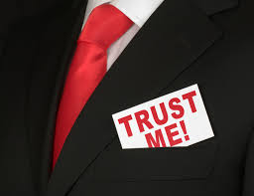
Managing your team at Polling Centre
Take photo of your whole team as this is the last time everyone will be together in daylight at Polling Centre
POs often also meet on the same morning at Polling Centre
  If you see them, introduce yourself. If possible, talk to PO1
Identify if there is another Polling Centre/school or location that can be confused with yours (eg., SK instead of SMK)
Check out where your pondok panas will be

Slide 44
PACA Kit and Material

Slide 45

PACA Kit
Each PACABA Kit will be labeled with Polling Stream
Electoral roll (specific to each Polling Stream)
Sample Forms 13, 14, 753
Sample of accepted and rejected Ballot Papers
Pencil, Eraser, Sharpener, Pen & Ruler
Permanent marker pen
Empty paper & Paper clip
Three Objection Letters
Optional/May be with Station Master only
Glue or Tape
Training slides
PA , CA & Station Master checklist
Relevant pages of Act & Regulations

Slide 46
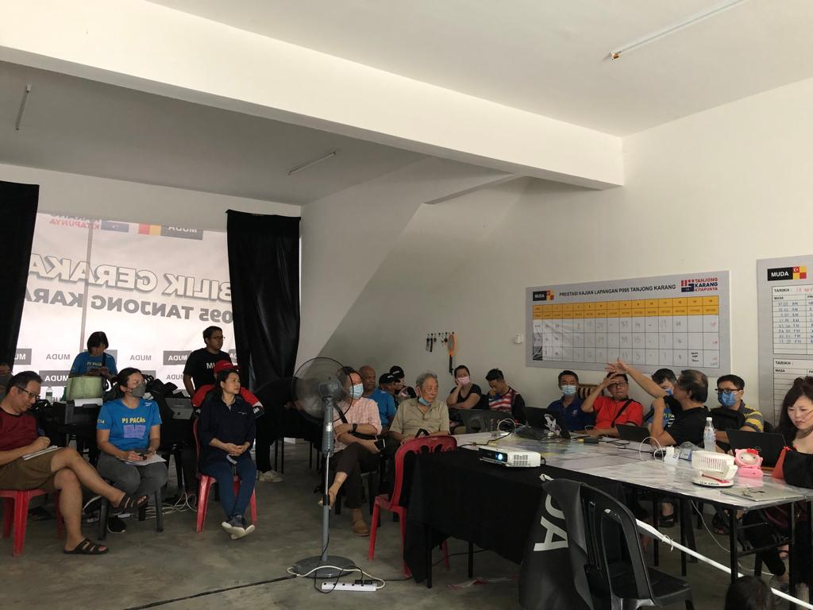
Final Station Master briefing
Pick up your PACABA Pack
  One PACA Kit for you
  One for each Stream, labeled
  PACABA documents
Ensure
  Each Kit is complete
  Each Kit has Electoral Roll for that Stream
    Early & Postal Voters marked
  Each PACABA has
    Red Form A Oath of Secrecy
      Signed by RO
    White Appointment Form
      Signed by Candidate/EA
    PACABA Tag with photo
Will be held 1-3 days before Election Day
  EC may change Election procedures 72 hours before start of Polling
Your final meeting with your PACABA team must be after this briefing

Slide 47

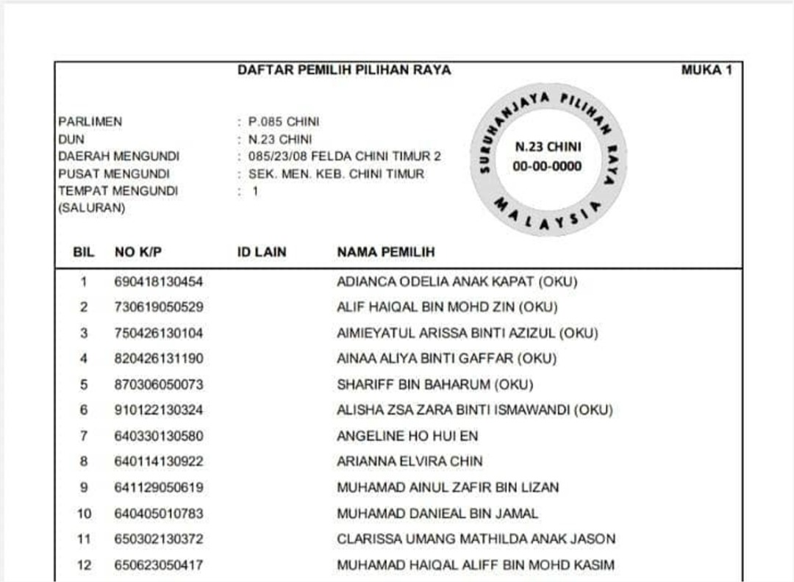
Check the Electoral Rolls
There should be an Electoral Roll in each PACA Kit for that Polling Stream. This may be the complete list of ALL Voters without identifying Early & Postal Voters.
Ensure
correct one for that Polling Stream
complete for all Polling Streams
  Check every page
they are for the latest month that has been gazetted
Check both Early and Postal Voters. Procedures may change!! EC may exclude one but not the other

Slide 48


Information to know
Find out from the PACABA Coordinator
Name & contact number of Candidate & Election Agent
What time water and lunch will arrive
Where to send Forms 13 & 14 after counting
Information & format to be sent to Bilik Gerakan
Whatsapp group set up for all Station Masters
Whether pondok panas has been set up
Most popular question

Slide 49
Before start of Polling

Slide 50

Reminder Eve of Election Day
Reminder text to PACABAs
Prepare the following
  MyKad
  Handphone charged and sufficient credits; smartphones should have sufficient data plan/quota; Powerbank
  Small torch
  Additional passport size photo
  Spare pens, paper, ruler & marker pen
Make sure adequate sleep
8pm
text to all PA1/BA1 to remind them to sleep early and be at pondok panas by 7am (or any other alternative arrangement)

Slide 51
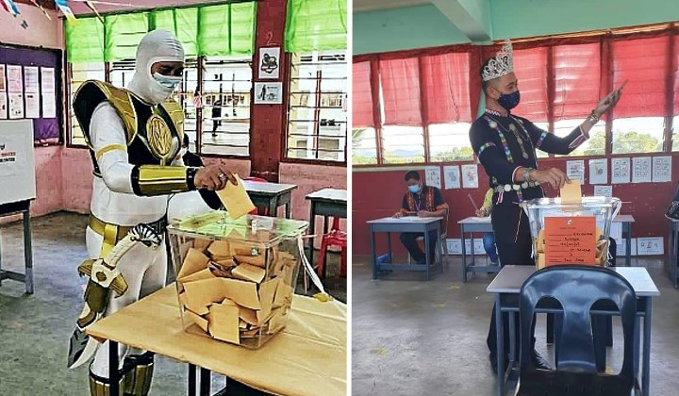
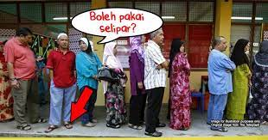
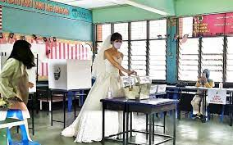
PACABA Dress Code
Smart casual – remember you are on official duty
  Dress comfortably – can get hot in the room
Legal requirement: No political statements or logos
Subject to discretion of PO
  No colours that can be interpreted as political statement
    If in doubt, wear or bring something neutral as spare
  No round-neck or sleeveless T-shirts.
  No shorts, mini-skirts, sandals nor slippers

Slide 52

Eve of Election Day
Follow dress code
Prepare the following
  MyKad
  Handphone charged and sufficient credits; smartphones should have sufficient data plan/quota; Powerbank
  Small torchlight (handphone light may not be enough)
  Additional passport size photo
  Spare pens, paper, ruler & marker pen
  The PACA kits
Make sure adequate sleep
  You will need to be at Polling Centre at 6.45am
  You will be on duty the whole day until night
PO equipment list also include emergency torch

Slide 53
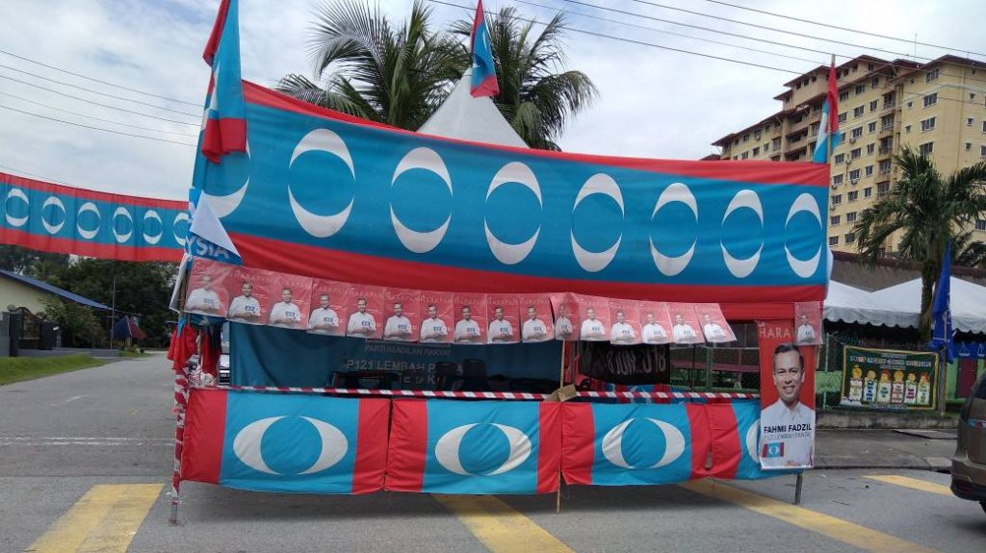
Early on Election Day
Be at designated meeting point at least 15 minutes before designated time instructed to PA1/BA1s, with
PACA Kits
For each PACABA
  Red Form A Oath of Secrecy, signed by RO and PACA
    If PACA has not yet signed the red Secrecy Oath, ensure they sign it before going in
    Sometimes, red Secrecy Oath is unsigned, even if PACA has previously signed one
  White Appointment Form appointing them as PA, CA or BA, signed by Candidate/EA
    One for each role
    If standby PACABA is transferred from another Polling Centre, ensure they have filled up empty Appointment Form for your Station signed by Candidate/EA.
  EC tags (colour coded for PA, CA or BA) with PACABAs’ photo – one for each role
Spare umbrellas & paper clips/tape/glue/staplers (for any last minute change of photos on EC tags)
Plastic chairs in your car if you have removed them from pondok panas the day before

Slide 54

Typical Polling Centre (School)
6
5
4
6
5
4
2 SPR clerks + BA, one for each contesting candidate
3
2
1
3
2
1
Streams in classrooms
Max 700 Voters per Stream
Electoral Roll organized by MyKad number
Stream 1 includes handicapped: 350
All the rest distributed equally
Voters
EC Kiosk
Voters
For Concurrent Elections:
No of PA allowed 2: 1 for P & 1 for N
No of CA allowed 2 if concurrent count
Covid Change

Slide 55
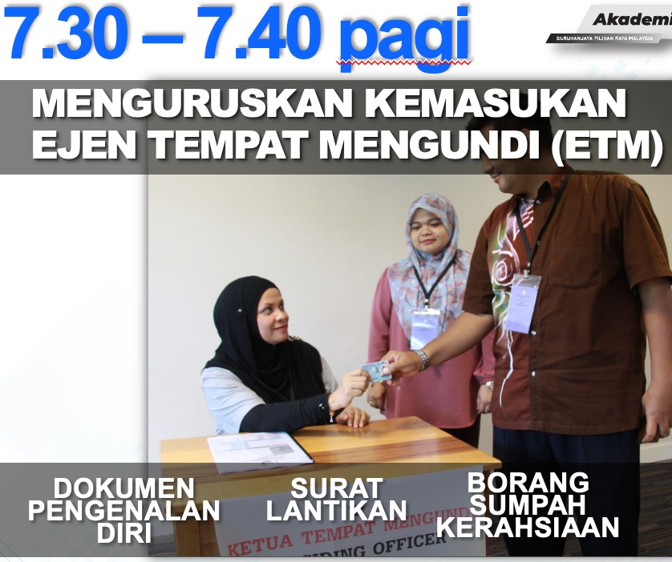
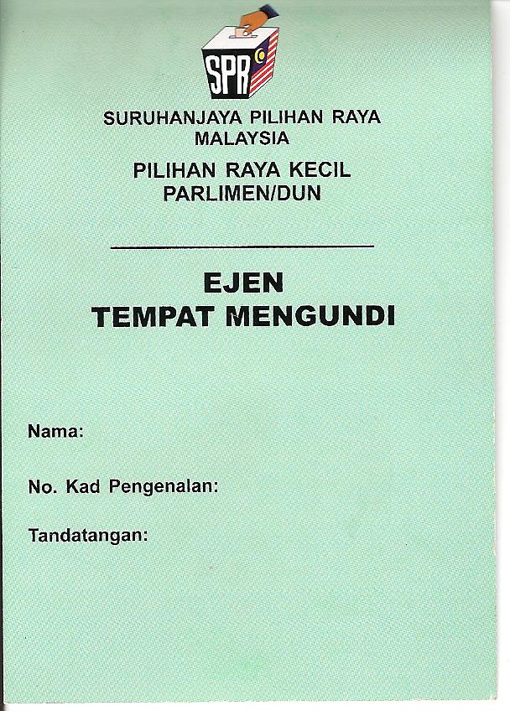
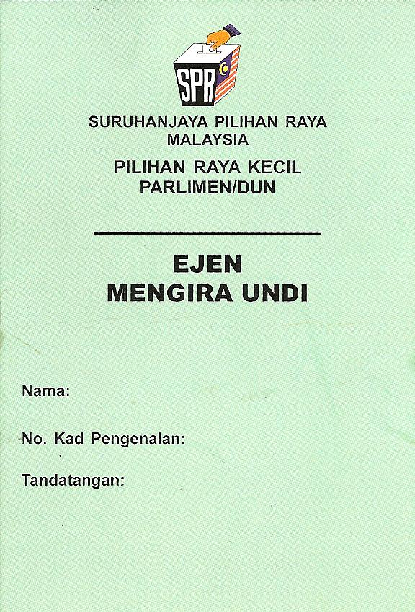
Entering Polling Stream
PA1 can enter Polling Stream at appointed time
  7.30am or any other time agreed with PO
Make sure that they enter with
  MyKad as identity
  Red Form A, Oath of Secrecy, allowing them into the Stream
  White Appointment Form authorizing them as PA
  EC tag, allowing them into the Polling Centre
  PACA kit
PO will brief PAs and Clerks

Slide 56

The Presiding Officer
Presiding Officer (Ketua Tempat Mengundi)
Normally non-partisan
Most are civil servants, called to work on day off
  Some are volunteers from outside government
May not be that familiar with laws or Regulations
  One training every five years
Make him your friend
PO1 more experienced

Slide 57


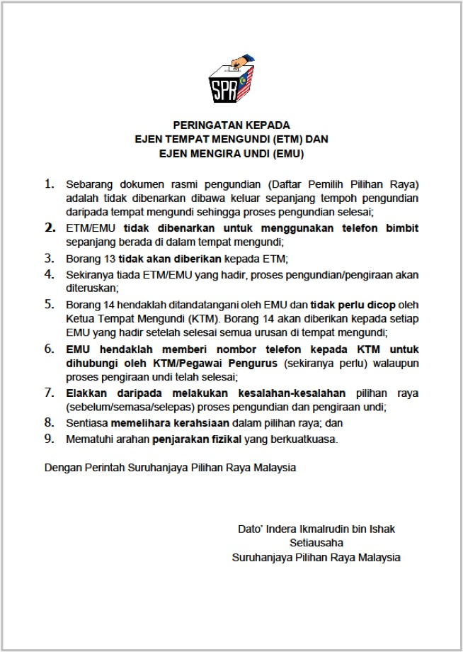
Use of handphones
EC procedures prohibit handphones from Polling Stream
  Always understood to mean prohibited from talking
  Surrender of phones only apply to Voters
  More zealous POs may ask for handphones in basket
Action
  Inform PO phones will not be used to talk & only text
  If no, ask PO if phones can be used outside the room
    PA to bring paper out to record voter number while texting
  If no, runner to be sent to the room every 30-60 minutes to talk to PA if anything to report
PAs to try to keep your handphones and not give it up. Turn off and keep in pocket or bag
Do not get thrown out of the room on this issue

Slide 58
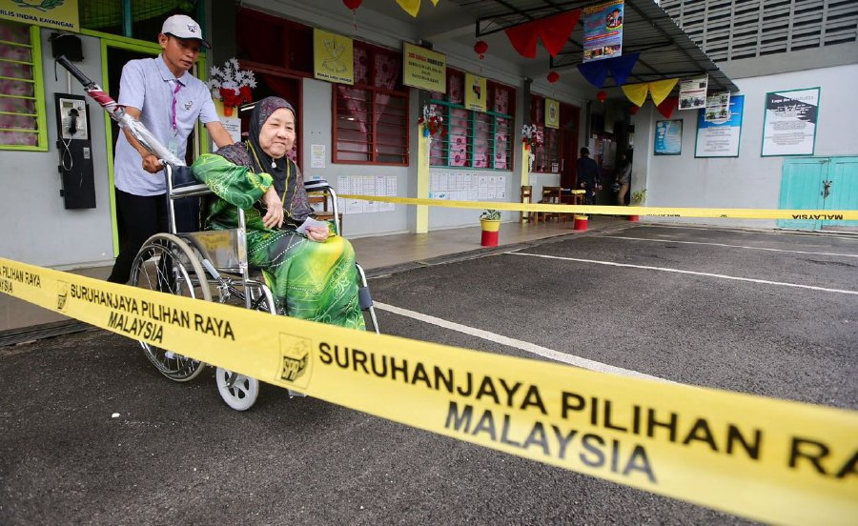
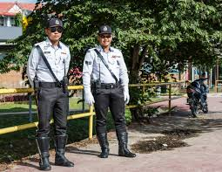
Centre officers and Police officers
Polling Centre Officer is in charge outside Polling Streams
Introduce yourself to Polling Centre Officer and police officers on duty
  Let them know who you are & where your pondok panas is
  Ask them to contact you if there is any problem
Throughout the day, go into the Polling Centre and wave at them as you pass
  Get yourself familiar to them
  If they don’t allow you in because you are not on duty, inform EA immediately, to call RO
  You will need their cooperation to bring your PACABAs in after close of Polling to watch Ballot Boxes
No campaign material allowed within 50m of Polling Centre, (eg., from school gate)
  Example: cars with party logos
  Inform Polling Centre Officer

Slide 59
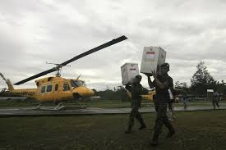
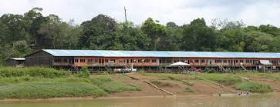
In remote areas
Agree with PO where polling hours are shortened
  Closing time displayed at Polling Stream for 3 days
  Make arrangements to observe Ballot Box after Polling
  Counting of results should not take place before 5pm
If PO responsible for more than one polling location, ensure
  one PA in each location
  PA1 to sign seal on opening of the Ballot Box with a 4-digit code or special rubber stamp and take a photo
  PA2 to take photo before opening the seal
If no telephone coverage
  Find out earlier: location with coverage to communicate with Bilik Gerakan
  Prepare standby PA as messenger
    Be outside each Polling Stream every 30 or 60 minutes

Slide 60


Reminders to PACABA
(Based on three shifts)
8am to remind PA2/BA2 to vote and be at pondok panas by 11.30am (or any other alternative arrangement)
11am to remind PA2/BA2 to meet in 30 minutes
11.50am to inform PA1/BA1 their replacement has arrived/not arrived. If not arrived, ask them to hold on and update them every 10 minutes
2pm to remind any PA3-CA to return by 3pm
3.50pm to all PA2 that PA3-CA has arrived/not arrived

Slide 61

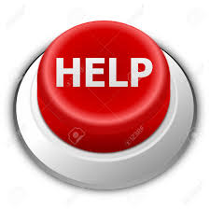
Communicating with Election Agent
Inform Election Agent & Whatsapp group of any non-compliance immediately
  State Polling Centre or Stream, your name, time and nature of non-compliance
  Stream format = [No parliament]/[No DUN]/[Polling Centre]/[Stream] = Pxx/Nxx/xx/xx
  Call if there is an unusual matter requiring explanation or immediate action
Normal regular items to report for each Stream
  Hourly voter turnout
  Form 13 beginning and end of the day
  Form 14 final results
Report any suspicion actions or circumstances
  Limit only to the facts & your responsibilities
Candidate & Election Agent can enter any Polling Stream

Slide 62
Before Polling starts

Slide 63
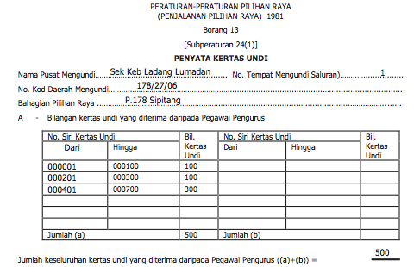
Form 13 Part A: Your task
Obtain details of Form 13 Part A from each PA1, whether the Form is given by PO or not
Text reminder to any of them if you do not get it by 7.50am
Text total of each Polling Stream to Station Master Whatsapp group

Slide 64
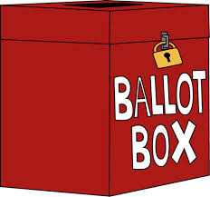
Before 8am: Potential Issues
PO refuse to give your PA his Form 13
  PA to obtain info to fill in own copy
PO refuse to stamp the Stream number for PA
  No issue, PA to take down the serial number
PO do not allow PA to sign Ballot Box seal
  Against the Regulations, Report to Station Master
PO refuse to allow use of handphone
  Speak to the PO and explain that PA will only be texting but will not be calling
  If refused, ask that PA will message outside the room
  If still refused, send standby PACABA to Polling Stream every 30 or 60 minutes for messages
    If necessary, PA comes out of room to discuss
No data coverage or phones disallowed altogether
  Send standby PACABA to Stream every 30-60 minutes
  Send standby PACABA to place with coverage to text to Bilik Gerakan

Slide 65
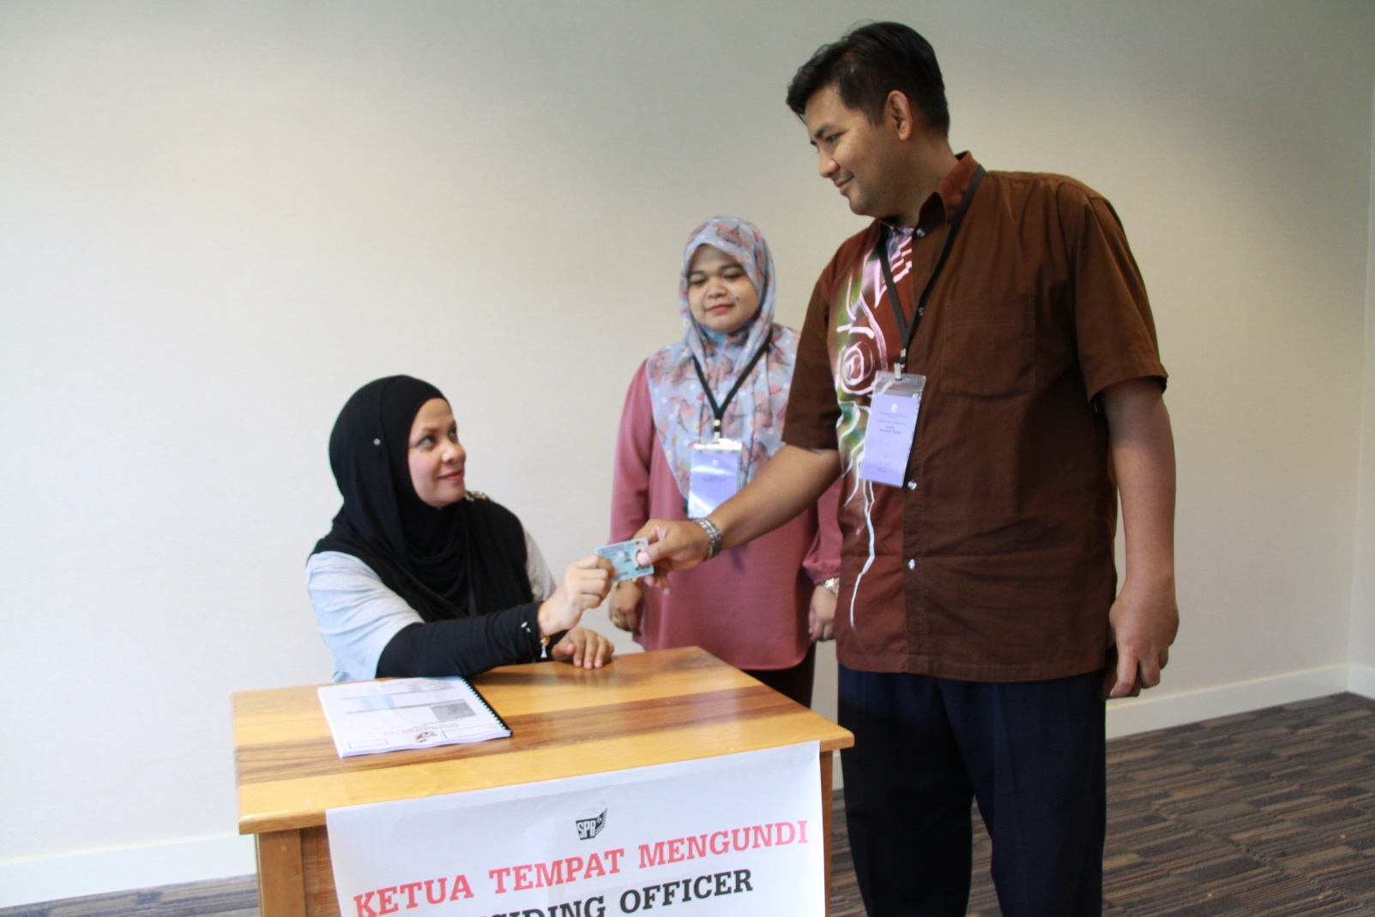
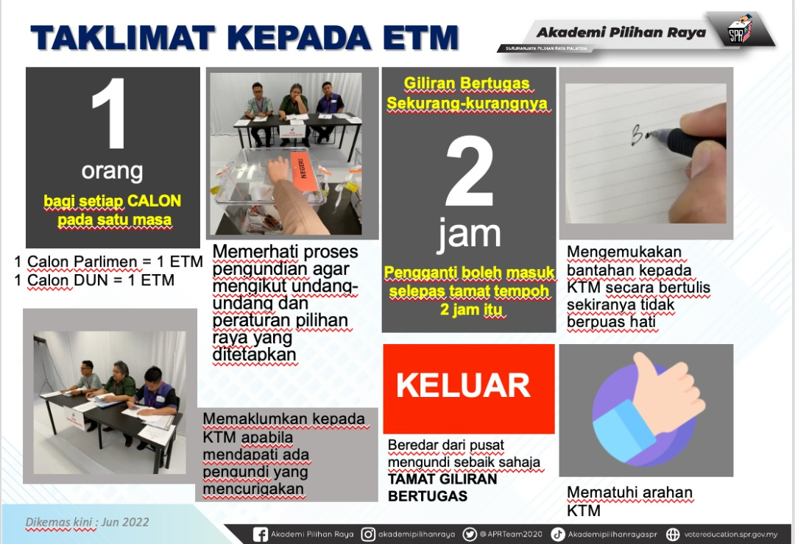
PO Slide – 2 hour rule
PO often misunderstand the two hour rule to mean maximum 2 hours
Refer PO to
  Sec 14 (1A) Election Offenses Act
  PO Training slide 95 Deck 1
If still misunderstood, inform Station Master immediately

Slide 66
Before Counting

Slide 67
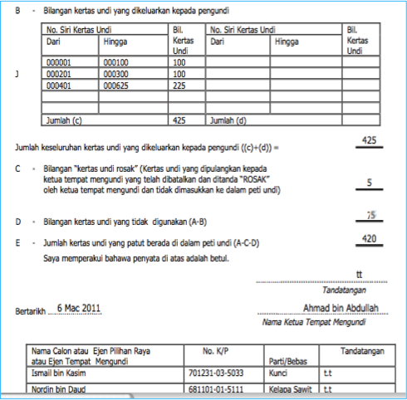
Form 13 – your task
Obtain details of Form 13 from each PA, whether the Form 13 is given by PO or not
  Follow up if you do not get it by 6.30pm
Text Form 13 details of each stream to Election Agent / Station Master Whatsapp group

Slide 68
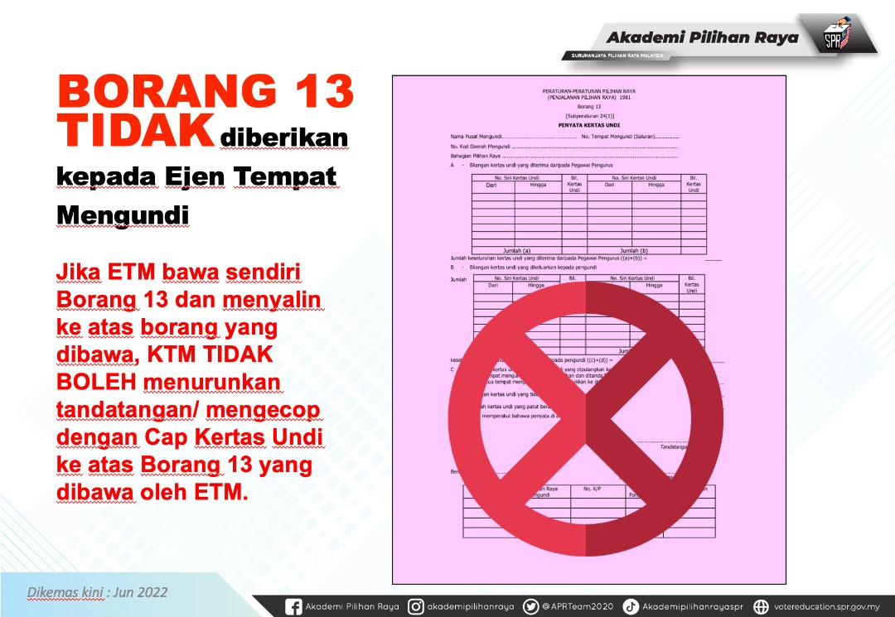
PO Slide – Form 13
PO are trained not to give PA a copy of Form 13 or sign PA’s copy
PO may misunderstand directive & refuse PA to copy or even see Form 13
Refer PO to
  PO training slide 68 Deck 2
If still misunderstood, inform Station Master immediately

Slide 69

PACABA Arrangements
Ensure all available PACABAs to be stationed outside Polling Stream to assist PACA in observing Ballot Boxes
  Ensure replacements if PA has dinner, prayers, or toilet break
If allowed, you should station yourself and your remaining team outside Polling Stream rooms where counting is taking place instead of at the pondok panas (especially if it is dark)
Release all PAs once counting start. Ask them to clean up pondok panas
  leave it cleaner than you found it

Slide 70
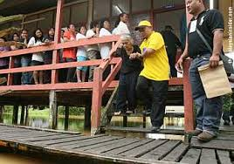
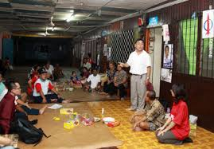
Reduced Polling hours
In interior, villages are grouped into clusters of villages (or longhouses into a village) and one of the villages (or longhouse) will be the Polling Stream
If number of voters is not numerous, polling hours may be reduced.
  Reduced polling hours gazetted in Election Gazette
  Notice of reduced hours posted at entrance of Polling place for at least 72 hours
Although not mandated by Regulations, try to persuade PO not to count the votes until after 5pm
  If you succeed, watch Ballot Box until Counting time
  If you fail, try delay announcement of results until after 6pm

Slide 71
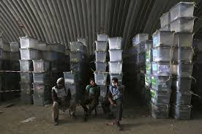
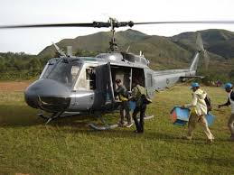
Moving Ballot Boxes
If PO is responsible for more than one venue (may not be a separate stream), a single Ballot Box will move from one venue to the next
  At first location, Ballot Box will be sealed before move
  At new location, Ballot Box will be unsealed before Polling
  New Form 13 will be filled in, superseding earlier Form 13
PO to inform PA where Counting will take place
Counting will take place as if one single Form 13 and one Ballot Box all along
There must be a PACA team in each location
  First team to sign on seal with 4-digit code and/or rubber stamp, inform second team and take a photo if permitted, before Ballot Box is moved
  Second team checks 4-digit code and/or stamp and take photo before the seal is removed

Slide 72
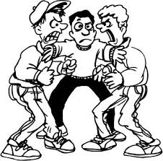
Polling: Potential Issues
Other PA note Voter number in chronological order or list bring out of room or text Voter numbers
  Inform PO and Station Master
PO asks PA to be replaced every two hours
  Regulations is minimum two hours, not maximum
    Sec 14 (1A) Election Offenses Act
Other party’s material within 50m of Polling Centre
  Prohibited under Sec24B(7) Elections Offenses Act
  Take photo and inform Station Officer
PO do not give any copy of Form 13
  PA to copy all details to own Form 13 before signing the PO’s Form 13

Slide 73
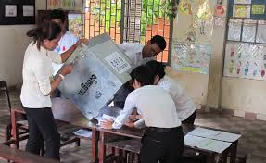
Concurrent or Consecutive
PO have two options where there are simultaneous State and Parliamentary elections
Concurrent Counting (preferred by EC)
  Both Ballot Boxes are counted at the same time
  PO will split his team into two, with 2 EC clerks each
  Will require two Counting Agents
Consecutive Counting
  Ballot Boxes are counted one at a time
  Will be default if less than 4 EC clerks available
  Will require only one Counting Agent

Slide 74
Early Polling and Postal Voting

Slide 75
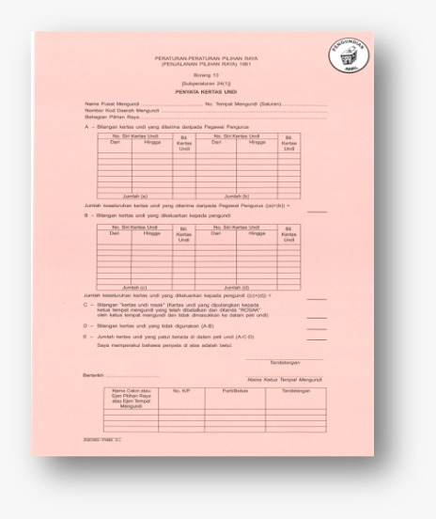
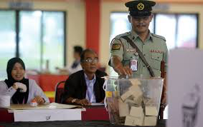
Early Polling
Separate Polling Stream
  Special sticker for Form 13 & Ballot Box
  PO is Assistant Returning Officer
Same procedures as Normal Polling
  Except (usually) 3 days before Election Day
    Regulations: 7 days after Nomination Day until 3 days before Election Day
    Ink must last that long
  Usually normal hours, but could differ
    2pm if < 50 voters
Ensure recording of
  Form 13 total after Early Voting
Counting after 5pm Election Day
  Complications over watching Ballot Boxes
Eligibility
EC officers
Police
Army
on duty on Election Day
and their spouses
ENSURE TURNOUT IS NOT MORE THAN THOSE REGISTERED

Slide 76
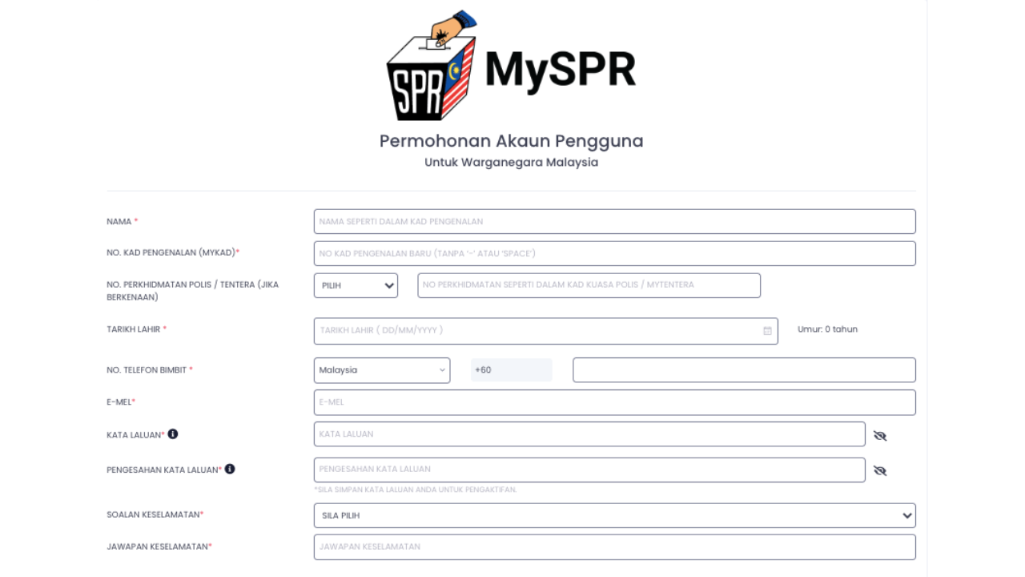
Postal Votes
Eligibility
On duty on Early & Election Day and wishes to vote by postal votes
  EC, Police, Military, Malaysian Maritime Enforcement Agency, Prisons Dept, Malaysian Fire and Rescue Dept, government hospitals & clinics, police volunteers, Civil Defence Force, Immigration Dept, National Disaster Management Agency, and Registration Dept
  Media workers
Malaysians with permanent address overseas
  Must have returned to Malaysia 30 days in last 5 years
And their spouses
Application must be made – Form 1A (foreign) or 1C (domestic) from EC website
  Copy of MyKad/Passport
Deadline:
  1A: Nomination day
  1C: 5 days before Election Day

Slide 77
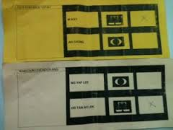





Postal Voter Procedures
Voter receives four items
    Ballot Paper(s)
    Envelope A
    Parliament: White
    State: Pink
    Form 2
    Envelope B
To arrive at RO Office by Close of Polling Election Day
Post/Courier
Deposit at Embassy
Personal delivery
Mark
Signed by Voter & Witness

Slide 78

Postal Voting – Form 2
Ensure
Signed by Voter and Witness
Same serial number on Ballot Paper

Slide 79

Overall Postal Process
24 hour notice
1️⃣
Fix postal ballots total
RO to provide date for final postal ballots approved
Obtain final total approved and Postal Electoral Roll
Issue ballot papers
Only one Ballot Paper issued to only those on postal electoral roll
Total ballot papers issued = postal ballots approved
2️⃣
24 hour notice
Counting of votes
Counting as normal but using Form 15
Total ballots counted ≤ Total envelopes opened
Opening postal envelopes
Check 2 criteria to be valid
  Ballot paper number = Form 2 = Envelope A
  Form 2 signed by Voter & witness
Total envelopes opened ≤ Ballot papers issued
4️⃣
3️⃣

Slide 80

Administering Postal Voting
Ballot Box is used to hold Postal envelopes returned to RO Office but not yet opened or sorted
  By day: Under control of ARO Postal Ballots
  By night: Kept in Police lockup, key kept by ARO Postal Ballot
Opening Postal Ballots normally start 2pm Election Day
  May have additional day (or morning session) if high volume
Counting of Postal Ballots after 6pm Polling Day
Separate stream
  PO is Assistant Returning Officer
Dates of issuing & opening of Postal Ballots determined by RO
  Must give 24 hours notice for the first instance
  May be more than once, subsequent dates “appropriate notice”
Normally in RO Office

Slide 81

Postal Votes – Issuing procedures
Issuing Procedures
Similar to Ordinary Voting
Rubber Stamp Form 753
Ballot Box shown to be empty
Postal Clerk 1 call out name & number and mark name & ‘PP’
Postal Clerk 2 issue Ballot Paper
Specific to Postal Voting
Postal Clerk 3 write Ballot Paper number on Form 2 & Envelope A
Postal Clerk 4 insert Ballot Paper, Form 2 , Envelope A and B into postal envelope
Documenting Postal Votes
Form Format A
Pos Malaysia list of Postal Ballot recipients
Pos Malaysia acknowledgment of receipt
Form 754
Number of Postal Ballots issued by departments and overseas

Slide 82

Postal Votes – Opening procedures
Sorting of Postal Votes
Valid Postal Ballots inserted into Ballot Box
Rejected Postal Ballots into Rejected basket
  No Envelope A/Ballot Paper AND Form 2
  Ballot Paper serial number differs from Form 2
  Form 2 not signed
  Recorded on Form 755
After opening, RO will inform when counting will take place
  Counting as normal
  Results on Form 15
Opening Postal Ballots
All trays shown to be empty
Total Envelopes B counted
Ensure that total opened not more than total issued
Each Envelope B must have Form 2 & Ballot Paper and/or Envelope A
  Form 2 may be in Envelope A
Criteria
  Form 2 signed by Voter & Witness
  Same Ballot Paper serial number on Envelope A and Form 2

Slide 83









Opening Postal Votes
Envelope A
2
A
A
Open Envelope B
Open Envelope A
✖
Form 2 signed?
Form 2 = Envelope A
2
✔
Contain Form 2 & Ballot Paper?
A
✖
✔
Envelope A = Ballot Paper
Form 2 signed?
Form 2 = Ballot Paper
✖
✖
✖
✔
✔
Ballot Box
Form 2
Reject

Slide 84


Manage your numbers
Deadline for registration
Total valid application for Postal Ballots
Issuance of Postal Ballots
Total Postal Ballots issued
Total valid Postal Ballots in Ballot Box
Total valid Postal Ballots counted
Opening of Postal Ballots
Counting of Postal Ballots
Record your numbers at every stage
Every PA must enter with the total from the previous stage
The numbers can only reduce not increase
Report your numbers to PACA Coordinator
Form 15 after the final stage
You will not be getting any document from EC until after final stage
First PA must obtain full Postal Voter list after issuance of Postal Ballots
Form 754
Form 755
Form 15

Slide 85


Forms 754 and 755
Form 755
After opening of Postal Envelopes
Records valid & invalid Postal Envelopes
  Close equivalent of Form 13
Form 754
After issuance of Postal Ballots
Records Postal Ballots sent by department and overseas

Slide 86
Form 15
Given to PA as in Form 14
All Polling Streams details are correct
Number of Postal Ballots issued
Order of candidates follow Ballot Paper
Rejected Ballots
PO signs
CAs sign
Could be on reverse of Form

Slide 87
On Completion

Slide 88




Tallying after counting
Total from Form 13
  This is the number of votes that should be in the Ballot Box
Total from Form 14
  This is the number of votes obtained by each candidate
  Agree with reported Form 13 totals

Slide 89


Polling Results
Text results of counting results to Bilik Gerakan/Election Agent or the Station Master Whatsapp Group the moment you receive from CA
Check the total votes add up to Form 13 for each stream
Consolidate all results into one final text and send to Election Agent, PACABA Coordinator or Bilik Gerakan

Slide 90


After the Counting
All CAs hand over PACABA Kit with their copies of Form 14 to you
  Their task end when they hand over observations to your Station Master
Procedures: Yellow EC bag handed over to PO1
  But normally each PO prefer to carry their own
PO1/POs will bring everything to Tallying Centre in police convoy
  You may ask help of your CAs to follow the EC car to Tallying Centre
  You cannot sit in the EC car

Slide 91



Form 14 and Ballot Box
Collect all Forms 14 & check that all forms are correctly filled in
  Correct name and number of Polling Stream
  Sequence of candidates are in same order as in Ballot Paper
  Numbers all add up
  Total Ballot Papers counted equal or less than Form 13
  Signed by PO & all CAs
Follow PO1 in your car all the way to the Tallying Centre and ensure all Ballot Boxes and Forms are handed over without any stops or interference
Hand over your Forms 13 & 14 to the Election Agent /PACABA Coordinator/Bilik Gerakan as instructed

Slide 92

Counting cannot complete
If counting cannot start or complete (eg., natural disasters), PO to inform CA & RO
  If Ballot Box not opened, PO to pass Ballot Box & Form 13 to RO or Police Station
    CA to follow in separate car
  If opened, PO to put everything (including Form 13 if filled up) back in the Ballot Box in presence of CA, affix with tape (PO & CA to sign) & hand to RO
Counting will take place at new venue

Slide 93
Potential Issues
PO asks PACA to leave the room to rearrange furniture
  PACA to stay in corner in room to observe
PO closes Stream for prayers or dinner
  Ensure doors locked but windows left open
PO does not give Form 14
  Explain mandatory under Election Regulation 25(4)
  CA to provide blank copy of Form 14 for PO’s signature
  Inform Whatsapp group and Candidate/Election Agent

Slide 94


Your responsibilities are now over
Your work is now completed. You may stay to observe the inclusion of your Polling Centre numbers into the final tally
Text the final result to all your PACABAs and thank them on behalf of the Candidate and the Rakyat Malaysia. Arrange for a get together for drinks for another day
Ensure all personal data deleted off your handphone
  Especially MyKad photo and details

Slide 95





A few observations
A few principles
PACA is last line of defense
PACA cannot stop well-planned frauds
PACA can only observe and record down
Look for patterns, not just incidences
Reports of non-compliance
Wrongly reported
Innocent errors/ miscommunication
Lack of training/competence
Isolated random frauds
Pre-planned frauds

Slide 96

Any Questions
Slides are at https://www.jimkhong.com/jim-the-polling-agent

